Slide 1



Developing the Army for
Force 2025 and Beyond
8 December 2015
Rickey E. Smith
Deputy Chief of Staff, G-9
US Army Training and Doctrine Command
http://www.tradoc.army.mil
http://www.arcic.army.mil
Follow us on Facebook and Twitter at “AdaptingTheArmy”

Slide 2
National Commission on the Future of the Army
Act of 2014
National Defense Authorization Act for Fiscal Year 2015. December 2, 2014
SEC. 1702. NATIONAL COMMISSION ON THE FUTURE OF THE ARMY.
STUDY ON STRUCTURE OF THE ARMY
  comprehensive study of the structure of the Army, and policy assumptions related to the size and force mixture of the Army
  assess size and force mixture of AC and RC
  make recommendations on the modifications, if any, of the structure of the Army related to current and anticipated mission requirements for the Army at acceptable levels of national risk and in a manner consistent with available resources and anticipated future resources
STUDY ON TRANSFER OF CERTAIN AIRCRAFT
  study transfer of Army National Guard AH–64 Apache aircraft from Army National Guard to the regular Army.
  considerations same as above
  REPORT Not later than February 1, 2016

Slide 3
  Distinct Purposes: Concepts and Doctrine
Concepts | Doctrine
Drive requirements determination and are a fundamental tool for designing the Army of the future through initiation of the capabilities development process. | Drives current force training and leader development by providing structured, refined thought, and proven methods oriented toward preparation for employment.
Drive institutional behavior for evaluation and prioritization of gaps and proposed capability solutions. | Drives operating force behavior through focused, deliberate methods for planning, preparing, executing, and assessing training and operations.
Not constrained by the limitations within the current force; they are ideas of how to overcome those limitations or to apply major opportunities for the future force. | Must be applicable to the current force and enable units to best organize and prioritize resources for near-term operations.
Address a timeframe of 6 to 18 years into the future (mid-term) and 19 to 35 years into the future (far-term). | Addresses the current operational environment out to 5 years into the future (near-term).

Slide 4
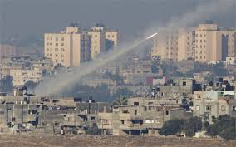
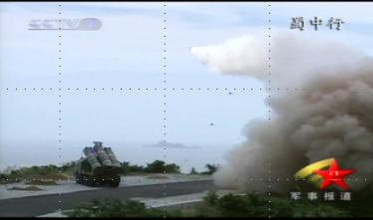
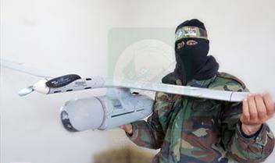
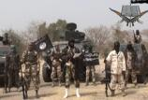
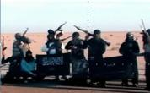

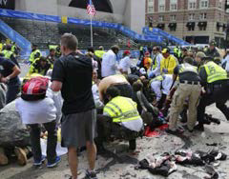
  Hybrid Strategies in a Complex Environment
Avoid
Disrupt
Hide in complex urban terrain
Area Access/Area Denial strategies
Emulate
Expand
Steal, copy, and adapt technology
Employ proxies and criminal networks
Future Forces Must: Shape, Defeat the enemy, Establish security, Consolidate gains

Slide 5
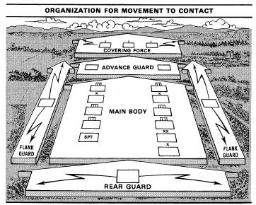
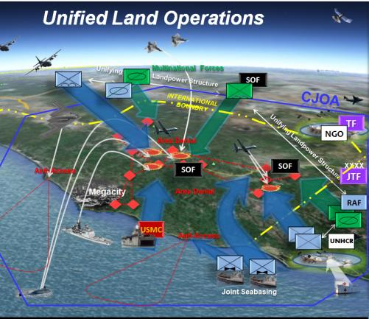
  A Unifying Concept for the Future
AirLand Battle:
Fight outnumbered, and win
Unified Land Operations:
Win in a complex world

Slide 6
2014 Army Operating Concept
Problem and Solution
Problem: To meet the demands of the future strategic environment in 2025 and beyond, how does the Army conduct joint operations promptly, in sufficient scale, and for ample duration to prevent conflict, shape security environments, and win wars?
Solution: Conduct Joint Combined Arms Operations to:
Protect the homeland and engage regionally
Create multiple options for responding to and resolving crises
Maneuver from multiple locations and across domains
Exercise mission command
Integrate joint, interorganizational, and multinational capabilities
Defeat enemy organizations, control terrain, and secure populations
Preserve joint force freedom of movement and action
Seize, retain, and exploit the initiative
Create multiple options, integrate multiple partners, operate across
multiple domains, and present our enemies with multiple dilemmas.
Defeat enemies, establish security, consolidate gains, and achieve sustainable outcomes
Notes:
The Army, as part of joint, interorganizational, and multinational teams, protects the homeland and engages regionally to prevent conflict, shape security environments, and create multiple options for responding to and resolving crises.
When called upon, globally responsive combined arms teams maneuver from multiple locations and domains to present multiple dilemmas to the enemy, limit enemy options, avoid enemy strengths, and attack enemy weaknesses.
Forces tailored rapidly to the mission will exercise mission command and integrate joint, interorganizational, and multinational capabilities.
Army forces adapt continuously to seize, retain, and exploit the initiative.
Army forces defeat enemy organizations, control terrain, secure populations, consolidate gains, and preserve joint force freedom of movement and action in the air, land, maritime, space, and cyberspace domains.

Slide 7
Win in a Complex World
CCJO: Globally Integrated Operations
Mission command
Seize, retain, and exploit the initiative
Global agility
Partnering
Flexibility in establishing Joint Forces
Cross-domain synergy
Use of flexible, small-footprint capabilities
Increasingly discriminate to minimize unintended consequences
Operational Environment
Increased momentum of human interaction
Capable, elusive enemies
Potential overmatch
WMD proliferation
Importance of cyber & space
Dense urban areas
Tech transfer
Ubiquitous media
Joint Combined Arms Operations
Elements
Engage Regionally, Respond Globally
Develop situational understanding
Conduct joint combined arms operations
Establish and maintain security
Consolidate gains
Sustain operations
Respond to crises in the homeland
Ensure institutional and operational synergy
Develop leaders and maximize Soldier performance
to support JFC…
to cope with these…

Slide 8
Future Force Development First Principles
Army Operating Concept Appendix B
(1) Ensure capacity and readiness to accomplish missions that support achieving national objectives.
(2) Build new capabilities or adjust existing capabilities to cope with emerging threats or achieve overmatch.
(3) Maintain U.S. Army asymmetrical advantages.
(4) Maintain essential theater foundational and enabling capabilities.
(5) Prioritize organizations and competencies that are most difficult to train and regenerate.
(6) Cut unnecessary overhead to retain fighting capacity and decentralize capabilities whenever possible.
(7) Maintain and expand synergies between the operating force and the institutional Army.
(8) Optimize performance of the Army through a force mix that accentuates relative strengths and mitigates weaknesses of each component.
Principles may change based on changes in national strategy, joint or Army concepts, senior leader guidance, or the operational environments

Slide 9
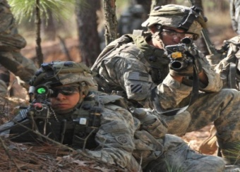
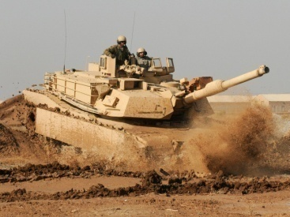
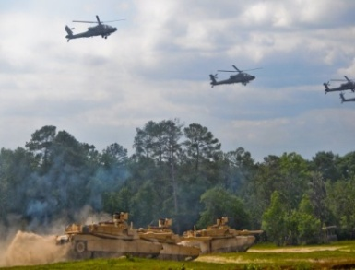
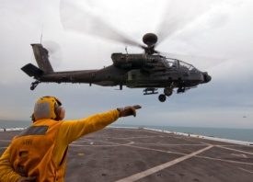

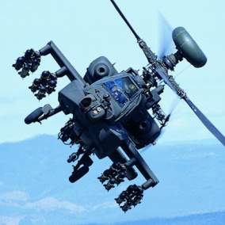
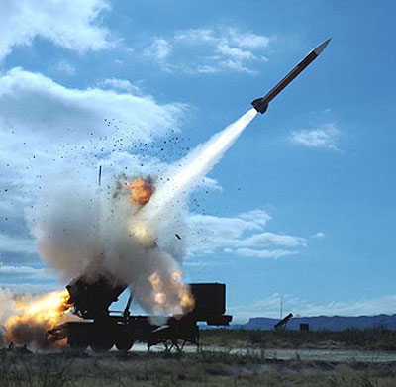
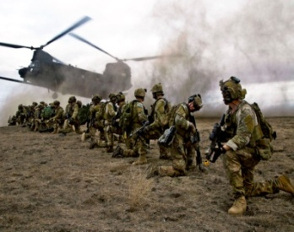
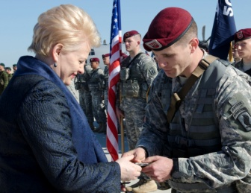
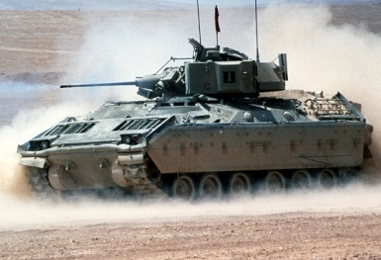
  The “Big Five” for the Next Generation
1970s - Today
2015 - 2025
…fight outnumbered and win
...win in a complex world
LD/LC
PL Future
Optimized Soldier and Team Performance
M1
XXXX
Capabilities
Overmatch
Joint/Interorganization Interoperable
UH-60
AH-64
M2
Scalable and Tailorable Joint Combined Arms Forces
Adaptive Professionals and Institutions to operate in complex environments
PATRIOT
LD/LC
PL Future
Focused on Weapons Systems
Countered near-peer capability
Unmatched advantage today
The Army of 2025 and beyond will be prepared to fight and win in a complex world because resilient Soldiers, adaptive leaders, and cohesive teams are committed to the Army profession.

Slide 10
  Army Warfighting Challenges
  AOC Appendix B (Revised Since Initial Publication)
(milWiki site) https://www.milsuite.mil/book/groups/army-warfighting-challenge-awfc-group
Develop Situational Understanding
Shape the Security Environment
Provide Security Force Assistance
Adapt the Institutional Army
Counter WMD
Conduct Homeland Operations
Conduct Space and Cyber Electromagnetic Operations and Maintain Communications
Enhance Realistic Training
Improve Soldier, Leader and Team Performance
Develop Agile and Adaptive Leaders
Conduct Air-Ground Reconnaissance
Conduct Joint Expeditionary Maneuver and Entry Operations
Conduct Wide Area Security
Ensure Interoperability and Operate in JIM Environment
Conduct Joint Combined Arms Maneuver
Set the Theater, Sustain Operations, and Maintain Freedom of Movement
Integrate Fires
Deliver Fires
Exercise Mission Command
Develop Capable Formations
Army Warfighting Challenges (AWFCs) are first order questions; the answers will improve the combat effectiveness of the current and future force

Slide 11




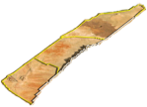

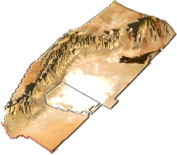


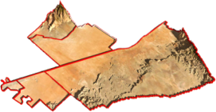
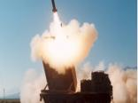
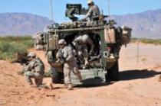

Army Warfighting Assessment
Operational Environment
Western Call-Up Areas
~40 Miles (64 Km)
White Sands Missile Range
Sub-terrain training (Caves)
High altitude training opportunities
Extensive live fire operations (air, ground, and missile)
Complex terrain and extensive maneuver area (mounted and dismounted)
E/W training and testing
Multiple drop zone locations
~40 Miles
Holloman Air Force Base
Live UAS integration
F-16 Squadrons
Ramp and runway
WSMR
~183 Miles (294 Km)
Holloman
AFB
Fort Bliss
Multiple, state of the art urban operations training facilities
Digital Air Ground Integration Range Complex
Extensive mounted / dismounted multi-purpose range facilities
Large maneuver area
Robust unit sustainment / Mission Command capabilities
Forward base camp locations
Drop zone locations
FT Bliss

Slide 12



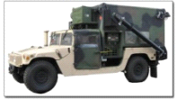
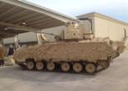
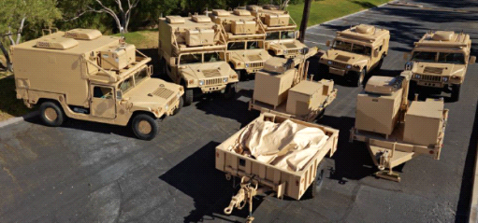
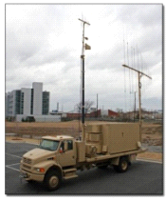
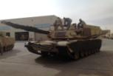




Army Warfighting Assessment
World Class OPFOR
Soldiers: ~700
HMMWV
Decisive Action Training Environment (DATE)
Electronic
Integrated
Intercept & Direction Finding
Warfare
Threat Force
D-40/TUD
Electronic
Attack Systems
Live, Virtual, & Constructive
Integration
M2A3
T-72 (M1A2)
Threat Computer Network Operations
Technicals (x6)
Insurgents
Conventional
Host Nation

Slide 13
















Army Warfighting Assessment
Multinational Participants October 2016
Nation Participant Forces/Capability
Nation Participant Forces/Capability
AUS
JTACs
GBR
JTACs
JTACs, UAS, Support Team, Transport Aircraft
BEL
JTACs
ITA
CAN
Infantry Section
NLD
JTACs, UAS
DNK
NOR
JTACs, UAS, Self-Propelled Artillery
Infantry Section, FACs
FIN
JTACs
POL
Ground to Air SA, Digitally aided CAS
mission support
JTACs, Infantry Response Cell, UAS, Transport Aircraft, Mirage Fighters
FRA
SWE
JTACs
DEU
JTACs, Tornado Fighters
NATO
Observers
USA
JTACs, UAS, C-130, C-17, F-15, F-16, F-18, JSTARs
NZL
Observers
13x Partner Nations participated
Notes:
JFS, JMT: Joint Feasibility Study, Joint Military Training
France: Transport and Mirage
German: Tornado
Italy: C-27J Spartan, 2x engine Prop Transport
US: F16, F18, F15, Transport (C-130/C-5), JSTARs

Slide 14
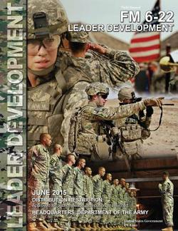
Leader Development (FM 6-22)
(Approved, Published JUN15)
Intent:
Provides a doctrinal framework covering methods for leaders
to develop other leaders, improve their organizations, build teams,
and develop themselves.
Integrates:
Doctrine and regulations
Input of successful Army commanders and Noncommissioned officers
Recent Army leadership studies
Research on effective practices from the private and public sectors
Provides:
Information on effective leader development methods:
  Translating Army leader feedback into quick applications
  Prioritizing leader development activities under conditions of limited resources
  Integrating unit leader development into occurring day-to-day activities
  Integrating ADRP 6-22 leader attributes and competencies across Army leader
development doctrine
Contains:
Seven chapters that describe the Army’s view on identifying and executing
collective and individual leader development needs

Slide 15
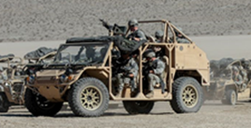
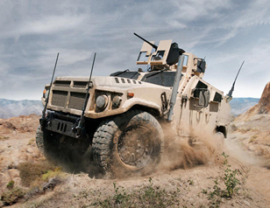
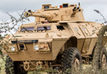
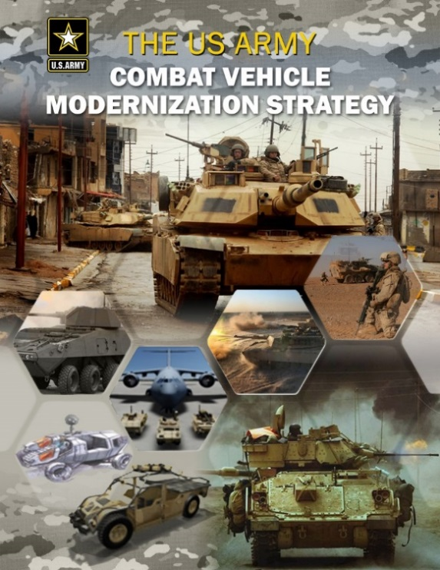
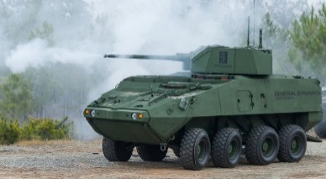
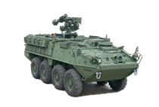
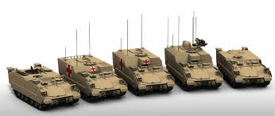
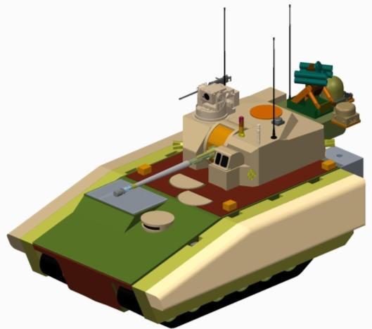
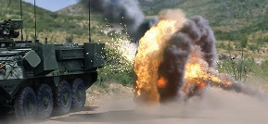
Combat Vehicle Modernization Strategy
CVMS Approach:
Addresses capabilities by formations
Priorities…
#1 is IBCT mobility
#2 is improved lethality of SBCT
GMV
(Ground Mobility Vehicle)
LRV (JLTV interim)
(Light Reconnaissance Vehicle)
MPF (Mobile Protected Firepower)
Stryker Lethality
AMPV
(Armored Multi-Purpose Vehicle)
APS/HFD
(Active Protection System/
Hostile Fire Detection System)
Approved, Published SEP15
FFV (Future Fighting Vehicle)

Slide 16
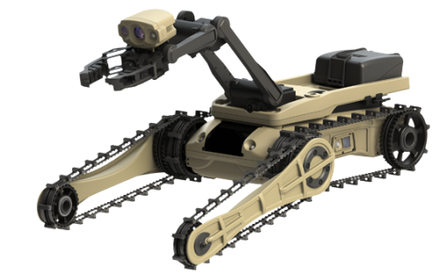
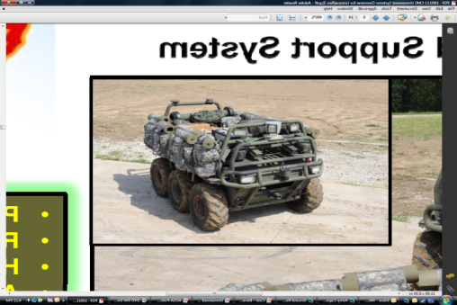
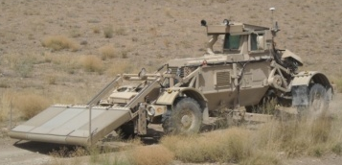

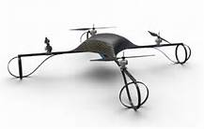
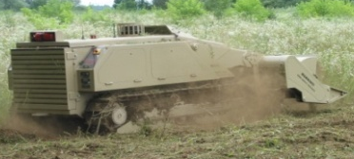
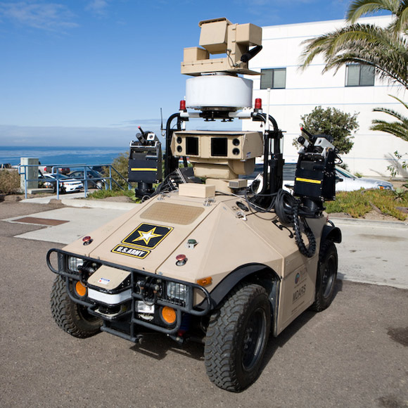
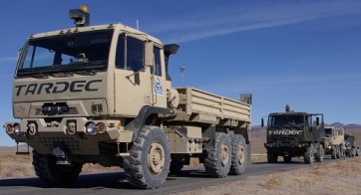
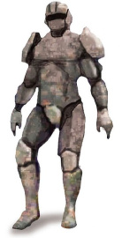
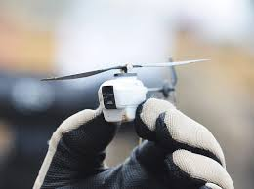
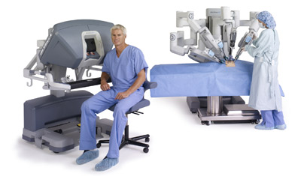
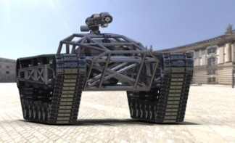


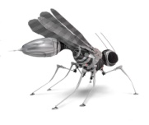
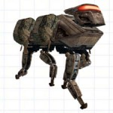

Army Strategy for Robotic and Autonomous Systems
Program of Record
Draft Requirement
Technology Initiative
Soldier Transportable | Vehicle Transportable | Self Transportable | Robotic Appliqué
Small | Mounted Towed | Soldier Follower | Remote Operation
Platoon |  | Recon/Security | Supervised Autonomy
Squad | Installed | Robotic Wingman | Exoskeleton
Nano Bot | Humanoid | Squad Member | Prosthetics
Common Robotic System – Individual (CRS-I)
Man Transportable Robot System (MTRS) Inc 2
Squad Multipurpose Equipment Transport (SMET)
Husky Mounted Detection System (HMDS)
Short Range Micro UAS
M160
Light Flail
Mobile Detection Assessment and Response System (MDARS)
Automated Convoy Operations (ACO)
Soldier Borne Sensor
da Vinci Surgical System
Tactical Assault Light Operator Suit (TALOS)
DARPA Robotic Challenge
DARPA Legged Squad Support System (LS3)
Photos are Notional Representations

Slide 17
Concepts to Capabilities:
Building the Future Force
OPERATIONAL UNIT IMPLEMENTATION
continuous feedback
Army Operating Concept
Army Warfighting Challenges
Drivers for Change
Threats
Missions
Technology
Historical Lessons
Force 2025 Maneuvers
Force 2025 and Beyond
Governance
HQDA Decisions
First-order required capabilities
continuous feedback
Focused and Sustained Collaboration across the Army and Key Stakeholders

Slide 18
Questions

