Slide 1
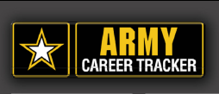


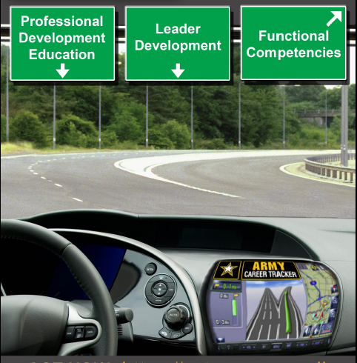


What is ACT?
Army Career Tracker (ACT) is a leadership development tool that integrates training and education into one personalized, easy-to-use website. Users can search multiple education and training resources, monitor their career development and receive personalized advice from their leadership.
Who Supports ACT?
As part of the 2011 Army Campaign Plan, Army Learning Concept 2015 (ALC 2015) and the Civilian Workforce Transformation Initiatives, ACT will allow users to manage their lifelong career objectives and monitor progress toward career requirements and goals. Army Civilian users can search for training or courses through multiple training catalogs and find educational resources to become multi-skilled, agile leaders of the 21st Century.
Customized Solution
ACT was tested in fall 2009 by 214 Soldiers whose feedback indicated very high satisfaction and resulted in approval for full deployment by CG TRADOC. Now customized for Army Civilians, ACT is personalized for users based on their Career Programs and
development
requirements.
ACT is Here
Maximize Your Performance
Find Out More
Email: act.now@us.army.mil
Log On: https://actnow.army.mil
Information Site:
https://www.us.army.mil/suite/page/601000
Spiral 1 31 Aug 2011
CP 18 CP 22 | CP 27 CP 31 | CP 32 CP 34
Spiral 2 18 Feb 2012
CP 10 CP 11 | CP 12 CP 13 | CP 17 CP 24
Spiral 3 TBD
CP 14 CP 16 | CP 20 CP 33 | CP 26 CP 28
Spiral 4 TBD
CP 15 CP 35 | CP 36 CP 50 | CP 53 CP 56
Spiral 5 TBD
CP 19 CP 29 CP 51 | CP 55 CP 60 | CP 61 CP 64
Army Civilian Rollout
Your Tool, Your Career, ACT NOW!
*CP = Career Program

Slide 2





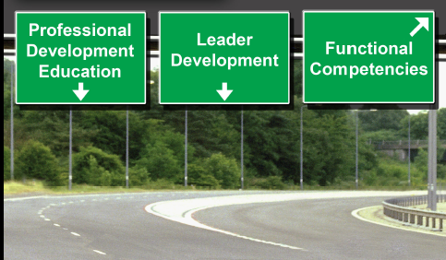
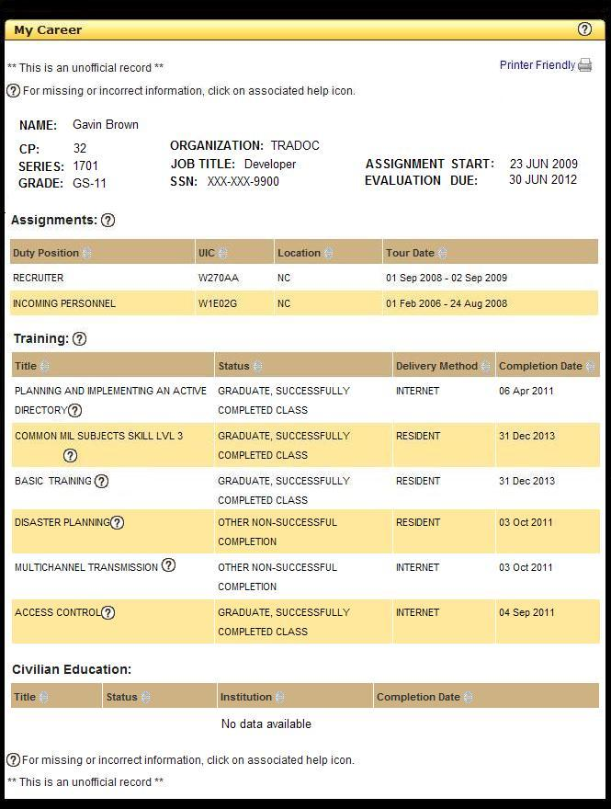
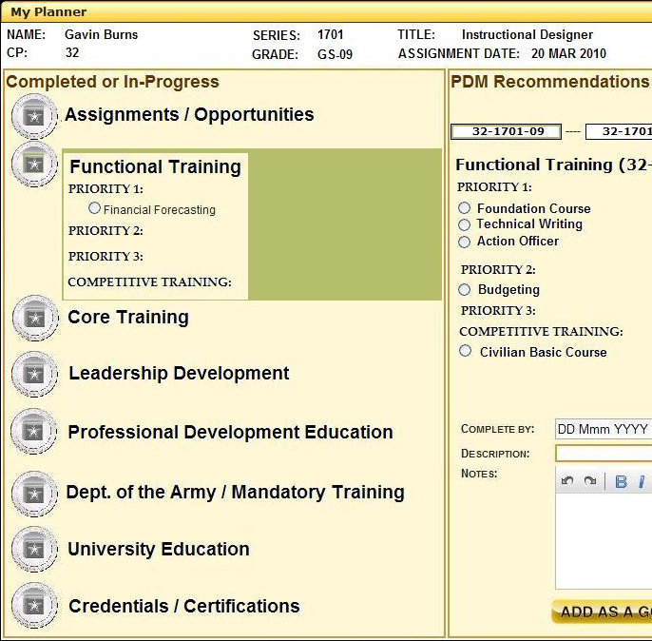
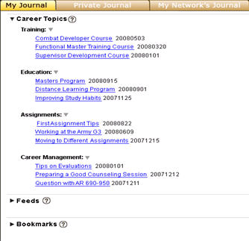
Your single career management tool that will help you to
See
Understand
ACT
Login to one website that compiles all career development related information
Read news from Career Programs
Learn more about DOD and Army training resources
Identify training activities
and requirements
based on a personalized
Career Program Maps
Track your progress within your Individualized Development Plan
Receive messages and recommendations from your supervisor and mentors
Identify upcoming deadlines for training and education
View multiple skill and competency career progressions
Search multiple training catalogs and educational resources
Set and track professional goals
Connect with peers through My Journal knowledge collaboration
      Supervisors can advise employees on their leadership development
My Career View
My Planner View
My Journal View

