Slide 1
UNCLASSIFIED
HQDA ADCS, G-2
Senior Leader DCIPS Update
12 March 2012
UNCLASSIFIED

Slide 2
Mr. James T. Faust
HQDA, Assistant Deputy Chief of Staff, G-2

Slide 3
Ms. Yolanda Y. Watson
HQDA, ODCS, G-2, Director, Intelligence Personnel Management Office

Slide 4
Purpose / Agenda
UNCLASSIFIED
    Purpose:
    Provide Army senior leaders with an update on the Army DCIPS transition from a pay banded structure to a graded structure and the impact to the Army DCIPS Civilian and Military workforce.
    Agenda:
      Where We’ve Been
      Current State
      Way Forward
      Open Dialog to Address Questions

Slide 5
What is DCIPS?
UNCLASSIFIED
    DCIPS is a Title 10 Excepted Service civilian human resource system that incorporates all DoD civilians within the Intelligence Community under a single, performance-based, mission-focused management and administration system that furthers the goals of both DoD and ODNI.

Slide 6
UNCLASSIFIED
    Where We’ve Been
UNCLASSIFIED

Slide 7
Where We’ve Been

Slide 8
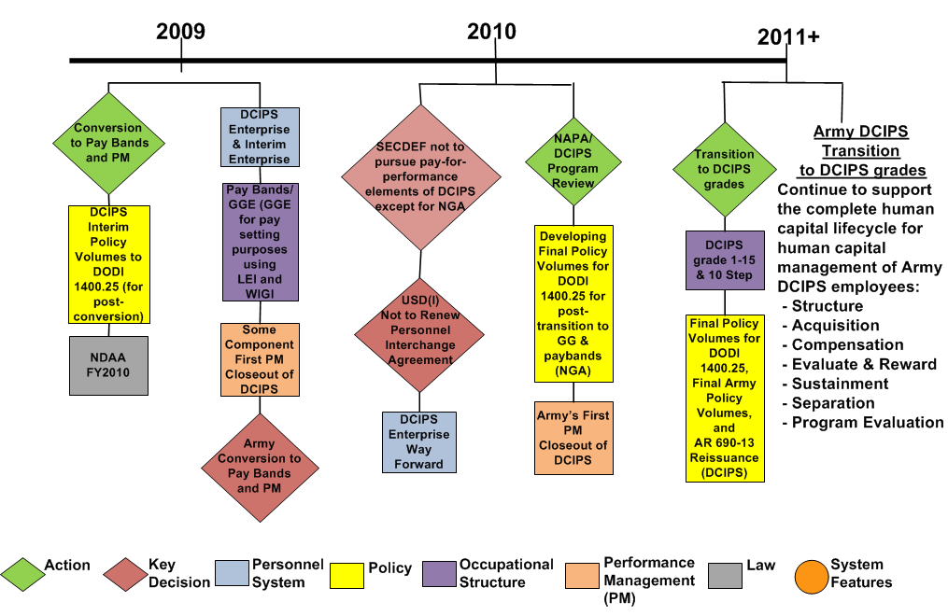
Where We’ve Been
(cont’d)

Slide 9
Army DCIPS Program Evaluation Framework
Leadership commitment and accountability for effective DCIPS implementation and application
Implementation and execution of training design, development, and delivery
Leadership Commitment & Accountability
Performance Culture
Diversity, Fairness & Transparency
Workforce Quality
Workforce Satisfaction
Implementation, Planning & Execution
Stakeholder Involvement, Outreach & Communication
Training Effectiveness
Mission Alignment
Employee alignment of goals and objectives to agency mission
Stakeholder involvement, outreach, and communication efforts to provide information to and obtain feedback from employees
Selected DCIPS Evaluation Dimensions
Promotion of a high performing workforce by differentiating between high & low performers and rewarding employees on the basis of performance
Preparation and implementation of a comprehensive management plan to ensure organizational change readiness and employee acceptance of DCIPS
Employee perception of fairness to the needs of diverse groups of employees and provision of transparent decision making
Attraction of high quality new hires in a timely manner, retention of high performers, and satisfaction with hiring process
Employee satisfaction with operating environment of DCIPS

Slide 10
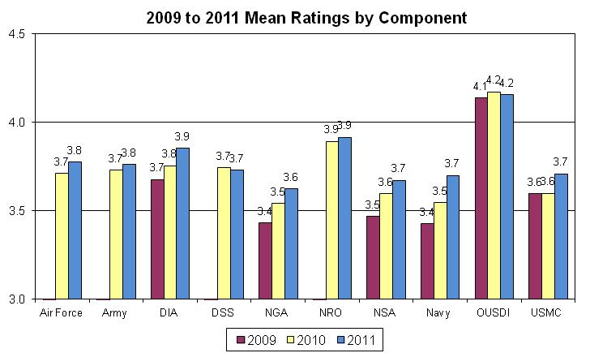
FY09/10/11 Rating Distribution Results
10

Slide 11
UNCLASSIFIED
    Current State
UNCLASSIFIED

Slide 12
IC Transition Timeline and Lessons Learned
25 Sep 11
DIA Transition
29 Jan 12
DSS Transition
25 Mar 12
Army, USAF & USAF NRO Transition
9 Oct 11
Navy & Navy NRO, USMC, OUSDI Transition

Slide 13
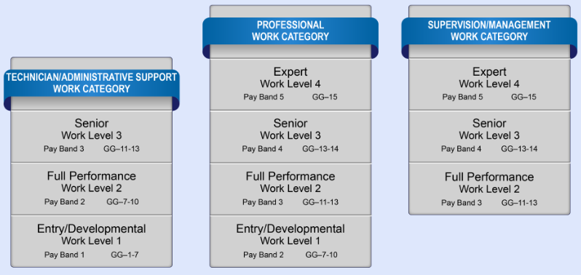
UNCLASSIFIED
Occupational Structure
*Please note: This graphic reflects the USD(I) enterprise-wide DCIPS occupational structure. The Army is aligned to the DCIPS Occupational structure and will follow the DCIPS grading standard in Army Policy Volume 2007. This will result in all Professional (including Supervision/Management) Work Category GG-13 Army DCIPS positions aligning to the Full Performance work level and all Technician/Administrative Support Work Category GG-7 Army DCIPS positions aligning to the Entry/Developmental work level.
UNCLASSIFIED
13

Slide 14
Distribution of Army DCIPS
Spheres of Influence
U.S. ARMY CENTRAL (AR3A) | 6 | 1.5% | MILITARY SURFACE DEPLOYMENT AND DISTRIBUTION COMMA (XT) | 15 | 1.1%
U.S. ARMY NORTH (AR5A) | 16 | 5.2% | EIGHTH US ARMY (P8) | 6 | 1.6%
U. S. ARMY ACCESSION COMMAND (ARAA) | 7 | 0.3% | OFFICE OF THE SECRETARY OF THE ARMY | 7 | 0.6%
U.S. ARMY ACQUISITION SUPPORT CENTER (ARAE) | 73 | 1.3% | FIELD OPERATING OFFICES OF THE SECRETARY OF THE ARMY (SB) | 21 | 0.9%
US ARMY INTELLIGENCE AND SECURITY COMMAND (INSCOM) (AS) | 3240 | 99.5% | U.S. ARMY SPACE AND MISSILE DEFENSE COMMAND (SC) | 59 | 6.5%
U.S. ARMY TEST AND EVALUATION COMMAND (ARAT) | 79 | 1.9% | HQDA FIELD OPERATING AGENCIES AND STAFF SUPPORT AGENCY (SE) | 17 | 0.2%
U.S. ARMY INSTALLATION MANAGEMENT COMMAND (ARBA) | 278 | 0.8% | JOINT SVCS & DOD ACTIVITIES SUPPORTED BY HQDA (SJ) | 99 | 7.4%
US ARMY CRIMINAL INVESTIGATION COMMAND (CB) | 2 | 0.2% | U.S. ARMY SOUTH (SO) | 24 | 7.6%
US ARMY CORPS OF ENGINEERS (CE) | 50 | 0.1% | US SPECIAL OPERATIONS COMMAND (ARMY) (SP) | 147 | 8.5%
US ARMY CHIEF OF STAFF (CS) | 248 | 14.4% | US ARMY TRAINING AND DOCTRINE COMMAND (TC) | 1047 | 8.1%
US ARMY EUROPE AND 7TH ARMY (E1) | 87 | 5.8% | U.S. ARMY WAR COLLEGE (TW) | 6 | 1.6%
21ST SUPPORT COMMAND (E2) | 2 | 0.6% | HQ US ARMY MATERIEL COMMAND | 32 | 4.0%
SEVENTH ARMY TRAINING COMMAND (EN) | 8 | 2.4% | AMC TRAINING ACTIVITIES | 4 | 2.9%
US ARMY FORCES COMMAND (FC) | 148 | 4.2% | U.S. ARMY AVIATION AND MISSILE COMMAND (ARX6) | 121 | 1.2%
NETCOM/9TH ARMY SIGNAL COMMAND (G6) | 102 | 2.1% | US ARMY TANK AUTOMOTIVE & ARMAMENT COMMAND (X7) | 43 | 0.3%
U.S. ARMY NATIONAL GUARD BUREAU (GB) | 2 | 0.3% | US ARMY COMMUNICATIONS ELECTRONICS COMMAND (X8) | 74 | 0.9%
UNITED STATES ARMY RESERVE COMMAND (HR) | 40 | 0.4% | U.S. ARMY CHEMICAL MATERIALS AGENCY (XB) | 1 | 0.1%
US ARMY ELEMENT SHAPE (J1) | 26 | 14.0% | U.S ARMY SUSTAINMENT COMMAND (ASC) (XC) | 13 | 0.9%
JOINT ACTIVITIES (JA) | 494 | 20.1% | U.S. ARMY CONTRACTING COMMAND (XD) | 11 | 0.2%
US MILITARY ACADEMY (MA) | 1 | 0.1% | US ARMY COMMAND (2A) – Cyber COMMAND | 20 | 11.6%
US ARMY MEDICAL COMMAND (MC) | 54 | 0.1% | U.S. ARMY JOINT MUNITIONS COMMAND (JMC) (XQ) | 8 | 0.1%
US ARMY MILITARY DISTRICT OF WASHINGTON (MW) | 2 | 0.4% | U.S. ARMY RESEARCH, DEVELOPMENT AND ENGINEERING CO (XR) | 142 | 0.9%
US ARMY PACIFIC (P1) | 71 | 4.7% | Total | 6947 | 2.5%
14
14

Slide 15
Transition
UNCLASSIFIED
    The Army will transition from pay bands to DCIPS grades on
    25 March 2012
    DCIPS occupational structure, common performance management system and performance-based bonuses will remain intact
    DCIPS occupational structure (alignment) will include 15 Grades and 10 steps, similar to the GS system
    Employees will not lose pay upon transition
    Base salary will be aligned to a DCIPS grade and step
    Some employees will receive an adjustment to base salaries as a result of alignment
    Employees were notified on 9 March 2012 of their alignment – their new salary and step can be found on their Notice of Personnel Action after 11 April 2012
    Policies critical to DCIPS transition will be published prior to transition
UNCLASSIFIED

Slide 16
Approach to Transition
The Army* completed the following activities in support of readiness to transition:
  Completed resource assessment and worked with G-2 leadership to identify options to resource transition for MIP, NIP, and Service-funded positions
  Identified and engaged key stakeholders in support of the transition to DCIPS grades
  Issued the Total Army Comprehensive DCIPS Transition Plan to develop the transition strategy and meet the USD(I) Readiness Tool requirements
  Army G-2 in collaboration with AG-1(CP) developed the IA2GG Tool currently used by stakeholders to facilitate the execution of the transition
  *HQDA, ODCS G-2 IPMO serves dual roles as the Transition Program Management Office and DCIPS Policy and Program Office (Synchronizing / Aligning IC and Army HC Initiatives).

Slide 17
Keys to Success: Transition
Execution by Stakeholder
USD (P&R)
USD(I)
ARMY
Final Army DCIPS Policies
ASA (M&RA), G-1, G-2, OGC, ACOMs*, ASCCs, DRUs, AASA
Position Alignment
CHRA, ACOMs, ASCCs, DRUs, AASA, AG-1 (Civilian Personnel)
Transition Training Strategy
G-2, CHRA
HR Solutions/Services
CHRA
TMs
Change Management and Communication Strategy
ASA (M&RA), G-1, G-2, ACOMs, ASCCs, DRUs, AASA
Human Resource Systems Support (DCPDS)
CHRA and AG-1 (Civilian Personnel)
Transition Cost
(Step Alignment, GAO Reporting)
G-2, ACOMs, ASCCs, DRUs, AASA
Leadership Commitment
ASA (M&RA), G-1, G-2, CHRA, ACOMs, ASCCs, DRUs, AASA
* ACOMs include joint commands

Slide 18
Policy Status
Army DCIPS Policy Status Chart*
Policy Volume |  | Current USD(I) DCIPS Policy Status (as of 2 March 2012) | Current Army DCIPS Policy Status (as of 9 March 2012) | Date the Commands can expect to see AP-V for Formal Coordination | Expected date comments are due from Army Commands for Formal Coordination | Date Final Army Policy Completed & Published
 |  |  |  | (Estimated Suspense Date) | (Estimated Suspense Date) | (Estimated Completion Date)
2011 - Performance Management |  | Complete / Approved | Complete |  |  | July 2011 | 0
2001 - DCIPS Introduction |  | Complete / Approved | OGC Review Complete | 9 February 2011 | 3 March 2011 | March 2012
2004 – Adjustment in Force |  | Complete / Approved | OGC Review Complete | 24 February 2011 | 18 March 2011 | March 2012
2005 - Employment and Placement |  | Complete / Approved | OGC Review Complete | 14 July 2011 | 11August 2011 | March 2012
2006 - Compensation Administration |  | Complete / Approved | OGC Review Complete | 25 July 2011 | 24 August 2011 | March 2012
2007 - Occupational Structure |  | Complete / Approved | OGC Review | 10 June 2011 | 30 June 2011 | March 2012
2009 - Disciplinary, Performance-based, and Adverse Actions |  | 28 Oct adjudicated WHS edits and sent to P&R for LSR. 5 Dec LSR completed, awaiting P&R release. | OGC Review | 27 May 2011 | 30 June 2011 | March 2012
2013 - Program Evaluation |  | Complete / Approved | OGC Review | 1 July 2011 | 1 August 2011 | March 2012
2014 - Employee Grievance Procedures |  | Complete/ Approved | OGC Review | 12 May 2011 | 10 June 2011 | March 2012
2015 - Special Categories |  | Complete/ Approved | OGC Review | 25 February 2011 | 25 March 2011 | March 2012
2008- Awards and Recognition |  | 28 Feb released for formal staffing. | Preparation for Laser Focus Session | 12 September 2011 | 17 October 2011 | April 2012
2010 - Professional Development |  | 6 Jan SD106 signed, waiting now for posting to the DoD portal for formal coordination. | Adjudication of Comments in Progress | 13 July 2011 | 12 August 2011 | April 2012
2012 - Performance-Based Compensation |  | 3 Feb Sent to Security Review | Adjudication of Comments in Progress | 14 November 2011 | 13 January 2012 | April 2012
*Note: This Policy Chart is a “living document” and dates and risk levels may shift based on USD(I) timelines and other issues.

Slide 19
Key Milestones
UNCLASSIFIED
9 March 2012 - Employee Notices were issued
NLT 24 March 2012 - Performance Management Midpoint Reviews completed
NLT 24 March 2012 - Mandatory “Special Closeout” (for those employees changing work levels with the transition to DCIPS grades)
25 March 2012 – Transition to DCIPS Graded Structure
30 September 2012 - FY2012 Performance period ends
October-November 2012 - DCIPS PM Rating Phase
November 2012 - PM PRA review PM results
November-December 2012 - Conduct DCIPS Bonus Pools
January 2013 – Performance-Based Bonus pay outs
UNCLASSIFIED

Slide 20
UNCLASSIFIED
Tammy Williams
HQDA, ODCS, G-2, Resource Integration, Chief, Budget & Execution Division
UNCLASSIFIED

Slide 21
DCIPS Grade and Step Alignment upon Transition
UNCLASSIFIED
Strategy – Army will process pay actions to align employees to a grade and step where applicable. Commands are responsible for funding the cost of this alignment.
Compensation Methodology – Employees will transition to the DCIPS graded structure at their current base rate adjusted for alignment to a grade and step.
Process – Army HQs is not funding the process. This is an unfunded mandate to implement.
Reporting Requirements – We anticipate a Resource Reporting requirement. Army’s Transition Plan contains framework to capture costs associated with transition.
UNCLASSIFIED

Slide 22
DCIPS Compensation
DCIPS Compensation:
  DCIPS employees will continue to receive Basic Pay adjusted for transition, to include the Local Market Supplement (LMS) and Targeted Local Market Supplement (TLMS)
  Employees OCONUS Foreign and Non-Foreign receive TLMS
  In 2009 the Non-Foreign Area Equity Assurance Act (NAREAA) mandated the gradual elimination of Cost of Living Allowance (COLA)
  In January 2012, the Non-Foreign area TLMS rates were increased, so that when the reduced COLA was factored in, the employee total gross pay (including COLA and TLMS) remained consistent with 2011 levels
  Starting 2013, the Non-Foreign area TLMS will be phased-out over a 3 year period (2013 - 1/3, 2014 - 50%, and 2015 - the remaining)
  OCONUS Foreign will continue to receive the TLMS
  The USD(I) in coordination with the DoD Components will conduct a continual review of DCIPS Compensation practices

Slide 23
DCIPS Awards and Recognition Budgets
DCIPS Guidance: Bonuses vs. Awards
  FY11/12 – Awards and Recognition budgets were limited to 1% of aggregate salaries
  The budgets were allocated for Bonuses FY11 and Awards throughout FY12
  The Bonus process supported the FY11 Performance Management System by rewarding the highest level of performance and impact to mission
  The Awards and Recognition Program will be used to reward extraordinary achievement or accomplishments throughout the remainder of FY12
  FY13/out – Bonus rules are expected to stay the same yet percentages may change
  The USD(I) and the DIHRB endorsed a rule that, generally, no more than 50%
  of employees in a pay pool will receive a bonus. The rule is intended to:
    Provide balance between meaningful performance recognition and budget
    Provide rewards to those who make the greatest contributions to the mission
    Allow for broad incorporation of bonuses into the compensation philosophy
DCIPS Volumes 2012 and 2008 provide guidance on
DCIPS performance bonuses and DCIPS Awards

Slide 24
UNCLASSIFIED
    Way Forward
UNCLASSIFIED

Slide 25
Intelligence Community Priorities
UNCLASSIFIED
    Intelligence Community Priorities:
      Strategic Workforce Planning – Close gaps in enterprise workforce
      Professional development – Certification of Intel professionals
      Foreign Language – Develop and retain language professionals
      DCIPS Policies – Enabling policies for enterprise workforce management. DCIPS will continue as the IC’s personnel system founded in performance management principles
    Army Intelligence Human Capital Priorities:
      Transition from pay bands to DCIPS grades on 25 March 2012
      Implement Program Evaluation process improvements
      Continue to fight for DCIPS Human Capital Management Flexibilities to meet Army needs
UNCLASSIFIED

Slide 26
Secretary of the Army Priorities
UNCLASSIFIED
    Ensure a highly capable force within evolving budgetary constraints
    Transform the Institutional Army
    Build the Army of 2020 (POM 15-19)
    Enhance Army Activities in the Asia-Pacific region
    Fund reset and modernization
    Champion Soldiers, Civilians, and Families
    Strengthen information assurance and cybersecurity
    Ensure accountability
    Develop energy solutions
    Finalize Arlington National Cemetery reforms
.
UNCLASSIFIED

Slide 27
Program Evaluation
5 Focus Areas
Professional development – career road maps
Manager/supervisor DCIPS training – soft skills, military supervisor training
Regular and timely communications, guidance and outreach to the commands
Transparency and standardization
PAA Tool improvements

Slide 28
Army Short Term vs. Long Term Goals
UNCLASSIFIED
  Short Term Goals:
    Release AP-Vs (pre-signature) - Commands should plan and develop supplemental guidance if required
    Work with USD(I) to finalize remaining DCIPS policy
    Certify Army readiness to transition to USD(I)
  Long Term Goals:
    Finalize remaining Army DCIPS policies (AP-Vs) as DoD policies are released
    Implement DCIPS Program Evaluation five focus areas
    Develop our leaders and the workforce
    Continue to articulate and reinforce a performance culture
    Continue to shape DCIPS to meet the needs of both the Army Military Service and the Combat Support Agencies
UNCLASSIFIED

Slide 29
Transforming
Human Capital
UNCLASSIFIED
Civilian Workforce Transformation (CWT) initiated to provide the Army:
    Flexible and adaptive civilian cohort
    Roadmap for improving recruiting, retention and leader development
  Publish an Army Intelligence Strategic Workforce Plan (SWP) by 30 September 2012 to support CWT, ACP and NDAA
Army Human Capital
Manage Friction
Minimize Rough Spots
Army DCIPS
IC Human Capital
UNCLASSIFIED

Slide 30
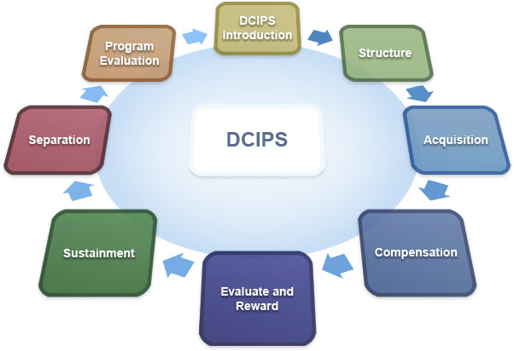
Conclusion
UNCLASSIFIED
Senior Leader Engagement
DCIPS Human Capital Lifecycle
UNCLASSIFIED

Slide 31
Questions?

Slide 32
Backup

Slide 33
DCIPS Progress for FY11 Across the IC
UNCLASSIFIED
    USD(I) Direction and way forward
    Transition to DCIPS Grades
    Performance Management
    Impact of OPM Awards Memo
    DCIPS Policy (DoDI)
    DCIPS Training
    Occupational Structure
    Performance Metrics & WOR2M
    Phase 2: Non-Foreign TLMS phase-out
    Positions In and Out of DCIPS
    JDA Program
    Executive Resources
    Foreign Language and Area
    Professional Development
    Addition of Fourth Estate
UNCLASSIFIED

Slide 34
DCIPS Flexibilities
UNCLASSIFIED
    Existing Flexibilities of DCIPS:
    One common occupational structure for all DoD IC Components
    Career Progress
    Policy – Supports the Human Capital lifecycle
    Sources – DCIPS seeks to hire the best employees from any source
    Conditions of Employment
    Pay Setting
    Employee Movement – Competitive Actions and Exceptions
    Special Programs
    Movement within a Work Level
    Non-Existing Flexibilities of DCIPS:
    Staffing
      Personnel Interchange between DCIPS and competitive service
      Noncompetitive Promotion between Grades
      Temporary Promotions
      Option of Temporary Promotions in Conjunction with Joint Duty Assignments
    Compensation
      Step increase on Reassignments
    Adjustment in Force
      Focus on Outplacement vs. Displacement
    Bonus Pools
      Command Level authority to determine funding levels
UNCLASSIFIED

