Slide 1
UNCLASSIFIED
(Command Name Here) Town Hall
DCIPS Transition and Way Forward
(Insert Date Here)
UNCLASSIFIED

Slide 2
Agenda
UNCLASSIFIED
    Why DCIPS
    Transition to DCIPS Grades
    How Does Transition Impact Me?
    What is Not Changing
    Approach to Transition
    Army DCIPS Occupational Structure
    Workforce Transition Timeline
    What’s Next
    Contacts
    Questions
UNCLASSIFIED

Slide 3
Why DCIPS
UNCLASSIFIED
    DCIPS provides the foundation to develop and sustain a high-performance workforce needed to meet Army’s mission objectives
    Unifies the Defense Intelligence Community under one common personnel system
    DCIPS Supports the Mission of Army Intelligence
    Tool for leaders to manage the Human Capital Lifecycle of Army’s civilian intelligence workforce
    Tool for employees to manage their civil service career
    Aligns employee performance with mission success
    Distinguishes levels of performance and recognition
    Provides career opportunities across the DoD IC and the Army IC
Notes:
DCIPS. The Defense Civilian Intelligence Personnel System (DCIPS) is an enterprise Intelligence Community (IC) Human Capital Management system founded in performance management principles and it supports the Army Intelligence Mission and you. DCIPS remains a critical component of the Army’s success as it provides the foundation to develop and sustain the high-performance workforce needed to meet our mission objectives. DCIPS helps to unify the Defense IC under a common personnel system.
DCIPS Supports the Mission of Army Intelligence:
DCIPS:
Links Employee Performance to the Mission. The DCIPS performance management system is designed to support your Intelligence mission. It connects your efforts with the objectives of your organization, the Army Intelligence strategy, and the Defense Intelligence Strategy.
Special Features to Select the Best. DCIPS provides the flexibilities to hire, promote, and retain the uniquely-qualified Army Intelligence workforce. Intelligence employees must meet higher standards than for conventional careers, and traditional personnel systems are not built for selecting the types of specialized employees that we need. DCIPS allows the Army to select the best.
DCIPS Provides Benefits:
- Bonuses and Awards. While the monetary awards the Army can offer will never equal the impact of your efforts, the Army grants annual bonuses to its top performing Intelligence civilians. The DCIPS performance management system effectively distinguishes levels of performance between the workforce, so your performance not only impacts the success of the Intelligence mission, it also impacts your bonus at year-end. DCIPS also authorizes other monetary and non-monetary awards to reward individual or team accomplishments.
- Intelligence Career Opportunities. All Defense Intelligence Components use the same human capital management system, so it makes it easier for employees to pursue opportunities seamlessly across in the Intelligence Community. Employees also have the opportunity to compete for a Joint Duty Assignment (JDA) anywhere within the Intelligence Community.
DCIPS enables Army military and civilian leaders to accomplish the mission of their respective commands by:
Establishing clear employee and manager roles and responsibilities and provides for continuous performance evaluation and improvement.
Creating a system of human capital policies and management practices that will make the Defense IC and Army Intelligence an attractive place to work and establish them as “employers of choice” for top talent.
Providing for planning training, education, and diverse assignments (such as Joint Duty Assignments) that supports retention and career development.
Developing policies and practices with consideration of the Director of National Intelligence (DNI) IC Human Capital Strategy. http://www.dni.gov/DNIHumanCapitalStrategicPlan18October2006.pdf
Maintaining a DCIPS workforce that meets high standards, sustains a culture of high performance and is recognized and rewarded (in both monetary and non-monetary ways) for their contributions in order to accomplish the Army’s mission.

Slide 4
Transition to DCIPS Grades
UNCLASSIFIED
    National Academy of Public Administration (NAPA) was engaged to conduct a review of DCIPS in January 2010
      Design of DCIPS was sound but implementation was flawed
    August 2010 SECDEF decided to return DCIPS Pay Banded employees (except NGA) to General Schedule (GS)-like grade and step system and no longer link base pay to performance
      DCIPS will have a pay banded (NGA) and grading standard structure after transition, however Army is only recognizing a DCIPS grading standard
      Implementing a new pay-for-performance system, and ignoring employee concerns, would detract from the highest priority of fighting two wars
      GS-like system is more familiar to all Army Intelligence employees
    DCIPS principles will remain intact, such as the occupational structure, common performance management system and performance-based bonuses
    DCIPS will continue to unify the Defense Intelligence Community (IC) under a common personnel system
    Transitioning to “GG” denotes Grades similar to GS which allows SECDEF to retain independent pay setting authorities
    All Army DCIPS Employees will transition at the same time: 25 March 2012
UNCLASSIFIED
Notes:
The Army converted to pay bands on 19 July 2009. (See the DCIPS evolution in the “About DCIPS” tab on the DCIPS website and in the backup slides of this brief.) While policies, guidance and training were made available to Army DCIPS employees, there were concerns about the quality, quantity and consistency of training and messaging, often varying by instructor, command and/or geographic location.
In January 2010, the National Academy of Public Administration (NAPA) was engaged to conduct a review of DCIPS. The National Defense Authorization Act for Fiscal Year 2010 (NDAA FY2010) directed the review and at the same time suspended certain pay authorities, including the base‐pay setting portions related to performance until 31 December 2010. The NAPA report (link available at http://dcips.dtic.mil) was delivered in June 2010 and found that the design of DCIPS was fundamentally sound but implementation had been flawed. It addressed in detail DCIPS design, implementation and impact, and made 25 recommendations.
On 3 August 2010, the SECDEF informed Congress that he had considered the NAPA findings and recommendations and would implement several of them, but that he would not accept their recommendation to move forward with implementation of the DCIPS policies linking employee base pay increases to performance in the Defense Intelligence Enterprise (except within the National Geospatial‐Intelligence Agency that had been operating under pay for performance for over a decade). As a result, the Army which had converted to the DCIPS a pay banded structure, would need to transition to a General Schedule–like grade structure overlaid onto the DCIPS policy framework. In his accompanying action plan, the SECDEF directed the implementation of the following NAPA recommendations: Complete and disseminate all DCIPS governing policies in the context of his decision.
Prepare and publish a comprehensive change management plan.
Establish a Program Office within the office of the USD(I) (OUSD(I)) with overall responsibility for implementation of DCIPS within the Department of Defense.
Address performance management.
Conduct and assess equity analysis.
Provide regularized oversight and reporting.

Slide 5
How does Transition impact me?
UNCLASSIFIED
    Army will transition from pay bands to DCIPS grades
    DCIPS Occupational Structure (Alignment) will include a DCIPS 15 grade, 10 step pay system
    Base pay will no longer be linked to performance
    Managers/supervisors of DCIPS employees that are being aligned to a new work level must complete a closeout performance evaluation immediately preceding the transition, conduct a PM PRA review and then establish a new performance plan with their new performance objectives aligned to their newly transitioned work level.
    An Employee notification letter will be prepared and issued to each DCIPS employee by their Manager/Supervisor to inform them of their new DCIPS grade NLT 9 March 2012
    Policies critical to DCIPS transition are expected to be published prior to 25 March 2012
UNCLASSIFIED
Notes:
DCIPS and the DCIPS policies align to the Human Capital lifecycle as outlined on the DCIPS website: Structure, acquisition, compensation, evaluate and reward, sustainment, and separation.
The Performance Management Special Closeout dates are targeted for March. Exact dates will be established and communicated.

Slide 6
What Is Not Changing
UNCLASSIFIED
    Pay:
      Employees will not lose pay upon transition
      Base salary will be aligned to a DCIPS grade and step - pay may stay the same or increase to align to a step
      Employees will continue to be eligible for performance-based bonuses
    Performance Management:
      Employee performance objectives will continue to be tied to the work level and the Command and/or Army mission
    Occupational Structure:
      The elements of the DCIPS Occupational Structure will remain
    Professional Development:
      Professional Development (i.e. Joint Duty Assignment)
UNCLASSIFIED
Notes:
DCIPS and the DCIPS policies align to the Human Capital lifecycle as outlined on the DCIPS website: Structure, acquisition, compensation, evaluate and reward, sustainment, and separation.
The DCIPS Occupational Structure will remain and DCIPS grades will be added.
The Performance Management Special Close out dates are targeted for March. Exact date will be established an communicated.

Slide 7
Approach to Transition
The HQDA G-2 in collaboration with key stakeholders have developed a Total Army Comprehensive DCIPS Transition Plan to support the Army’s transition to DCIPS grades to ensure a smooth transition.
IPMO G-2 is developing the requirements for mandatory Web Based Training (WBT) transition training and working with CHRA to deliver instructor led training.
The Army DCIPS website will be continuously updated with FAQs, fact sheets and job aids to enable and inform the workforce on transition activities.
A Special Edition EYE Newsletter will be issued to the workforce with specific transition information.
Notes:
The HQDA G-2 in collaboration with ASA(M&RA), AG-1/CP, and CHRA has developed a transition strategy which was published in October 2011. You can find the details of the plan on the DCIPS website under the transition tab.

Slide 8
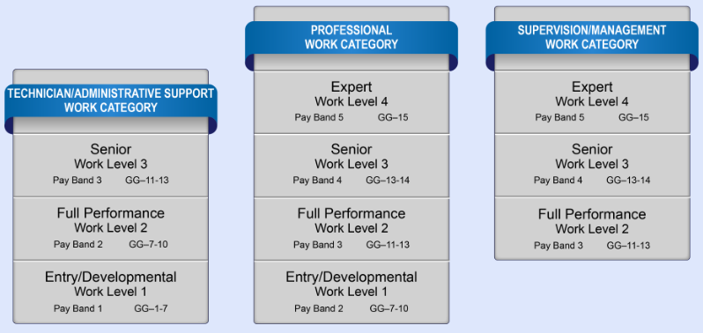
UNCLASSIFIED
Army DCIPS Occupational Structure
*Please note: This graphic reflects the USD(I) enterprise-wide DCIPS occupational structure. The Army is aligned to the DCIPS Occupational structure and will follow the DCIPS grading standard in Army Policy Volume 2007. This will result in all Professional (including Supervision/Management) Work Category GG-13 Army DCIPS positions aligning to the Full Performance work level and all Technician/Administrative Support Work Category GG-7 Army DCIPS positions aligning to the Entry/Developmental work level.
UNCLASSIFIED
8
Notes:
AP-V 2007 is critical to transition and we expect it to be published prior to March 2012.

Slide 9
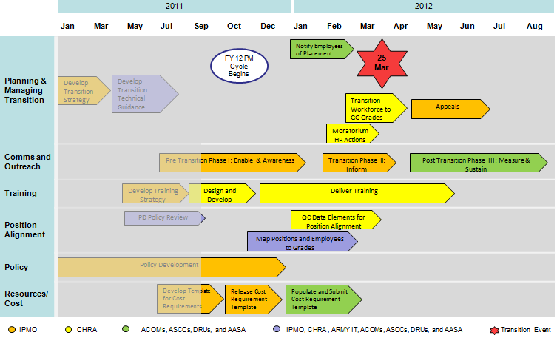
Workforce Transition Timeline

Slide 10
What’s Next
UNCLASSIFIED
  Until Transition (25 March 2012):
    The Army will continue to operate under DCIPS Interim policy/guidance
    DCIPS employees are eligible for a Periodic Increase (PI) similar to the Within-Grade-Increase based upon their Last Equivalent Increase (LEI) date
    Employees will be notified of their grade NLT 9 March 2012
    Army will certify to USD(I) our readiness for transition 45 days prior to the transition date – NLT 10 February 2012
UNCLASSIFIED

Slide 11
What’s Next?
(Continued)
UNCLASSIFIED
  Army DCIPS employees should:
    Talk with their supervisors/managers or their Command DCIPS TM for questions about transition
    Complete required DCIPS training when available
    Review the Army DCIPS website regularly and read DCIPS-related emails for updated transition information
    Share their DCIPS knowledge with their coworkers:
      Share this information with those who couldn’t attend this brief
      Reduce RUMINT
25 March 2012 – Army Transition
UNCLASSIFIED

Slide 12

Contacts
UNCLASSIFIED
  (COMMAND NAME HERE):
    (POC / Transition Manager): (POC / Transition Manager email address and phone numbers here)
New Army DCIPS Website:
  Launched on NIPR only on 25 July 2011
  Primary source for all up-to-date DCIPS information and FAQs
  NIPRnet: http://www.dami.army.pentagon.mil/site/dcips/
UNCLASSIFIED
Notes:
The new Army DCIPS website will continuously be updated with new information. There are plans in the coming months to launch the site on SIPR and JWICS. More to come on these release dates.

Slide 13
Questions?

Slide 14
Back Up

Slide 15
DCIPS Evolution Timeline

Slide 16
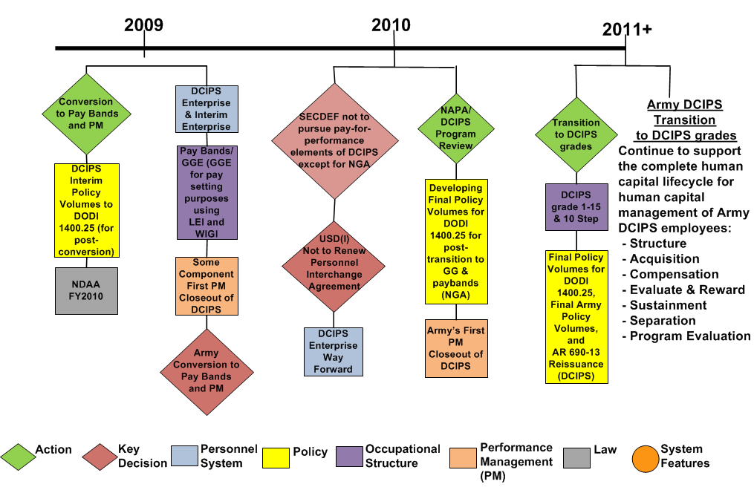
DCIPS Evolution Timeline (cont’d)

Slide 17
Key Inputs for Successful Transition
UNCLASSIFIED
Key Stakeholder support for these requirements must be in place for the Army’s transition from pay bands to grades
Final Army DCIPS Policies
ASA (M&RA), G-1, G-2
OGC, ACOMs*, ASCCs, DRUs, and AASA
Position Alignment
CHRA, ACOMs, ASCCs, DRUs, AASA, and AG-1 (Civilian Personnel)
Transition Training Strategy
G-2, CHRA
HR Solutions/Services
CHRA
Change Management and Communication Strategy
ASA (M&RA), G-1, G-2, ACOMs, ASCCs, DRUs, and AASA
Human Resource Systems Support (DCPDS)
CHRA and AG-1 (Civilian Personnel)
Transition Cost
(Step Alignment, GAO Reporting)
G-2, ACOMs, ASCCs, DRUs, and AASA
Leadership Commitment
ASA (M&RA), G-1, G-2, CHRA, ACOMs, ASCCs, DRUs, and AASA
UNCLASSIFIED
* ACOMs include joint commands
17
Notes:
This graphic demonstrates the stakeholders actively engaged in planning, preparing and executing the activities to transition to DCIPS grades.

