Slide 1
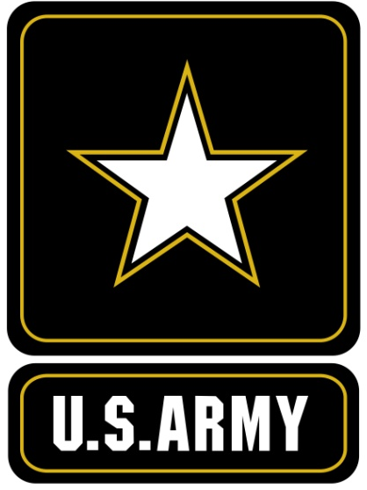

U.S. Army North
(USARNORTH)
This Briefing is Classified
Unclassified
Notes:
Welcome comments
Briefer can comment as well on the pictures and how they depict our mission sets (optional).
Comment that the brief is unclassified.

Slide 2
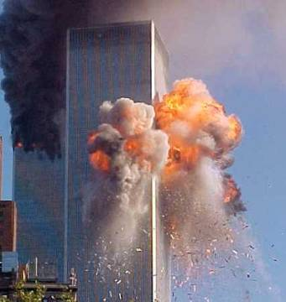
Homeland Security (HS) / Homeland Defense (HD)
After the terrorist attacks on 11 Sep 2001…
President Bush created the Department of Homeland Security (DHS)
  Responsible for securing the United States
  Consolidated several agencies under one Department (USCG, CBP, TSA, FEMA, etc)
Department of Defense (DOD) created U.S. Northern Command (USNORTHCOM)
  Responsible for defending the United States
  All Domains: Air, Land, Maritime, Cyber
Notes:
Intro slide to set the scene – how Homeland Security and Homeland Defense became a major focus
Critical takeaways:
DHS is responsible for securing the Homeland – preventing another terrorist attack on US soil
DOD is responsible for defending the Homeland - protection of US sovereignty, territory, domestic population, and critical defense infrastructure against external threats and aggression, or other threats as directed by the President.

Slide 3

UNCLASSIFIED
USNORTHCOM
Mission
The United States Northern Command partners to conduct homeland defense, civil support, and security cooperation to defend and secure the United States and its interests.
3
UNCLASSIFIED
Notes:
Highlight this is our higher HQs and their mission statement, ensure to expand on the “anticipate” – this was added by GEN Renuart – we see this as our efforts in the preparation / planning phase where our DCOs and the staff work with our Federal and State partners to see where there may be gaps in their response plans that we may anticipate – also the Joint Staff DSCA EXORD assists the COCOM to anticipate – giving him more flexibility to place capabilities on PTDO, etc.
Comment on the wire diagram – the COCOM’s decision as of 31 Oct 07 to create Functional Component Commands vice just operating through his Service Component Commands. Also highlight the necessary relationship with NGB and USCG.
Also highlight the shared responsibility with PACOM for Alaska – forces assigned to Alaska are PACOM; HD & CS are NC responsibilities and that Fleet Forces Command is sptd to supporting and executed through 2nd or 3rd Fleet.
Reference the AOR (map) highlight that just recently the UCP altered the boundary with SOUTHCOM which gives PR and VI back to NORTHCOM along with a few other islands – Bahamas, Turks & Caicos Isl, British VI, etc.

Slide 4
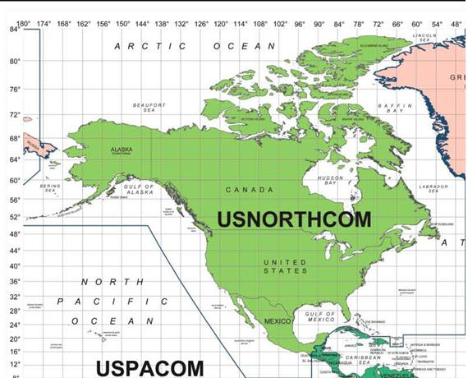
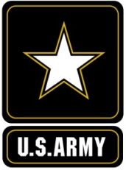

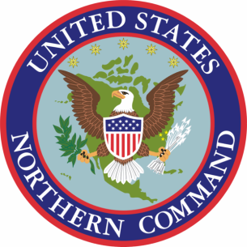
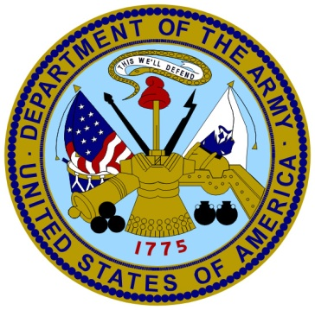
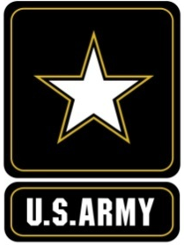

U.S. Army North (Fifth Army)
Operational
Administrative
The Army Headquarters within the United States dedicated to:
  Homeland Defense
  Civil Support
  Security Cooperation
Our Purpose – to contribute to the defense and security of the United States
ARNORTHBrieftoAttache.2Nov15

Slide 5
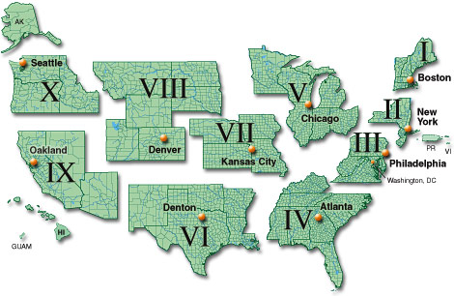

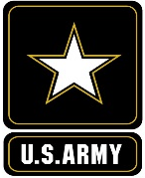

USARNORTH Array
COL Burwell
COL Snyder
COL Dougherty
COL Prairie
COL Drummond
COL
Heintzelman
NORTHCOM
Liaison Team
COL
Van Camp
COL Butts
HQDA Liaison
COL Graham
JTF
Civil Support
COL Thompson
Defense Coordinating Officer

Slide 6
Theater Army Functions and
Required Capabilities
Working “by, with, and through” the ASCC as NC’s JFLCC – ARNORTH accomplishes three broad categories of functions:
(1) execute combatant commander’s daily operation[al] requirements
(2) set and support the theater or joint operations area(s), and
(3) provide mission command for immediate crisis response and small scale contingency
ASCC / Theater Army Functions
CCDR’s daily operations requirements | Set and support the theater and the joint operations area | Direct mission command of operations
Title 10 administrative control of Army forces | Army executive agent | Small scale contingency operations Foreign humanitarian assistance Noncombatant evacuation operations Immediate crisis response Replicate corps or division headquarters for major exercises *Peace operations *Unlikely to execute in this AOR
Theater security cooperation | Chemical, biological, radiological and nuclear
Infrastructure assessment and development | Theater specific training
Concept and operation plan development | Force modernization
Regional intelligence collection | Sustainment Theater opening Reception, staging, onward movement, and integration Theater distribution Medical Army support to other Services Common-user logistics
Communications architecture
Land based theater air and missile defense
TACON for Force Protection
* Internment and resettlement * Detainee Operations

Slide 7
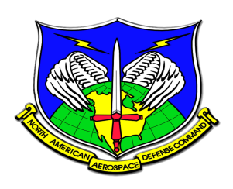
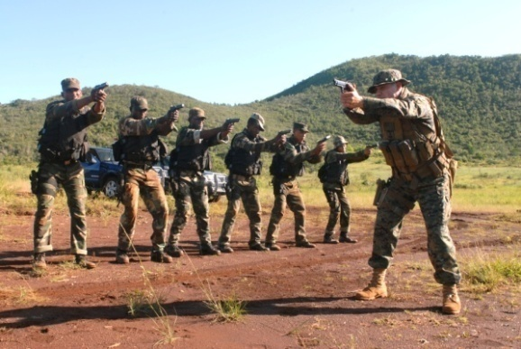
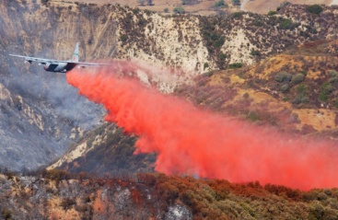

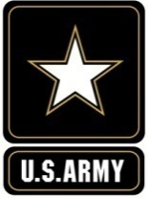

…Across a Range of Operations…
UNCLASSIFIED
Homelands
Defense
Security
Cooperation
Civil
Support
Aerospace Warning
Aerospace Control
Maritime Warning
Air
Missile Defense
Maritime
Land
Disaster Relief
CBRN Incident
Civil Disturbance
Special Events
Canada
Mexico
Bahamas
Land Domain
ARNORTHBrieftoAttache.2Nov15
Notes:
Our missions span a range of operations and are depicted here in three categories…Homeland Defense, Security Cooperation, and Civil Support.
You may notice that all of the NORAD missions are shown in the Homeland Defense side, while USNORTHCOM operations span everything.
NORAD is a bi-national command with the U.S. and Canada. USNORTHCOM is U.S. only, but our area of focus covers all of North America, including the Bahamas. It’s difficult to separate these two commands because of NORAD’s warning mission and USNORTHCOM’s response mission.
Although it’s not depicted here, Canada Command is the Canadian counterpart to USNORTHCOM. It’s significant for Canada Command to have an established link and relationship with both NORAD and USNORTHCOM.

Slide 8



Enhancing North American Security
Military to Military relationships to enhance the overall security of North America
Secure Land Approaches to the Homeland
Assist our neighbors to build capability and capacity to defeat common threats
Maintain warfighting interoperability
Notes:
This highlights a bit more our efforts with TSC – our main focus has been with developing improved relationships with the Mexican Army. Our TSC focus is to Secure the Land approaches to the US – primarily by enabling (as best we can) the Canadian and Mexican Militaries to deny, deter and defeat our enemies on their soil before they approach the US.
We continue to work our relationship with Mexico through our annual Border Commanders Conference and we unification of our TSC efforts with Mexico with JTF-N being assigned OPCON to ARNORTH.
In Canada we see our point of entry with the six regional JTFs and to date have had two conferences with them to start to develop a viable working relationship. We have also assumed admin control for the MPEP to Canada and Mexico.

Slide 9
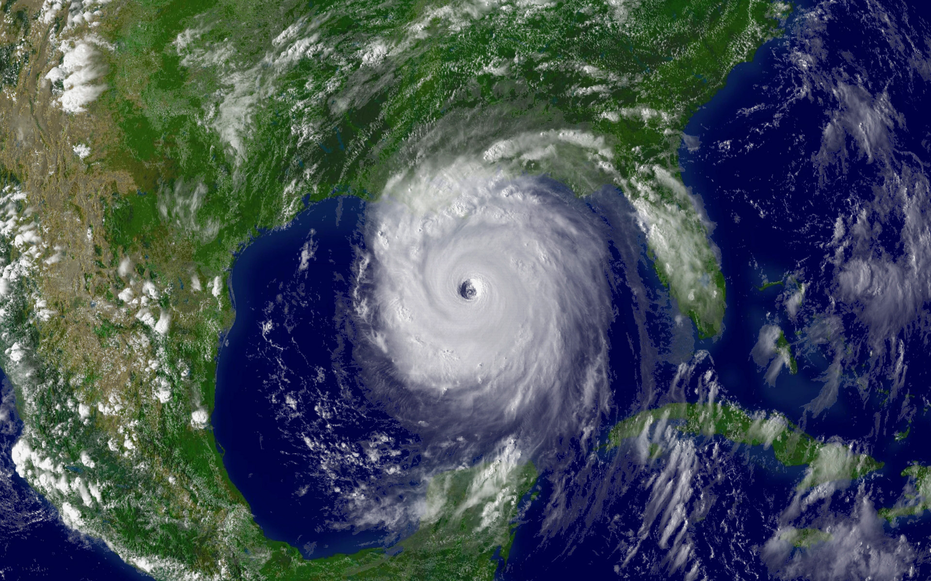
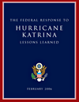
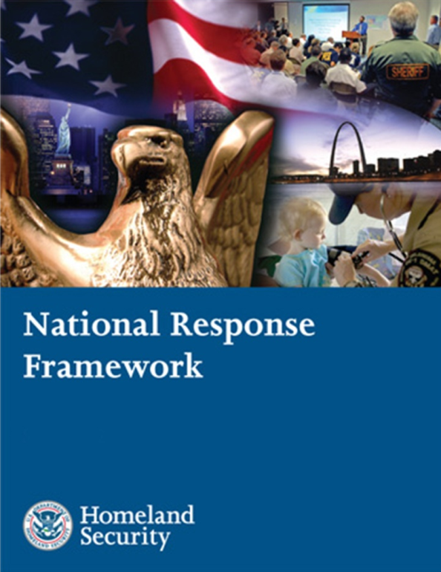
Post Katrina

Slide 10








Spectrum of Operations
UNCLASSIFIED
5
DoD’s #1
Priority
Characteristics:
Not the Lead Federal Agency (Interagency Centric)
States’ Rights (Unity of Effort)
No Fail (Politically Charged / Media Scrutiny)
Force Availability (Contingency Based)
Specialized Capabilities (Training Mandate)
Extraordinary
Circumstances
Emergency
Circumstances
Temporary
Circumstances
Civil
Support
Execute OPLANS
Transnational Threats
Disaster Relief
Civil Disturbances
CBRNE
Incident Mgmt
Special Events
10
ARNORTHBrieftoAttache.2Nov15
Notes:
This slide depicts the spectrum of operations for NORTHCOM—military assistance on the left and homeland defense on the right. These are our 2 missions
At the left end of our spectrum (in our Defense Assistance of Civil Authorities mission area) we support special events (such as the G8 Summit or DNC) for a certain period of time.
In the middle of the spectrum we support unplanned events, emergencies or disasters (such as fires or hurricanes) for an uncertain period of time—as long as necessary
Finally, at the far right, under extraordinary circumstances, we will defend our homeland. While this is DoD’s #1 priority, we believe that we’ll spend most of our time in the left end of our spectrum providing military support to Lead Federal Agencies
Note: A CBRNE incident may not be a terrorist attack. It could be a train derailment with chemical cars, for instance.
Lastly comment on the Characteristics – stress that we tend not to be the lead federal agency, that our response must not be slow or delayed and that except for the assignment of the CBRNE CM Response Force our reseponse will be contingency based (i.e. not T10 forces dedicated)

Slide 11
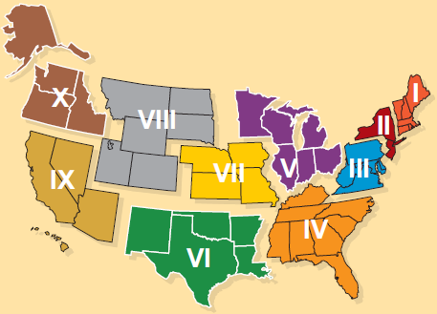
Complex Catastrophe “Key Terrain”
Complex Catastrophes also could include those with National-level effects such as cyber attacks (financial sector, energy/water distribution) or a 1918-style pandemic
Mount Rainier Eruption
Improvised Nuclear Device (IND) in major U.S. city
Cascadia Subduction Zone Earthquake, Tsunami
NMSZ Earthquake
10
1
4
9
7
5
3
2
CAT V Hurricane along Atlantic Seaboard
California Earthquakes
11
8
#
2011 Tier 1 Urban Area Security Initiative (UASI) Cities (number indicates priority)
6
CAT V Hurricane along Gulf Coast
ARNORTHBrieftoAttache.2Nov15

Slide 12
DoD’s Total Force Response
Federal Title 10 Assistance
Defense Coordinating Officer (DCO)
When Directed:
- Deploys in support of the Primary Federal Agency (FEMA)
- Work Requests for DOD Assistance
State Military Forces (National Guard)
First to respond under authority of the Governor – State Response
- Coordinated response with other State emergency management capabilities
FEMA
Region
VI
3
1
FEMA
Region
IV
DCO
JFO
2
Immediate Response:
- Authorizes local military commanders to take action to save lives, prevent human suffering, or mitigate great property damage
12
Notes:
This is a build slide that describes in very simple (Dick & Jane) terms how ARNORTH would respond to a DSCA operation
Step One – When directed the DCO would deploy with the LFA (PFO or FCO) to plug into the Joint Field Office and begin to coordinate any requests for DoD capabilitiies and then processing those LFA funded requests (Mission Assignments) through NORTHCOM to JDOMS and to the SecDef for approval. Either the main will stand up as the JTF or one of the OCPs will stand up as a JTF and BPT deploy in support
Step Two: As the SecDef approves the MA forces are flowed into the JOA and a Base Support Installation is established to allow these forces to conduct JRSOI and the BSI also provides that sustainment requirement to those forces. At this point the DCO is also the Joint Force Commander (JFC) within that JOA / incident area.
Step Three: A trigger will be established that clearly will identify when there are too many DoD forces within the JOA for the DCO to command (exceed his span of control) at which point all or a portion of an OCP will deploy into the JOA and assume that C2 requirement from the DCO.
This is all METT-TC dependent – the disaster maybe of such a magnitude that an OCP is launched early on and will establish as close to the JFO as possible to affect a unified Federal Response.

Slide 13
CBRN Response Enterprise
UNCLASSIFIED
State-Led Response
Federal-Led Response
State National Guard assets may operate under
State or Federal Control
DCRF
(5,200 personnel)
Critical Lifesaving Capabilities
Command & Control
Security
Aviation
Medical
General Support
HRF
(10 Forces / 566 per)
Critical Lifesaving Capabilities
Command & Control
Security
CERFP
(17 Packages / 186 per)
Critical Lifesaving Capabilities
C2CRE
(2 Elements / 1,500 per)
Command & Control
Small Packages = to DCRF
Contingency Sourced
WMD-CST
(57 Teams / 22 per)
Detect, ID & Assess
CST: WMD-Civil Support Team DCRF: Defense CBRN Response Force
CERFP: CBRNE Enhanced Response Force Package C2CRE: C2 CBRN Response Element
HRF: Homeland Response Force
UNCLASSIFIED
13
ARNORTHBrieftoAttache.2Nov15

Slide 14
CBRN Response Enterprise (State)
AK
1O3rd
VT
Region I
15th
ME
NH
WA
Region VIII
11th
12th
1Oth
Region V
MT
ND
MA
Region II
1st
OR
ID
83rd
81st
MN
NY
RI
1O2nd
SD
WI
13th
101st
55th
MI
2nd
24th
CT
Region X
WY
82nd
54th
51st
14th
84th
NJ
IA
IL
OH
PA
21st
UT
NE
71st
IN
52nd
3rd
Region III
95th
CO
72nd
5th
53rd
DE
NV
85th
8th
MO
WV
VA
31st
KS
35th
34th
MD
CA
92nd
73rd
7th
DC
32nd
Region VII
41st
KY
33rd
9th
42nd
NC
AZ
OK
45th
TN
SC
HI
NM
63rd
AR
AL
43rd
91st
61st
MS
46th
GA
64th
47th
4th
93rd
TX
LA
Region IV
GU
Region IX
48th
6th
62nd
FL
44th
Region VI
94th
PR
USVI
CERFP
22nd
23rd
HRF
Region II
ARNORTHBrieftoAttache.2Nov15

Slide 15
Questions

