Slide 1
980th Engineer Battalion LTC Jeffrey Hartsell CSM Thomas Champion
302 EN CO (V)
WTGDAA
SAN ANTONIO, TX
121 CH DET
WZTYAA
SAN ANTONIO, TX
312 EN DET (C)
WQ51AA
SAN ANTONIO, TX
980 EN BN
WS5NAA
AUSTIN, TX
TX
277 EN CO (H)
WRYGAA
SAN ANTONIO, TX
HHC 980 EN CO
WS5NT0
AUSTIN, TX
808 EN CO (H)
WS50AA
HOUSTON, TX
FCS 980 EN CO
WS5NA0
AUSTIN, TX
321 EN CO (RC)
WZ3VAA
HOUSTON, TX
352 SPT
WRYVAA
YOAKUM, TX
463 FF HQ
WRZZAA
HOUSTON, TX
451 EN DET (AC)
WZ5FAA
CONROE, TX
Notes:
BRIEFER: Unit commander for officer development and CSM for NCO development
FORMAT: Each chart is in Excel format
INSTRUCTIONS:
Double click on the chart to activate the Excel spreadsheet
Enter data as indicated

Slide 2
The Engineer Branch
“The Engineer Regiment exists to provide the freedom of action for land power by mitigating the effects of terrain.” (FM 3-34 Intro)

Slide 3
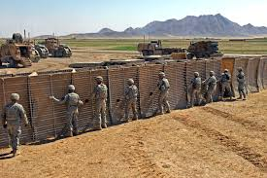
Engineer Company
General Engineer
Increased focus on the construction aspect of the engineering mission
Consist of horizontal, vertical, and other special purpose units
Armed and equipped to fight primarily in a defensive role

Slide 4
302nd Engineer Company
Unit History
Established 24 March 1942 as Company D, 334th EN Combat BN
Eventually reorganized in 1 APR 2007 and redesignated as 302nd EN CO
Campaigns
GWOT
World War II

Slide 5
302nd Engineer Company
Mission
To command, control, and construct basecamps and internment facilities; and construct, repair, and maintain vertical infrastructures in support of support brigades or Engineer Brigades.

Slide 6
302nd Engineer Company
Mission Explained
Provide Base Camp or facility enhancement
Enable Force Projection and Logistics
Build Partner capacity and Develop Infrastructure

Slide 7
302nd Engineer Company
Mission Explained
Improvement facility maintance
Improve infrastructure
Provide utilities to a field environment
Establish base-camp for friendly forces
Provide service work for utilities

Slide 8
302nd Engineer Company
Mission in Context
Provide Base Camp or facility enhancement
-Unit is able to establish a base camp as well as provide service support to maintain

Slide 9
302nd Engineer Company
Capabilities-Man Power
Structure
Company/Platoon/Squad/Teams
Line/maintenance platoons
Manpower
Composition (officers/enlisted)
MOS’s
12W- Carpentry Masonry Specialist
12R- Interior Electrian
12K- Plumber
12H- Construction Supervisor
12X- General Engineer Supervisor
12A Engineer Officer
120A Utilities Warrant Officer

Slide 10
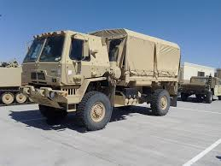
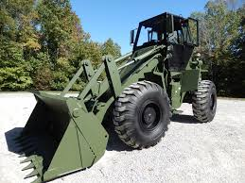
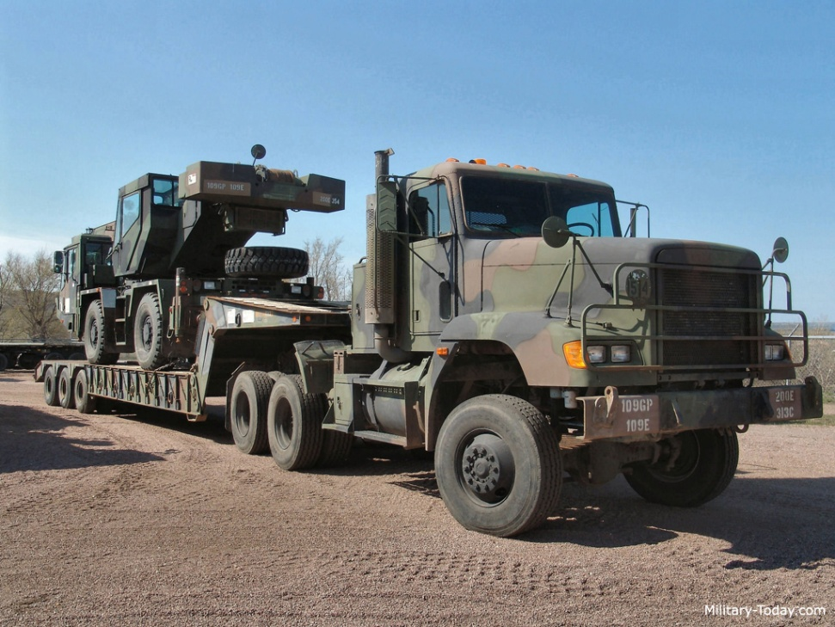
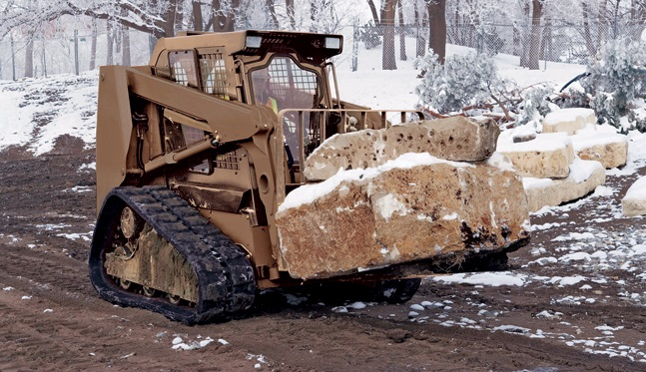
302nd Engineer Company
Capabilities-Equipment
Others

Slide 11
277th Engineer Company
Unit History
Established 3 APR 1944 as Company A, 1298th EN Combat BN
Eventually reorganized in 1 APR 1954 and redesignated as 277th EN CO
Campaigns
GWOT

Slide 12
277th Engineer Company
Mission
To provide command and control of assigned platoons and teams to unit that coordinates, directs, conduct repairs, maintain and/or construct roads and airfields; emplace culverts; haul construction materials; conducts clearing and grubbing; and provides force protection.

Slide 13
277th Engineer Company
Mission Explained
Permanent road/airfield construction/repair
Expedient road/airfield construction/repair
Earthwork preparation of construction sites
Defensive Earthwork
Obstacle Creation/Clearance

Slide 14
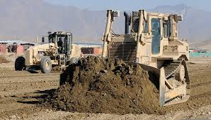
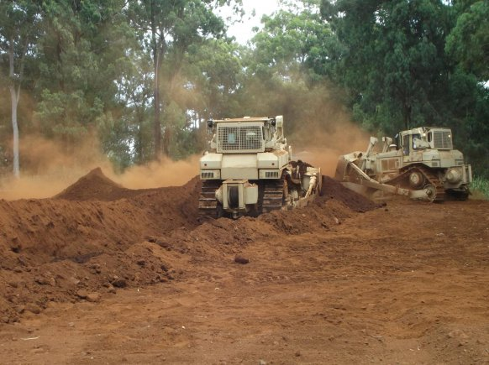
277th Engineer Company
Mission in Context
Enhance Mobility
Mobility
Principal mission is the construction and maintenance of roads, airstrips
Heavy equipment suitable for breaching secured obstacles
Counter-mobility
Heavy equipment suitable for construction of obstacles

Slide 15
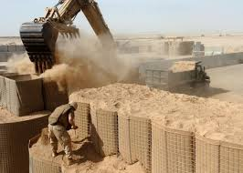
277th Engineer Company
Mission in Context
Enhance Protection
Equipped with heavy earthmoving equipment suitable for long term fortification
Enable Force Projection and Logistics
Army’s principal organic element for the maintenance of major supply routes

Slide 16
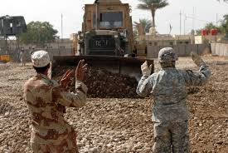
277th Engineer Company
Mission in Context
Build Partner Capacity and Develop Infrastructure
Train partner organizations in engineer tactics and techniques
Army’s principal organic element for the maintenance and construction of roads and airfields

Slide 17
277th Engineer Company
Capabilities-Man Power
Structure
Company/Platoon/Squad/Teams
Line/maintenance platoons
Manpower
Composition (officers/enlisted)
MOSs
12N- Horizontal Construction Engineer
12A- Engineer Officer
12X- General Engineer Supervisor

Slide 18
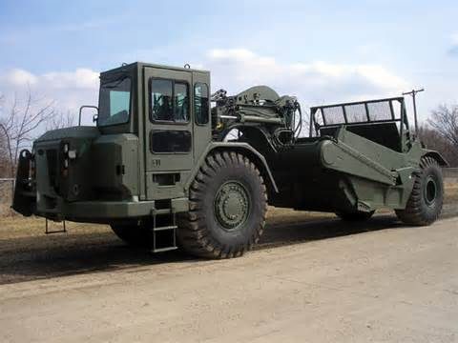
277th Engineer Company
Capabilities-Equipment
621B Scraper
The scraper is a large piece of equipment used in mining, construction, agriculture and other earthmoving applications. The scraper can transport its load to the fill area where the blade is raised, the back panel of the hopper, or the ejector, is hydraulically pushed forward and the load tumbles out. Then the empty scraper returns to the cut site and repeats the cycle

Slide 19
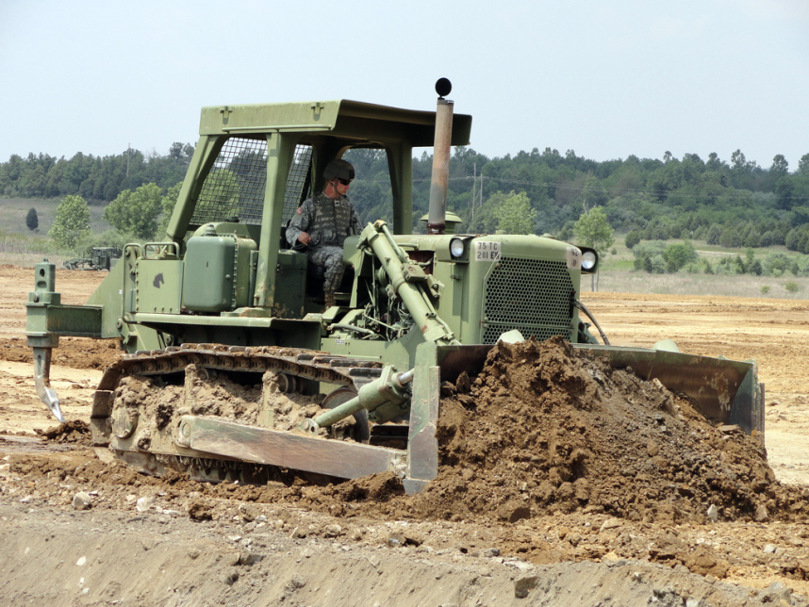
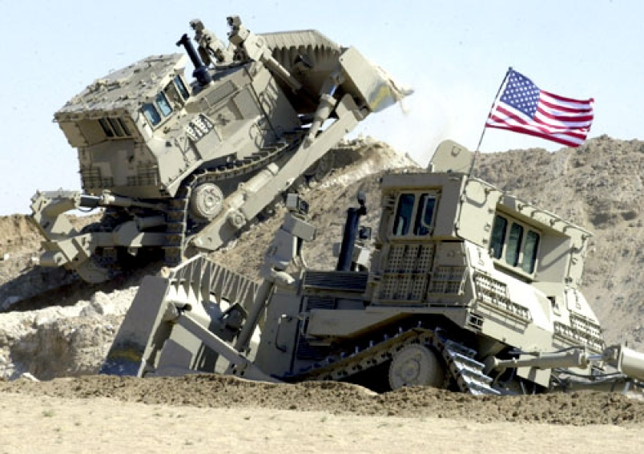
277th Engineer Company
Capabilities-Equipment
D7-Bulldozer
The Caterpillar D7 is a medium bulldozer manufactured by Caterpillar Inc. D7 is primarily used to move material short distances or through challenging terrain. This makes it ideal for working on very steep slopes, in forests, and for backfilling pipelines safely without risking damage to the pipe.

Slide 20
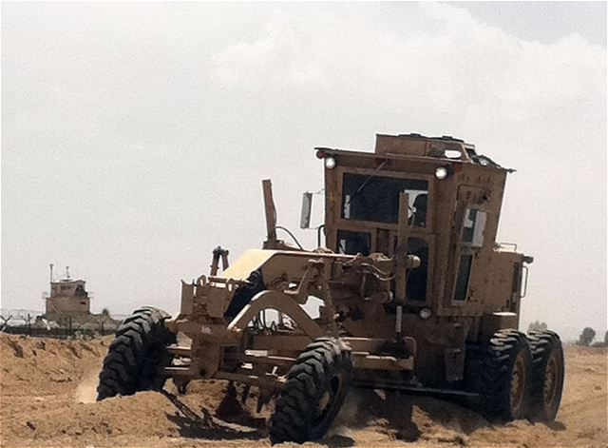
277th Engineer Company
Capabilities-Equipment
120M Grader
A grader, also commonly referred to as a road grader, a blade, a maintainer, or a motor grader, is a construction machine with a long blade used to create a flat surface during the grading process. Certain graders can operate multiple attachments, or be used for separate tasks like underground mining.

Slide 21
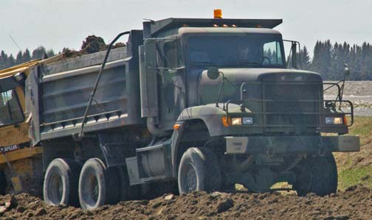
277th Engineer Company
Capabilities-Equipment
M917 Dump Truck
A dump truck is a truck used for transporting loose material (such as sand, gravel, or dirt) for construction.

Slide 22
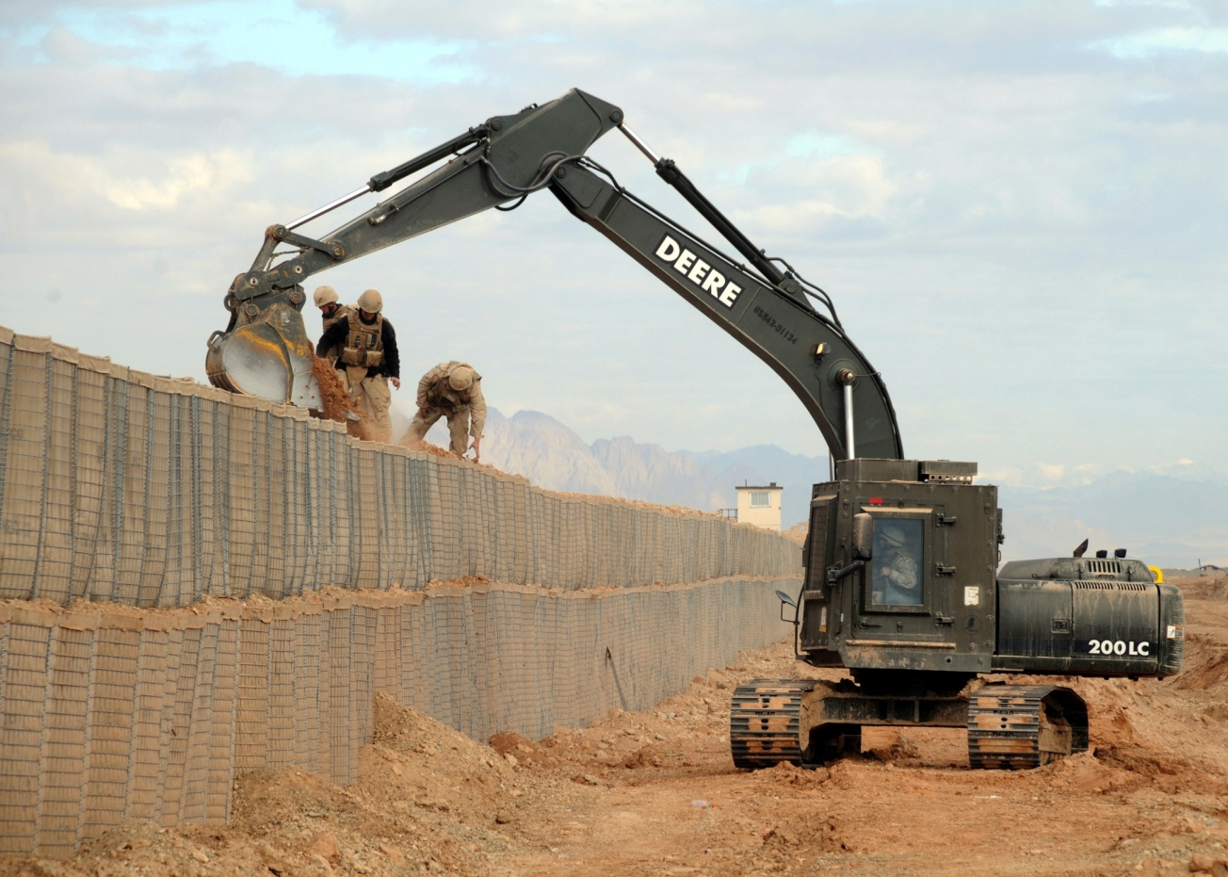
277th Engineer Company
Capabilities- Equipment
JD230LCR Hydraulic Excavator
Excavators are heavy construction equipment consisting of a boom, stick, bucket and cab on a rotating platform known as the "house”

Slide 23
277th Engineer Company
Capabilities-Equipment
Others

Slide 24
Questions

