Slide 1
Texas Military Department
Informational Briefing
Major General William “Len” Smith
Commander, Texas Army National Guard
November 04, 2015

Slide 2

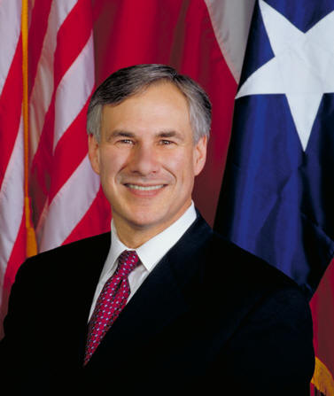
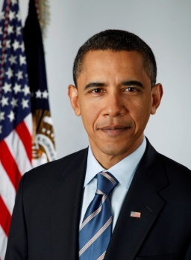








Texas Military Forces
State
Federal
19%
32%
21%
Defense Support to Civil Authorities (DSCA)
Humanitarian Assistance/ Disaster Relief (HA/DR)
  Hurricanes, Flooding
  Wildfires, Ice Storms
Medical Support
Operation Lone Star
Rabies Eradication—DSHS
Assisting At-Risk Youth Programs
ChalleNGe/Star Base
Homeland Security
Border/Shores/Highways
Operation Border Star—LEA
CDAE (Counter Drug Aviation Element)
Homeland Defense
14%
Homeland Defense
Augment Combatant Commands
  CENTCOM
  PACOM
  EUCOM
  NORTHCOM
  SOUTHCOM
  AFRICOM
Partnership Programs
Peace Prairie (Singapore)
Czech Republic
Republic of Chile
NORTHCOM-SEDENA Support
Libyan Delegation
SWB Support
Can be Federalized (Title 10)
Notes:
Supports both the State of Texas and the United States Government. It performs these dual roles by operating under the different legal authorities of the United State Code. Title 32 governs the National Guards State role in support of civil authorities, while Title 10 governs our support of the president at home or abroad. Each block contains examples of operations representative of the two roles.
As you can see, 32% of the total Army Force Structure and 21% of the total Air Force Structure resides in the National Guard.
When TXMF are not deployed ISO a federal mission, our CDR in Chief is the GOV of TX. This structure enables the state to quickly and efficiently leverage local DoD and state military resources to respond to any natural or man-made crisis, emergency, hazard, or event which may occur.
To support our mission >>>

Slide 3

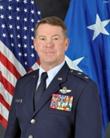
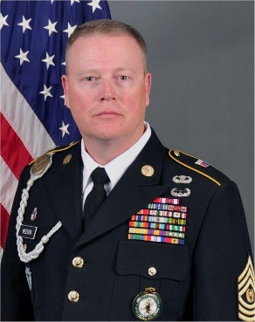
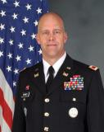

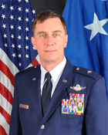
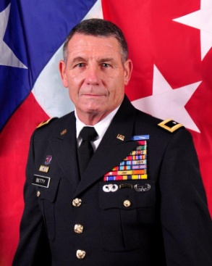
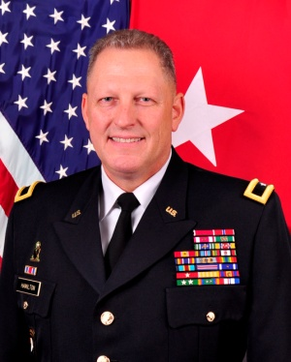

Texas Military Department
Organization and Leadership
Commander in Chief
Governor Greg Abbott
The Adjutant General
Maj Gen John Nichols
Senior Enlisted Advisor
CSM Weedon
Chief of Staff
COL Greg Chaney
Commander, TXARNG
MG Len Smith
Commander, TXANG
Maj Gen Ken Wisian
Commander, TXSG
MG Gerald “Jake” Betty
Commander, DOMOPS TF
BG Pat Hamilton
Director TXMD
Mr. Duane Waddill
3
Notes:
3
The Texas Military Forces is composed of the three branches of the military in the state of Texas. These branches are the Texas Army National Guard, the Texas Air National Guard, and the Texas State Guard. All three branches are administered by the state Adjutant General, an appointee of the Governor of Texas, and fall under the command of the Governor.

Slide 4

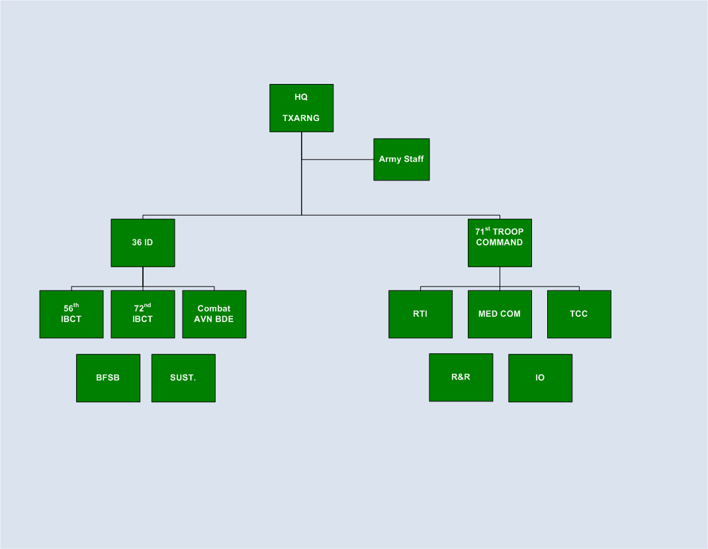
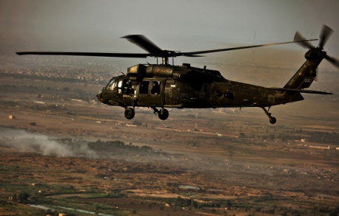

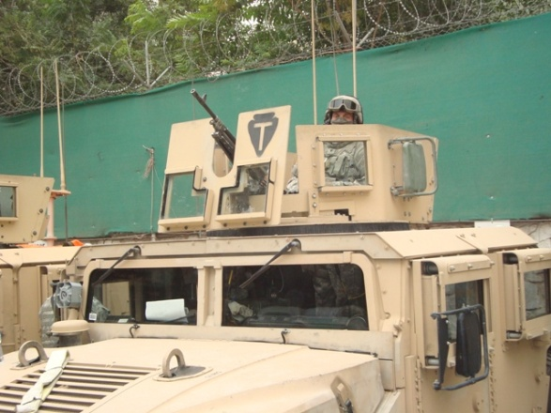




Texas Army National Guard Units
15,081
Commander, TXARNG
MG Len Smith
SOD-A
MISSION
The incredible versatility of the Texas Army National Guard enables us to respond to domestic emergencies, combat missions, counterdrug efforts, reconstruction missions and more—all with equal speed, strength and efficiency.

Slide 5
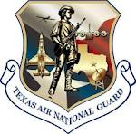
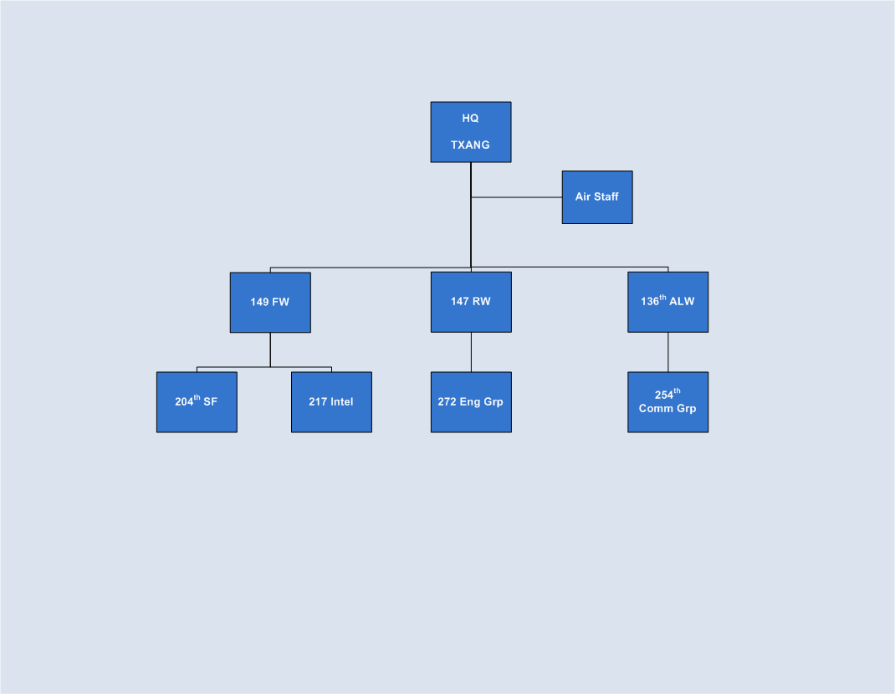
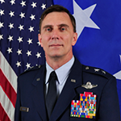

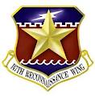
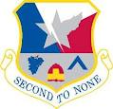
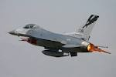
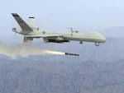
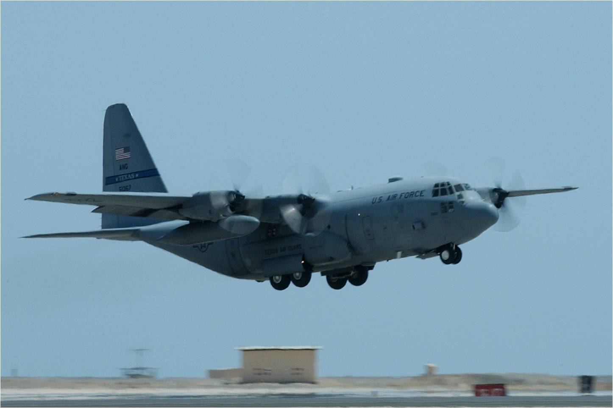
Texas Air National Guard Units
3,028
Commander, TXANG
Maj Gen Ken Wisian
MISSION
Be ready to defend the homeland as the Governor’s first responders and decisively take the fight to the enemy abroad with superb Leadership, relevant training, and equipped citizen-Airmen in our Total Force Core Functions.

Slide 6
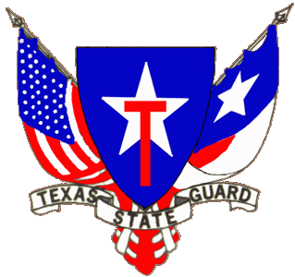
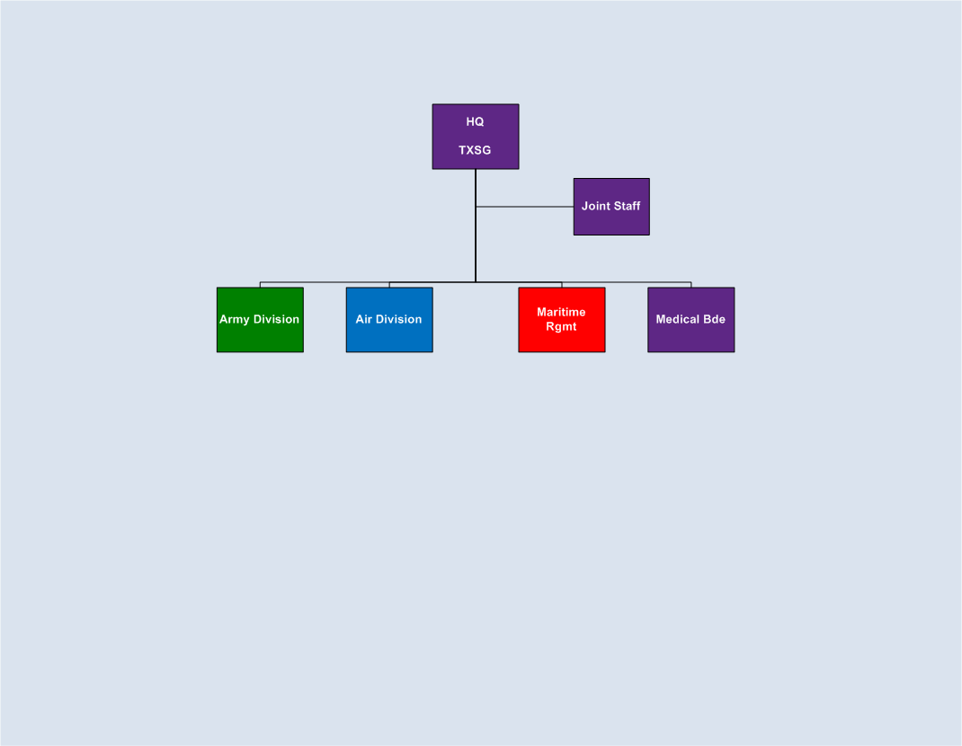
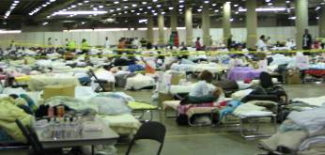

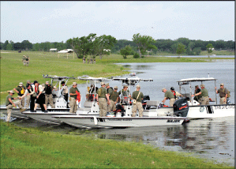
Texas State Guard
2,300
Commander, TXSG
MG Gerald “Jake” Betty
MISSION
Provide mission-ready military forces to assist state and local authorities in times of state emergencies; to conduct homeland security and community service activities under the umbrella of Defense Support to Civil Authorities; and to augment the Texas Army National Guard and Texas Air National Guard as required.

Slide 7
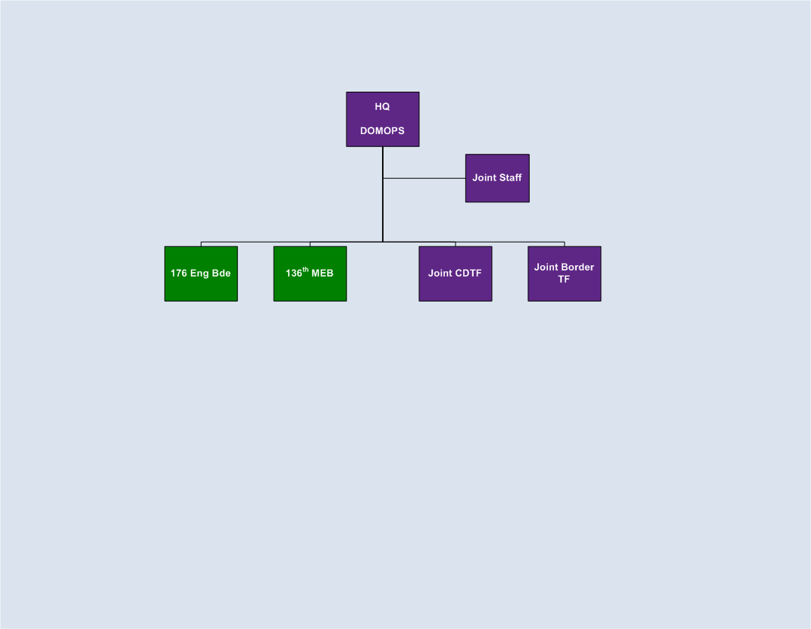



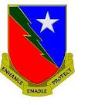
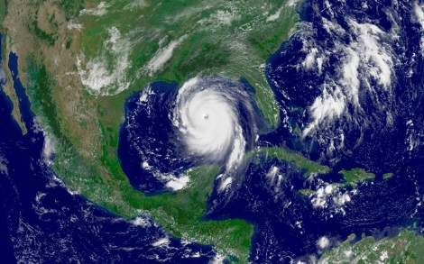
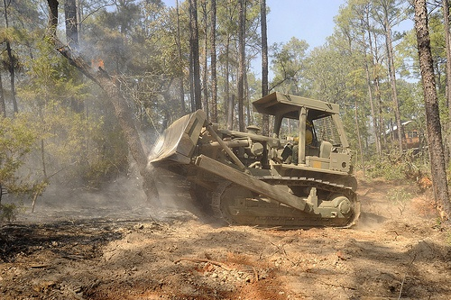
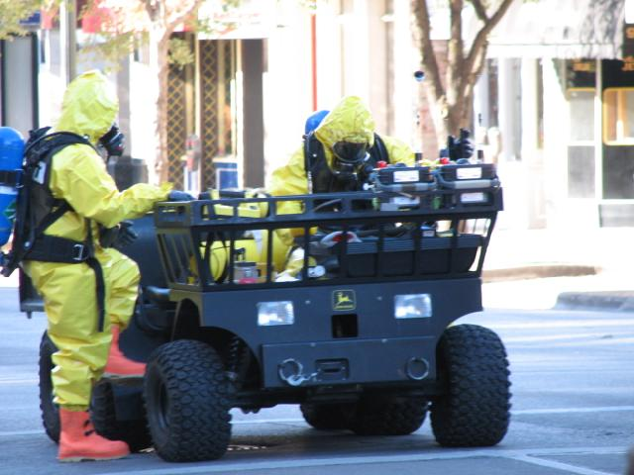
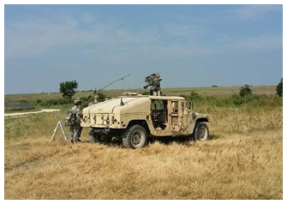
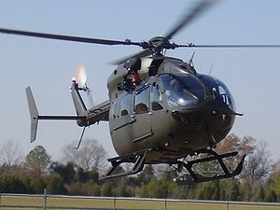
Domestic Operation Task Force
Commander, DOMOPS TF
BG Pat Hamilton
4,300
Joint TF OSS
MISSION
Provide direction and oversight of Texas Military Forces throughout Texas and Federal Emergency Management Agency (FEMA) Region VI during emergencies and disasters as part of Defense Support of Civil Authorities (DSCA) or civil support operations to save lives, alleviate suffering and protect property. When authorized, provide mission command of Title 32 and Title 10 forces within a Dual Status Command for immediate and long term DSCA response at the request of the Governor of Texas
Notes:
The Domestic Operations Task Force is the component which is charged with providing direction and oversight of Texas Military Forces throughout the state during Defense Support of Civil Authorities (DSCA) events IOT assure appropriate Civil Support response.
When authorized, provide mission command of State Active Duty, Title 32 and Title 10 forces within a Dual Status Command for immediate and long term DSCA response at the request of the Governor of Texas.
The DOMOPs TF consists of a HQ element here at Camp Mabry, an EN BDE, HQ in Dallas, a MEB, HQ in Round Rock, a Joint CD TF, HQ here at Camp Mabry, and a Joint Border TF which supports Federal and State border security missions in the RGV.

Slide 8
DOMOPS CIVIL SUPPORT MISSION
- Evacuation Support
- Search and Rescue
-Fire Suppression (Ground and Air)
- Re-entry Support
- Aero-Medical Evacuation
- Air Operations Cell
- Re-entry Support
- Airfield Re-opening
- Shelter Management Teams
- Emergency Tracking System
- Communications Support
- Evacuation HUBS
- Mass Care
- Search and Rescue
TEXAS ARMY NATIONAL GUARD
TEXAS AIR NATIONAL GUARD
TEXAS STATE GUARD
Notes:
While the DOMOPs TF represents just under 20% of the entire TXMF, each component may be tasked to augment DOMOPs with additional units, equipment, and personnel during a domestic crisis. These are just some of the missions performed by the Army, Air, and State Guard components of TXMF.

Slide 9
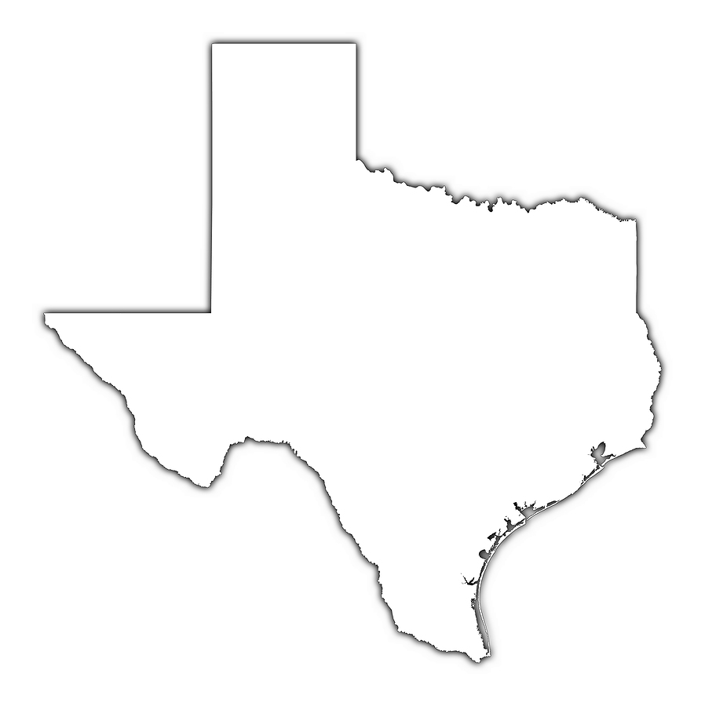





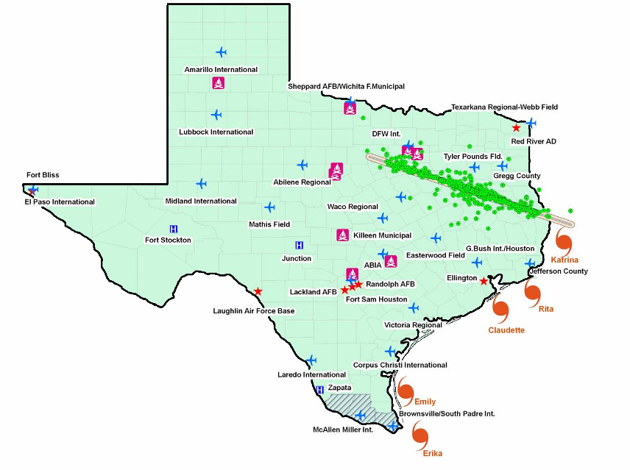
DSCA Mission 2003-2015
DSCA Mission Summary
Event Type # Missions
Over 564,000 Man-days
since 2003
Tropical Weather 33
Flood Response 37
Wildfire – AVN 28
35
Wildfire – Ground 26
DFW
ELP
Winter Weather 23
LE
LE
LE
35
Civil Support 47
LE
505 miles (11 hrs)
505 miles (11 hrs)
Law Enforcement 22
10
879 miles (13hrs)
10
AUS
HOU
LE
HOU
Katrina
LE
SAN
10
Eduardo
LE
1,241 mile border
with Mexico
Rita
Fay
LE
35
LE
Claudette
Ivan
  Support Most State Agencies in Disaster Response
  Provide Advice, Planning, Personnel and Equipment in support of State’s designated lead agency
  Provides Command & Control and coordinates all Military Support
Shuttle Recovery Wildfire Ground
Tropical Weather Winter Weather
Flood Response Civil Support
Wildfire – AVN Law Enforcement
LE
LE
367 mile gulf
coastline
Humberto
LE
LE
Ike
LE
LE
Isidore
Gustav
LE
Erika
LE
Charlie
LE
LE
Lillie
Grace
LE
LE
Dean
Frances
Dolly
Chris
Notes:
Over the past 12 yrs, the TXMF has significantly contributed to DSCA in a variety of ways –
-- assisting the State and Federal Government in securing our international border
-- assisting state and federal agencies during the Space Shuttle Columbia Disaster, Superbowl, West Explosion
-- bringing medical and dental care to the citizens of the southern regions
-- as well as rapid responses to numerous, hurricanes, tornadoes, floods and wild fires
Since 2003 over 25,000 Texas Guardsman have participated in over 353,000 mandays
Significant contributions (large scale operations):
Operation Lone Star – (Annual Event-RGV), Shuttle Crash (2003), Wild Fires/Bull Dozer Ops (2005,2008), Hurricanes- (12 threats-5 severe impacts), Tornado (2000-DFW,2002 Eagle Pass), OJS- (2006-2008), Aviation Support/Flood Response/Texas Task Force 1 – (2000-2010, High years -2003,2006,2008), 6th CST – (Columbia Shuttle, Hurricane Impacts, Ft Hood, World Series, Super Bowl, FBI Requests), JOIC (2008-2010), MED Ranger – (Hurricanes/OJS)

Slide 10
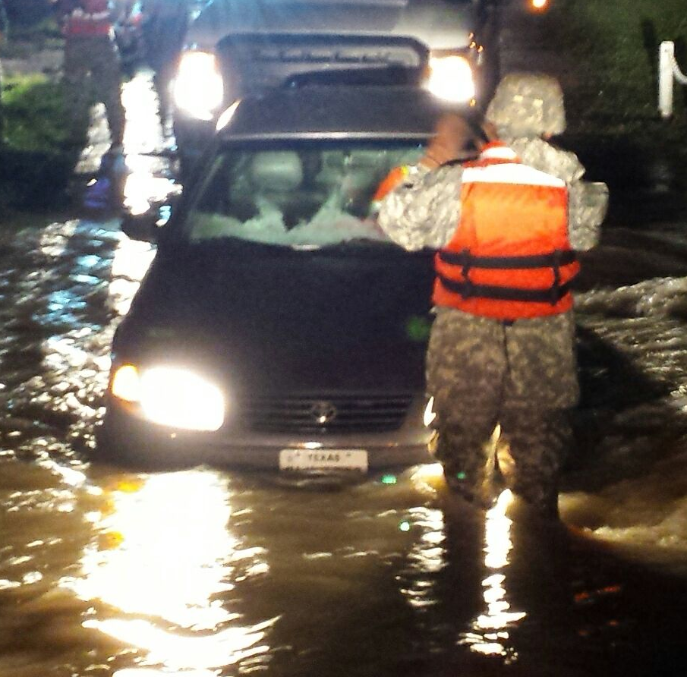
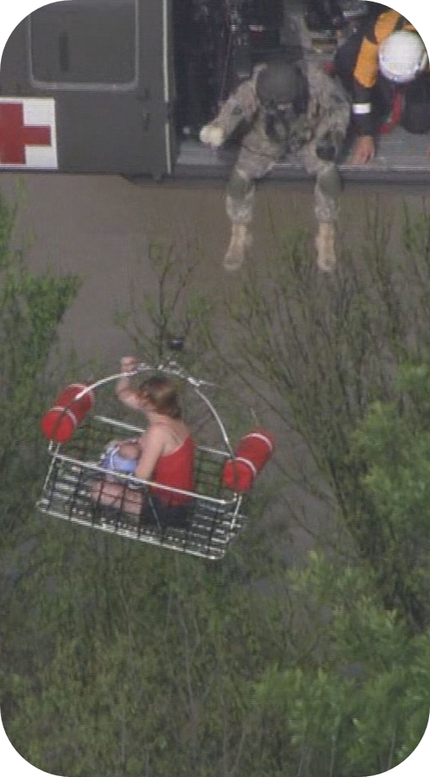
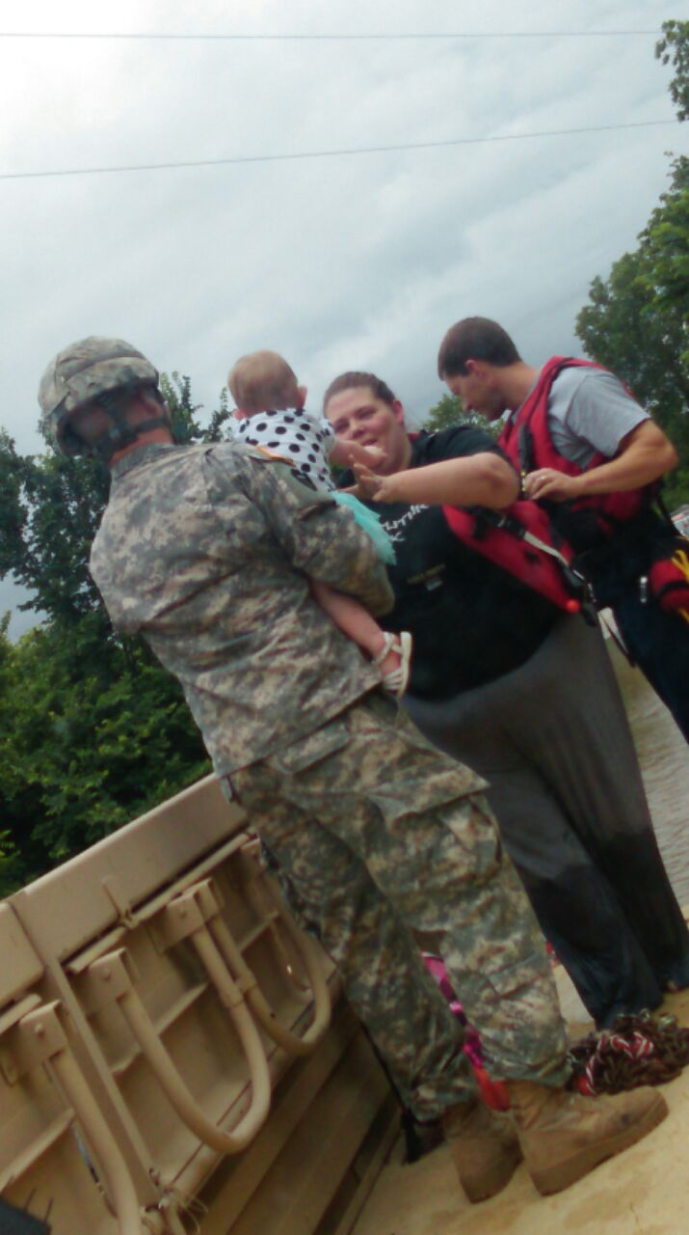
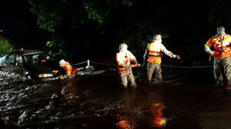
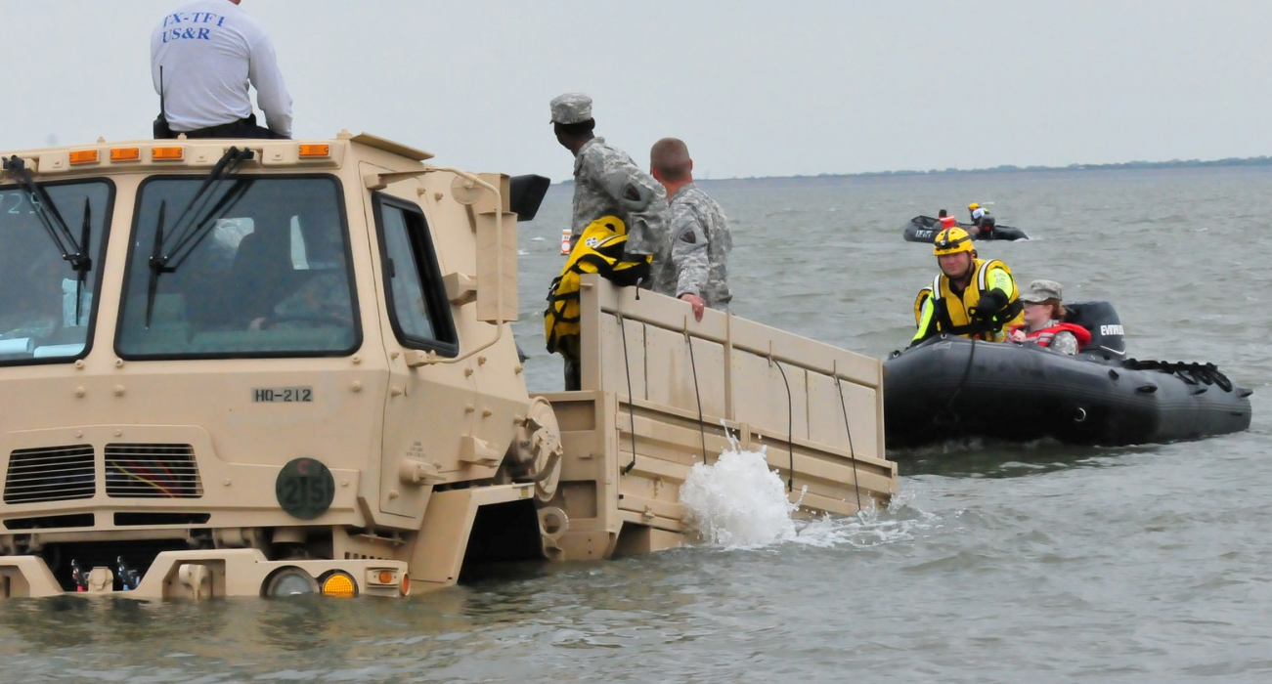
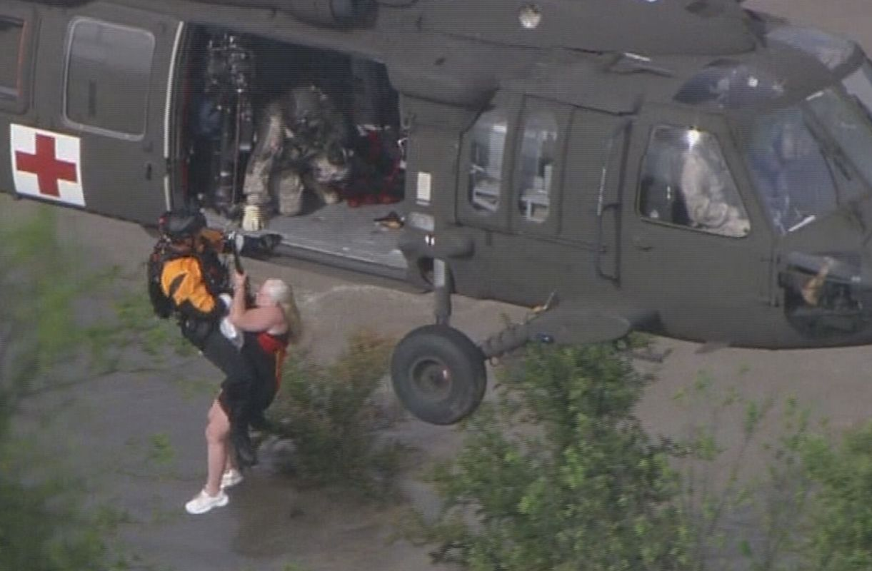
2015 Texas Severe Weather Event
54 Missions -30 Locations
132 Rescues & Evacuations
9 Declared Disaster Districts
378 Troops
30 Days of SAD (7 May-5 Jun 15)
Multiple Resource Types
  Ground Search and Rescue
  Aerial Search and Rescue
    8x UH-60s (2 from LAARNG)
    2x UH-72
    4x CH-47
  Communications Support (TICP)
  High Profile Vehicles
    2x SAR Ground Companies
    2x Ground Transpo Companies
  Ground Search and Recovery
  Dept. of Emergency Mgmt: Planners
  Dept. of Emergency Mgmt: RSOI
  Dept. of Emergency Mgmt: Liaisons
  Local Government: Liaisons
Notes:
During our most recent DSCA response, TXMF provided more than 300 SMs and valuable ground high profile vehicle and hoist equipped rotary wing SAR resources which resulted in the rescue and evacuation of hundreds of citizens in need.

Slide 11
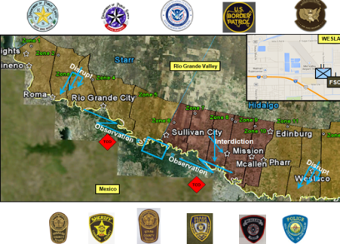
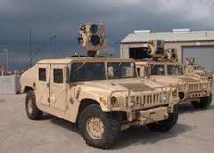
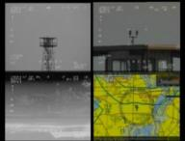
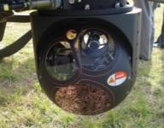
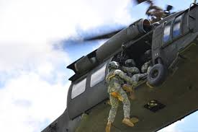
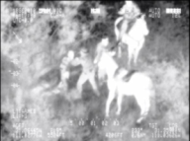
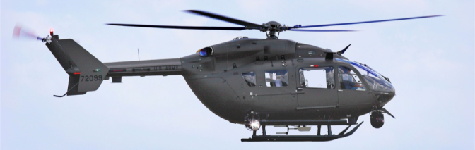
Border Support
OSS
Ramped up over 1,000 Guardsmen in less than 45 days in support of Department of Public Safety’s Operation Strong Safety to secure the Texas Border assisting in the interdiction of over 15,000 illegal entries and seizure of over 337,000 lbs of narcotics. Support continues with 200 pax minimum through Aug 2015
Operation Phalanx
-Provided over 85 personnel in support to southwest Border conducting aerial detection and monitoring as well as criminal investigative support to disrupt and interdict trans-criminal organizations as well as drug trafficking organizations in support of Department of Homeland Security.
Joint Counter Drug Task Force
- Leverage unique military capabilities to assist Law Enforcement Agencies (LEAs) and Community Based Organizations (CBOs) in the disruption of illicit drug financing, production, transportation, distribution and promotes drug-free living through community-based education and prevention Our Joint Counter Drug

Slide 12
Questions?

