Slide 1
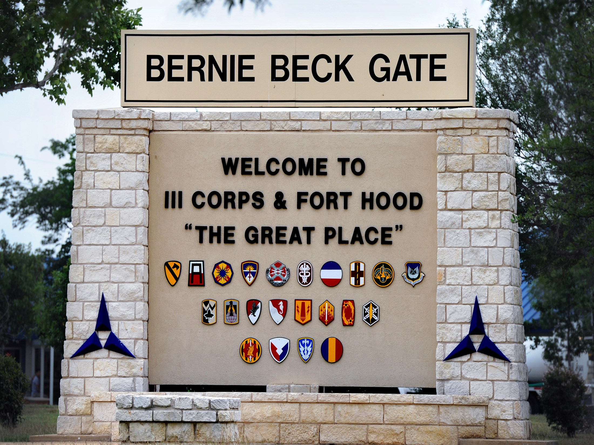

Slide 2
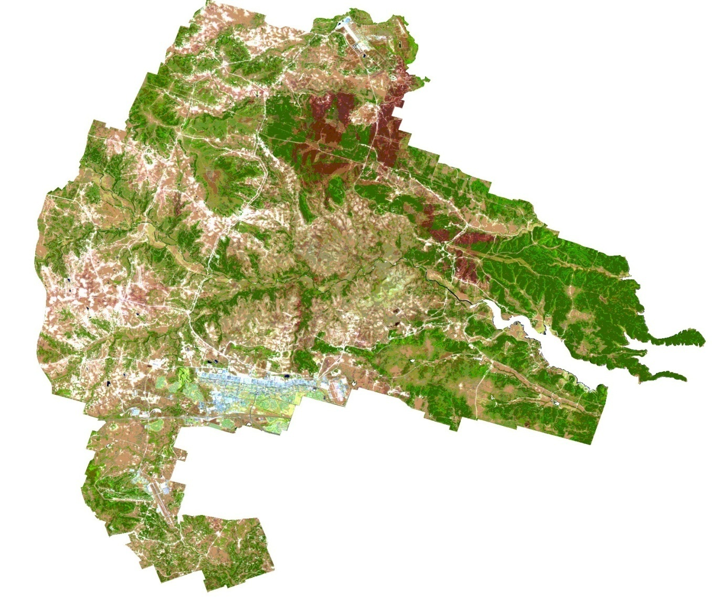
Fort Hood, Texas-The Great Place
Notes:
Rod Chisholm – 1.5 mins.
Who he is (his role at Ft. Hood)

Slide 3
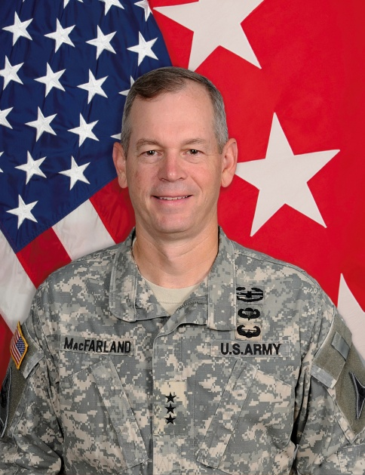
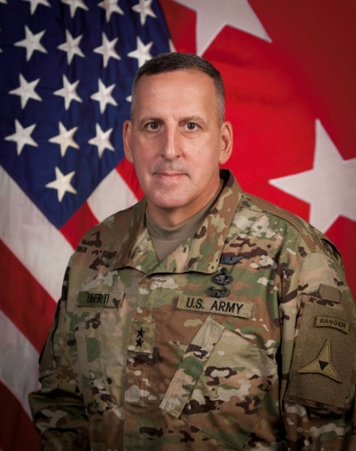
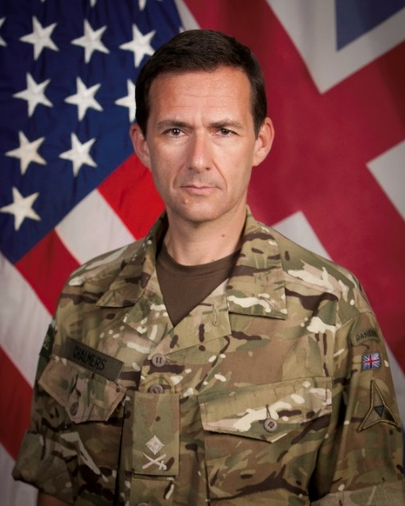
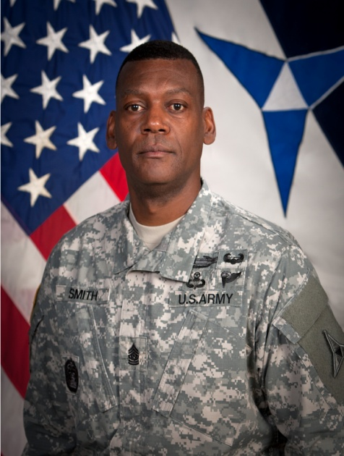
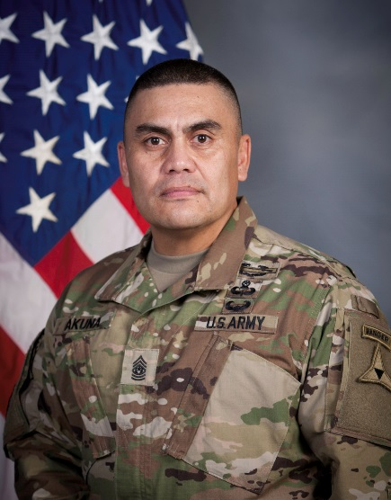
III Corps Leadership
LTG Sean B. MacFarland
Commanding General
III Corps and Fort Hood
MG John Uberti
Deputy Commanding General
III Corps and Fort Hood
MG Doug Chalmers
Deputy Commanding General
III Corps and Fort Hood
CSM Alonzo Smith
Command Sergeant Major
III Corps and Fort Hood
CSM Patrick Akuna
Command Sergeant Major
Task Force Phantom

Slide 4

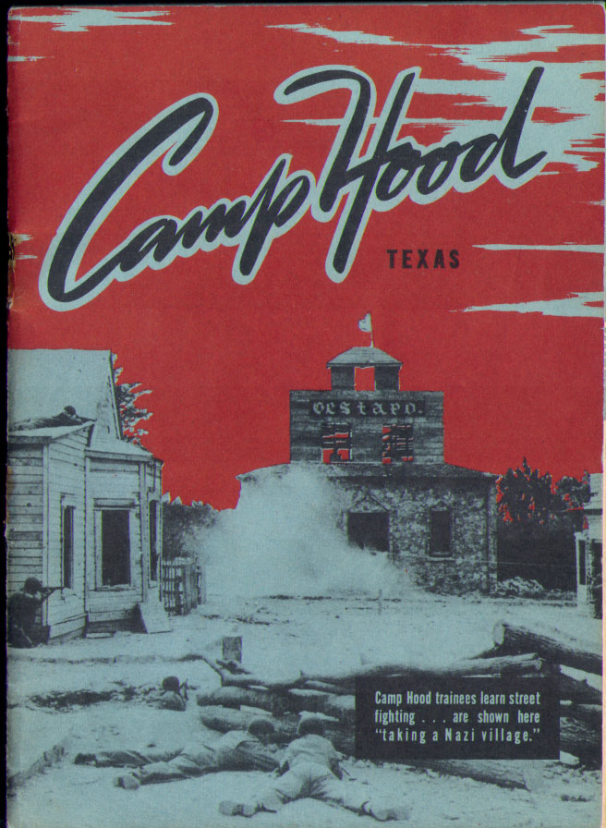
Fort Hood History
“Camp” Hood officially opened 1942. Designated Fort Hood, a permanent installation, 1950
Named for General John Bell Hood, CSA, “The Fighting General of the South” who led the Texas Brigade during the Civil War
“SEEK, STRIKE, DESTROY” Camp Hood is originally established as a Tank Destroyer Tactical Training and Firing Center
Killeen Base (Site Baker), Gray Air Force Base constructed in 1947. The airfield is named after CPT Robert Manning Gray, a B-25 pilot on the famous Doolittle Raid over Tokyo and native son of Killeen.
III Corps assigned to Fort Hood in 1954 and permanently assigned 1961.

Slide 5

III Corps History
World War I—participated in the Aisne-Marne, Lorraine, and the Meuse-Argonne campaigns
World War II—established the Remagen Bridgehead and earned the nickname the “Phantom Corps”
(1950-Present )Strategic Army Corps (STRAC) /Counterattack Corps "America's Hammer "
  Vietnam
  Panama
  Honduras
  Saudi Arabia
  Kuwait
  Somalia
  Bosnia and Herzegovina
  Desert Shield/Desert Storm
  OIF/OND
  OEF
17 Campaign Streamers
3 Joint Meritorious Unit Commendations for service in Iraq

Slide 6
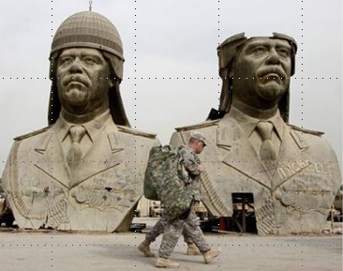
III Corps/Ft. Hood History
War on Terror
First Deployment (2004-2005)
MNC-Iraq
Offensive Operations
Secure Environment
Stabilize & Support
Establish Services
Economic Development
Transfer of Sovereignty
Second Deployment (2006-2008)
MNC-Iraq
Reduce Violence
Secure Population
Stop accelerants
Third Deployment (2010-2011)
USF-Iraq
Drawdown and Transfer of Authority
End OIF, begin OND
Fourth Deployment (2013-2014)
International Security Assistance Force (ISAF), Joint Command (IJC) Afghanistan
Drawdown and Retrograde
Stabilize and Support

Slide 7
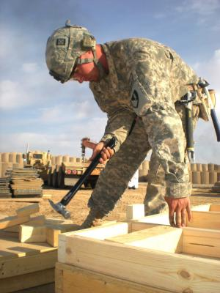
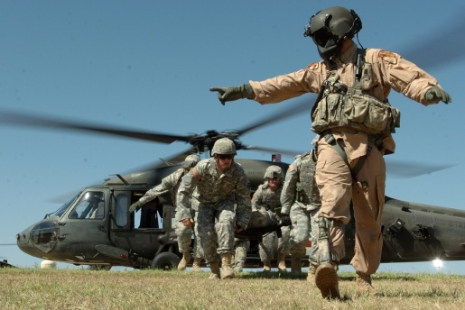
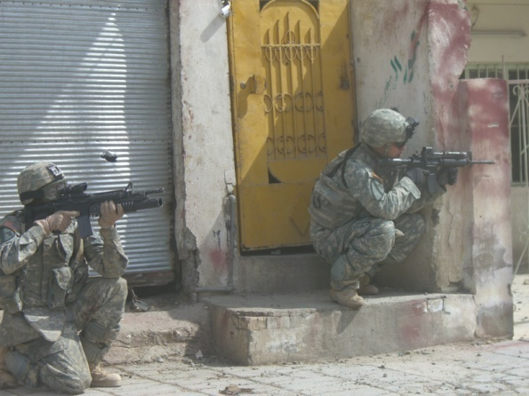
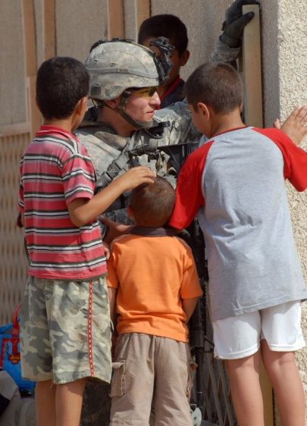
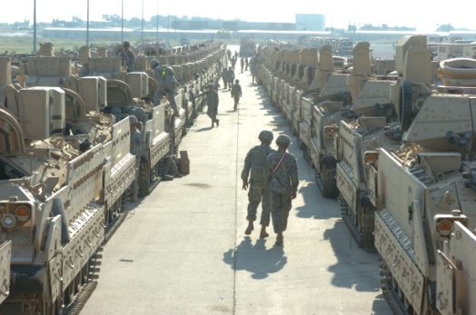
III Corps/Ft. Hood History-War on Terror
1 CD HQ: 3 rotations to OIF; 2 rotations to OEF
3 CR: 4 rotations to OIF; 1 rotation to OEF
13th ESC: 3 rotations to OIF; 1 rotation to OEF; 1 rotation to Kuwait
4 ID HQ: 3 rotations to OIF; now re-stationed to Ft. Carson
IIIC HQ: 3 rotations to OIF/OND: 1 rotation to OEF
80 (+) Brigades have deployed from III Corps for OIF/OEF
850K (+) Soldiers have deployed for OIF/OEF----RGAAF
90,000(+) National Guard and reserve Soldiers mobilized through Fort Hood
Notes:
Data POC List:
Unit Rotations: MSE G3 Current OPS – Mike Brewer
BDE Totals: MSE G3 Current OPS – Mike Brewer / Lane Thames, MSE G3 Operations, III Corps & Fort Hood, Texas,
287-7725
Troops from RGAAF:
National Guard: DPTMS - Ms. Renée Lorine T. Young, 254.285.5923

Slide 8
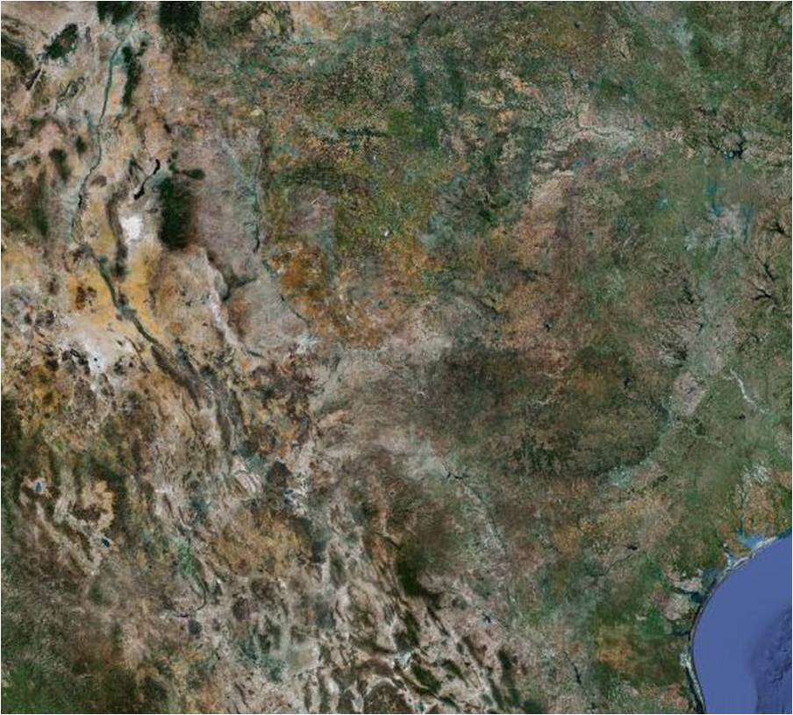
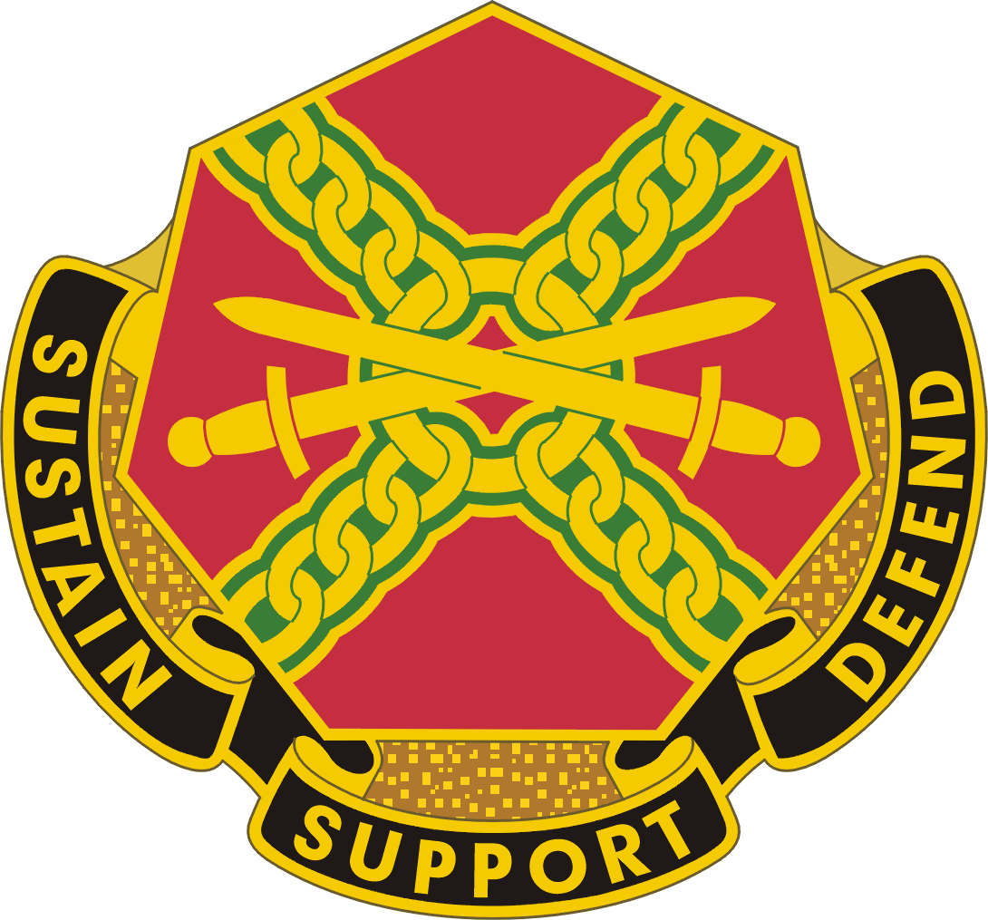

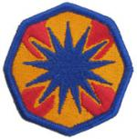
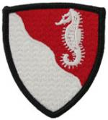

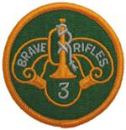
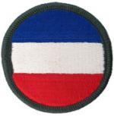
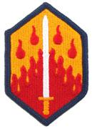



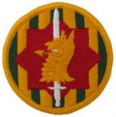
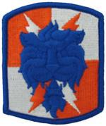

The Army’s Premier Maneuver Training Facility
Fully Integrated Live/Virtual training capability with Joint Connectivity
232 TANKS
420 BRADLEYS
137 UAS
Variants
250 M113 Variants
338 Stryker
Variants
87 RANGES
120 ADA Systems
Patriot/Avenger
Western Training Area for Rotary Wing Training--
18,150 sq miles available
127 Rotary Wing
Aircraft
96 Field Artillery Tubes/
Missile Launchers
Notes:
THE CURRENT III CORPS STRUCTURE IS BASED ON A MODULAR CORPS HQ ABLE TO DEPLOY ANYWHERE IN THE WORLD AND PROVIDE MISSION COMMAND OF A JOINT OR COMBINED HQ AND SUBORDINATE UNITS IN SUPPORT OF FULL SPECTRUM OPERATIONS. DURING GARRISON OPERATIONS AT FORT HOOD, THE IIIC HQ GOES THROUGH THE ARFORGEN PROCESS LIKE ANY OTHER MODULAR HQ OR UNIT AND RESETS AND PREPARES TO ASSUME RESPONSIBILITIES AS A CEF OR DEF UNIT.
LEGACY/PRE-MODULARITY: THE III CORPS ORGANIZATION WAS IMMENSE AND OFTEN LABELED AS THE MOST POWERFUL MILITARY ORGANIZATION IN THE WORLD. THE ORGANIC CORPS CONSISTED OF AN ARMORED CAVALRY REGIMENT, TWO HEAVY DIVISIONS, TWO HEAVY BRIGADES, AIR DEFENSE BRIGADE AND CORPS ARTILLERY. THE FORCES COMPRISED IN EXCESS OF 900 MAIN BATTLE TANKS, OVER 700 INFANTRY FIGHTING VEHICLES, 186 MLRS LAUNCHERS, OVER 200 TUBES OF ARTILLERY, OVER 70 APACHE HELICOPTERS AND 80 PATRIOT LAUNCHERS.
Data POC List:
Reserve Component Mobilized: Ms. Renée Lorine T. Young, 254.285.5923
Ranges: DPTMS
Size: USAG 101 brief
Vehicles/AC: USAG 101 brief

Slide 9
The Army’s Premier Maneuver Training Facility
Land mass: 218,823 acres; 342 square miles; 886 square kilometers
Supported population: ~400,000 people
  On post military, family members, and civilian workers: 91,000
  Off post family members: 70,933
  Retirees, survivors, and their families: 251,250
Buildings and structures: 6,323 (34 million square feet or 3.2 million square meters of floor space)
Community partners: 11 cities and 2 counties

Slide 10
Sustainable Infrastructure
Family Housing: 5940 units
Soldier Barracks: 97 total with over 15000 rooms
Unit Headquarters & Motorpools:
    - 400+ company to corps headquarters
    - 67 motorpools
Ranges:
- Small Arms: 26
- Tank / Infantry Fighting Vehicle: 11
- Artillery Firing Points: 21
- Multi-purpose/Multi-use: 29
Maneuver Space: 4 distinct land groups
Airfields:
  - Robert Gray Army Airfield (collocated with Killeen-Fort Hood
  Regional Airport at West Fort Hood)
  - Hood Army Airfield (east side of main cantonment)
  - Longhorn Airstrip (at North Fort Hood)
  - Shorthorn Airstrip (at North Fort Hood)

Slide 11
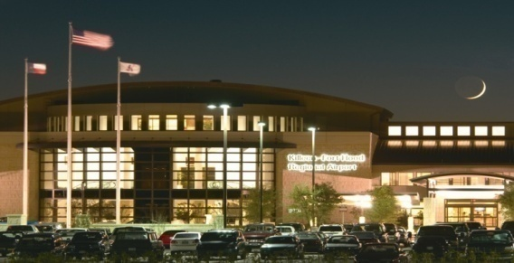
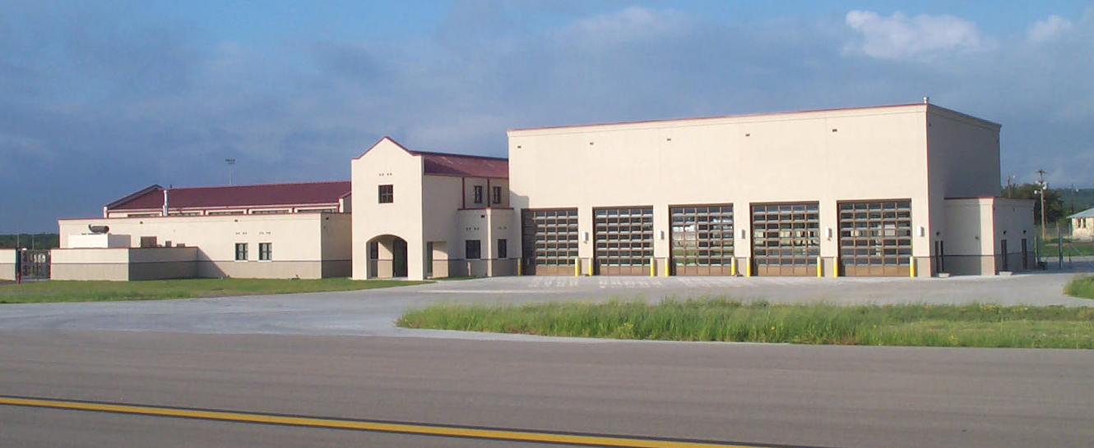
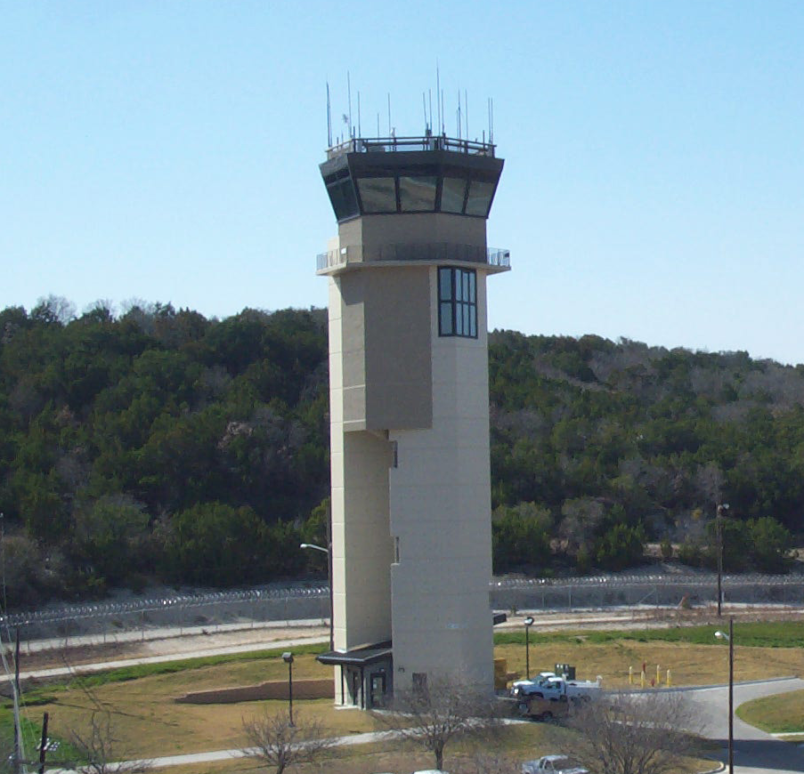
Partnerships with the Community
Joint Use Airfield
Robert Gray Army Airfield – 10,000 foot runway with multiple instrument approaches
76 acres, 50 year lease, payment in services
Ted C. Connell Terminal - $85 million dollars (FAA Military Airport Program)
Opened on 4 August 2004 (initially 18 flights a day – today 42 flights a day)
180,000(+) deplanements in 2005, up approx 8-9% each year there after
Army provides Air Traffic Control and Crash Rescue services
City shares cost for maintaining airfield
Good for the Army, Soldiers, family members, and the Central Texas Community
Three non-stop, round trip flights daily to Atlanta by Delta
Killeen-Fort Hood Civil Terminal
New Air Traffic Control Tower
New Fire-Crash Rescue Department

Slide 12
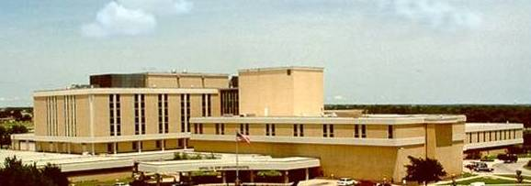
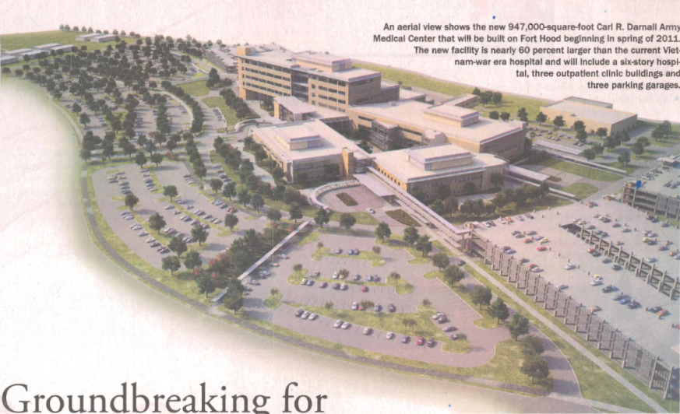
New Medical Center - 2015
Current
Future
PN74650: Medical Center – MEDCEN (FY09) ($800M+)
Justification:
Carl R. Darnall Army Medical Center (CRDAMC) is 42 years old, 33% undersized and cannot be adequately renovated to meet its mission.
The hospital supports 140,000 enrolled beneficiaries including 50,000 active duty soldiers. The pediatric clinic, located in a temporary building with less than half the needed exam rooms, supports a population of 30,000 children.
Over 15,000 separate trips are made annually by soldiers and family members for specialty care to medical centers over 150 miles away.
Scope:
Regional Medical Center: 585,000 SF.
- Includes an Ancillary Hub and an Outpatient Tower
- Will provide :
- Preoperative Services
- Radiology
- Pharmacy
- Pathology
- Primary and Specialty Care Clinics
- Physical Therapy
- Behavioral Health Clinic
Project Status: Construction Start = September 2010.
Construction Complete ≈ September 2015.

Slide 13

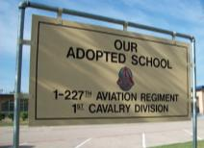
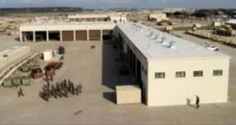
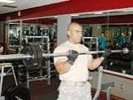
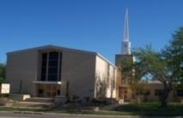
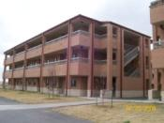
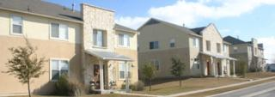
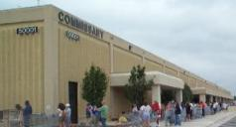
The Fort Hood Community
The World's Premier Installation
Comprehensive Soldier Fitness Training Facility
(CSFTF)
41,000 Soldiers
18,248 On-post family members
70,933 Off-post family members
5,249 GS Civilian employees
13,599 Service & contractor employees
251,250 Retirees/Family Members/Survivors
≈ 400K Total population served
9 On-post Schools
838 Teachers (+staff)
24,770 students
on/off post
67 motor pools--
7.2 miles of combat power
FIRST
IN THE ARMY
LARGEST
IN THE ARMY
9 Gyms
13 Chapels
97 Barracks
(over 15,000 rooms)
5,940 Family Quarters
Annual Economic Impact
$25.3 BILLION
2012 Texas State Comptroller’s Office
2 large “department stores,”
2 large “grocery stores,” and
121 Exchange Facilities
Notes:
The post’s facilities rival that of a mid-size city.
The last economic impact study was conducted by the state comptroller in 2008 ($10.8 Billion)
Data POCs:
On-post Family Members: Cari Guerra, USAG OPS
Civilian Employees: Cari Guerra, USAG OPS
Service & Contract Employees: Cari Guerra, USAG OPS
Soldiers: Timothy W. Roop, DHR, 254-553-2722
Retirees/Family Members/Survivors: Timothy W. Roop, DHR, 254-553-2722

Slide 14


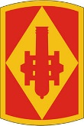


III Corps Today
KANSAS
COLORADO
OKLAHOMA
TEXAS

Slide 15
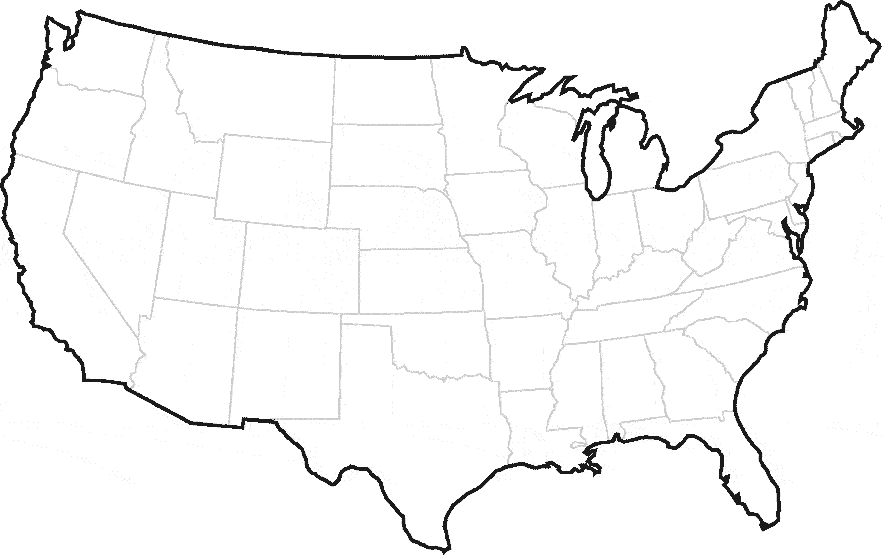


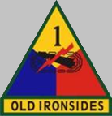
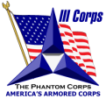
Geographic Span of III Corps TRA for FORSCOM Units
II
84
CA
JBLM
II
II
83
CA
Bragg
701
MP
FBNC
FCCO
FRKS
FLMO
X
75
FIB
II
II
II
FSOK
82
CA
Stewart
40
ESB
2
EN
WSMR
WSMR
CSH TM DET
FSGA
FHAZ
115
MED
Polk
FBTX
FPLA
I
418
MED
SAMC
SAMC

Slide 16

III Corps and Fort Hood Units
Effective 1 Oct 13
XX
+
I
X
X
X
X
E
ESC
CA
HQ
1
13
3
504
1
36
85
X
X
I I
X
I I
X
MP
MI
CID
AFSB
89
69
15
48
11
407
32 AADMC TRA
INSCOM TRA
20 SPT CMD TRA
6 MP GRP TRA
AMC/ASC TRA
XX
●●●
X
PA
11
DIVISION WEST
(Hood)
FIRST ARMY
TRA
OCT 2013 TRA to III Corps not residing on Fort Hood
XX
XX
XX
1
1
4
(Bliss)
(Riley)
(Carson)
Notes:
Next Slide: CS/CSS UNITS

Slide 17
Deployed World-Wide
Where are III Corps Units?
Middle East
-Iraq
-Bahrain
-Afghanistan
-Kuwait
-Jordan
-Qatar
-United Arab Emirates
-Jordan
Europe
-Germany
-Kosovo
-Latvia
South Korea
Africa
-Kenya
-Egypt
-Senegal
-Djibouti
-South Sudan
Central and South America/Caribbean
-El Salvador
-Honduras
-Guatemala

Slide 18
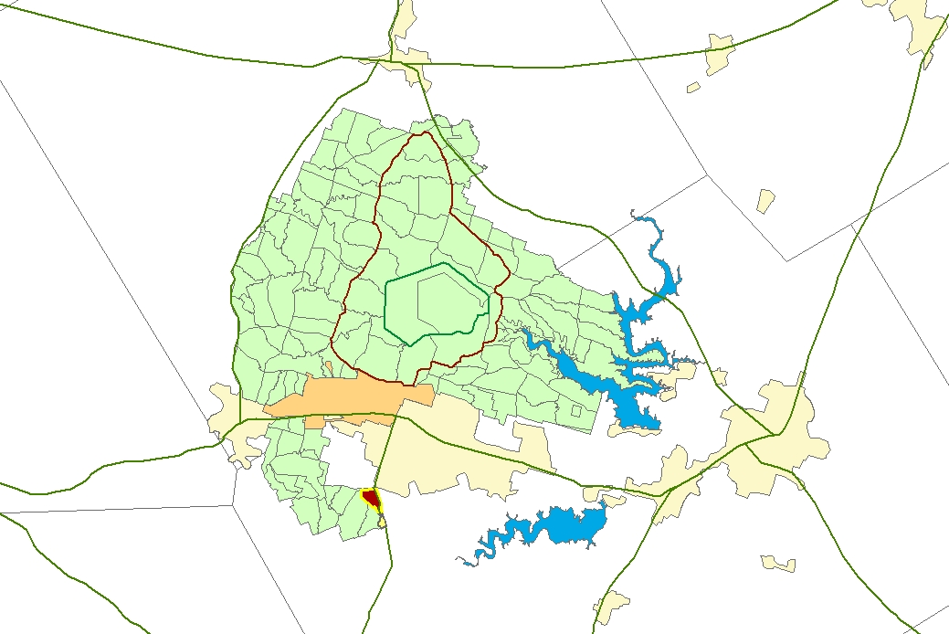

FORT HOOD and CENTRAL TEXAS
Gatesville
Waco
North Fort Hood
McGregor
Coryell
County
West Range Road
McLennan
County
East Range Road
Impact Area
Cantonment Area
Lampasas
County
FORT HOOD
Belton Lake
Copperas Cove
Lampasas
Killeen/Harker Heights
Belton/Temple
TX State
Veterans
Cemetery
Stillhouse Lake
Burnet
County
Bell
County
Salado
Florence

Slide 19
