Slide 1
Cavalry History
Mission Statement
Task Organization
Where We Have Been
Deployment Experience
Total Army Force Partnership
1st Cavalry Division
Command Brief
Purpose: Inform visitors of Fort Hood about 1st Cavalry Division current force structure, operations.

Slide 2
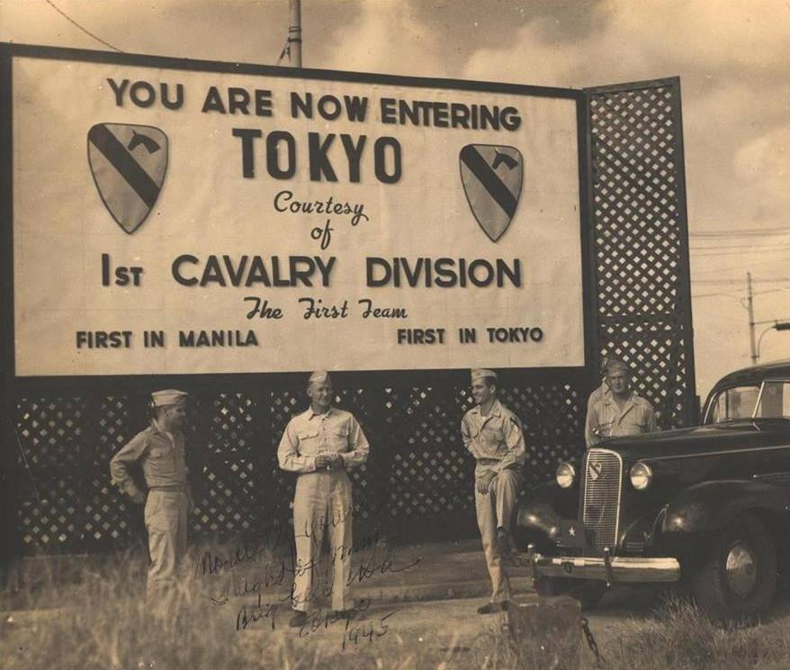
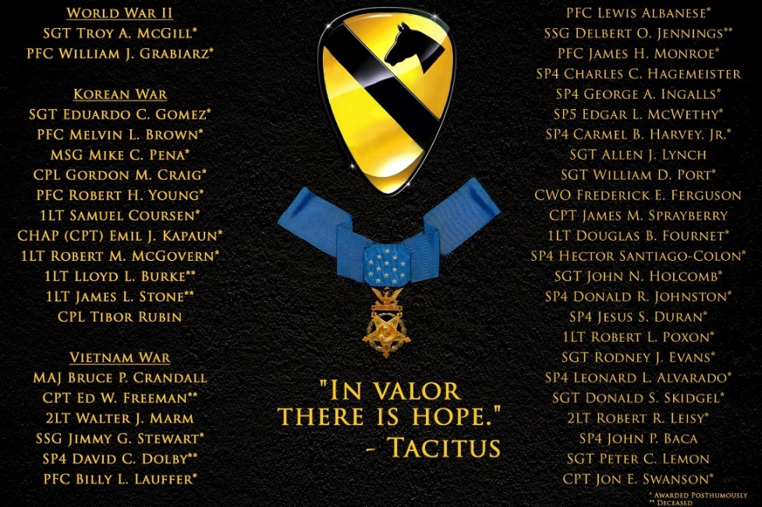
Cavalry History
UNCLASSIFIED
Division was formed on 13 September 1921 at Fort Bliss Texas.
43 Medal of Honor Recipients since 1944.
Cavalry Regiments in the division date back to 1861.
The regiments fought during the Indian Campaigns, guarded against incursions by Pancho Villa/his forces.
World War II: The division dismounted and fought in numerous engagements and was first in Manila and first in Tokyo where they prepared for occupation duties
Korea: Halted the North Korean advance in 1950 then were the First in Pyongyang
Vietnam: First Airmobile Division in July 1965, remained stationed in Vietnam until 1970.
Operation Desert Shield/Desert Storm – 1990-91
Bosnia – 1998
OIF/OND: Four deployments – spearheaded the surge in Baghdad (2004-05, 2006-08, 2009-10, 2011-12)
OEF: Two deployments, RC-East in 2011, RC-South/TAAC-S 2014 – 2015
Notes:
MG Howze was the first division commander…..it’s fitting that we are conducting this event here today.
We have a proud history, one that includes valor, sacrifice and XX Medal of Honor Recipients.
The Division has a long and storied history, beginning with the oldest Cavalry Regiment being formed in 1861. Our regimental lineages tell the story of the Civil War, the Indian Wars, and the punitive expedition against Pancho Villa.
The Division, as a whole, was formed on September 13th 1921 at Fort Bliss, TX. This was when our patch was designed, but I’ll discuss that specifically in a minute.
The Division fought as dismounted cavalry during World War II, participating in multiple campaigns and performing admirably throughout and had the distinction of being First in Manila and then First in Tokyo prior to assuming occupation duties.
In Korea, the Soldiers of the Division fought hard under extremely difficult conditions and were able to stem the north Korean advance and then turn the tide to be the first into Pyongyang.
As many of you know, the Division was deeply involved in Vietnam, beginning with another First, it’s designation as the First Airmobile division.
The Division has a big role in Operation Desert Storm, Gen Schwartzkopf signed the order “Send in the First Team, Destroy the Republican Guard. Let’s go home”
Additionally, the division served in a peace keeping role in Bosnia and has been at the forefront of the efforts in Iraq, four division level deployments, highlighted by the Division’s time leading Multi-National Division Baghdad during the Surge from 2006-2008 while also fulfilling a crucial role in Afghanstan while serving as the HQ for Regional Command East, and most recently Regional Command South which transitioned to Train, Advise, Assist Command – South.

Slide 3
UNCLASSIFIED
Mission Statement
Mission Statement: 1st Cavalry Division provides combat ready forces in support of Regionally Aligned mission and Combatant Commanders. When directed, the 1st Cavalry Division deploys as an Expeditionary Division and executes Unified Land Operations.
Key Tasks:
Execute tough and realistic training creating lethal, agile and expeditionary forces
Maintain operational flexibility through a high state of Soldier and unit readiness
Instill a culture of materiel readiness within the Division
Develop adaptive, learning leaders who exemplify the tenets of Mission Command
Build and maintain resilient Soldiers, Teams, and Families
End State: The 1st Cavalry Division provides ready, resilient, resourced and well led units that are proficient in the Army’s core competencies, having completed all assigned missions and postured to deploy in support of future RAF or contingency missions.

Slide 4
UNCLASSIFIED
1st Cavalry Division Task Organization
1
SUST
HHBn
1
2
3
3
1
H
1
DIVARTY
1-3
1-227
AR
4STB
SUST
1-82
HSC
1-7
4-9
6-9
H
GS
553
CSSB
SUST
2-82
OPS
2-5
1-5
1-12
2-3
2-227
3-16
I&S
2-8
1-8
3-8
3-3
ASLT
3-227
M
Fires
SIG
2-12
1-9
2-7
4-3
4-227
AR
H
E-Date:
17JUN15
BAND
E
SPT
2-20
91
8
3
RES
615
Includes F/227 and E/227
(Grey Eagle Companies)
FSC
HCD
BSB
BSB
BSB
67
115
15
215
SPT
SUST
TRA to 75th FAB
Notes:
Largest Division in the United States Army
Division In Transition:
Division Headquarters
1ABCT, 2ABCT, 3ABCT: Triangle Design, Scouts Under Armor
3CR: LRS, Double V Hull

Slide 5
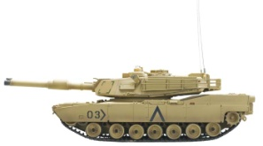
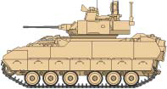
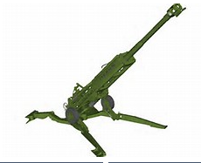
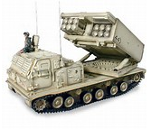
UNCLASSIFIED
Current 1CD Major Combat Systems
M1A2 Tank
Scout Bradley
Infantry Bradley
Fist Bradley
STRYKER FOV
HMMWV
Mortar M1064
M109A6 Paladin
M777
M270 MLRS
CH-47
UH/HH-60
AH-64
Grey Eagle

Slide 6
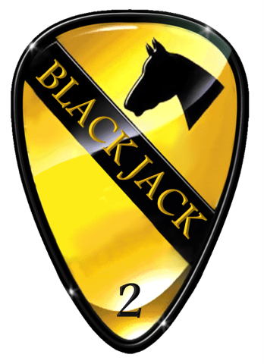
UNCLASSIFIED
Where We Have Been
NTC
EUCOM
Kuwait
Afghanistan
2ABCT
3ABCT
1ACB
1ABCT
1SB
1ACB
1SB
3CR
1ACB
1SB
DIV HQ
DIV HQ
DIV
ARTY
1SB
WLFF (PTDO)
DSCA
1ACB
1ABCT
1SB
Guantanamo Bay
Egypt
Korea
GRF (PTDO)
3CR
3CR
3ABCT
DIV
ARTY
2ABCT
3CR
3ABCT

Slide 7
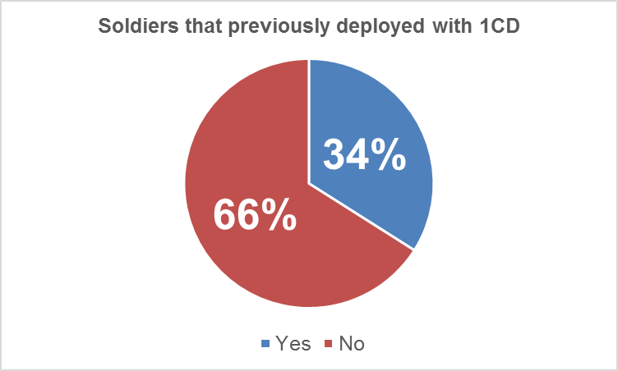
UNCLASSIFIED
Current Deployment Experience in 1CD
51% of our Soldiers have a prior combat deployment
34% of those Soldiers deployed with 1CD units
11841
No Combat Deployments Combat Deployments
7902
4658
487
229
As of: 20150911
Notes:
“0 Combat Tours by rank breakdown” percentages are relative to each respective population vs. total population of all ranks.

Slide 8
UNCLASSIFIED
Total Army Force Policy/Partnership Program Accomplishments
Our Partners
3^{d} CR and 56th SBCT
1 CD with 136 MEB (TX ARNG)
3^{d} CR and Lord Strathcona’s Horse (Royal Canadians)
1
1/1 ABCT and 56th IBCT
1st ACB and 36th CAB
ACB
2/1 ABCT and 72nd IBCT
1st Sustainment BDE with 36th Sustainment BDE (TX ARNG) & 90 USAR Sustainment BDE (AR)
2
SB
3
3/1 ABCT and 155th ABCT
Recent Highlights FY15
11 Troopers from 4/3 CR participated in a LFX with the Lord Strathcona’s Horse (Royal Canadians) in October 2014
3/1 CD supported Mission Command Academics and MDMP for 36th ID in November 2014
3 BEB conducted a breaching operation while representatives of 155th ABCT observed in December 2014
155th ABCT provided three O/Cs for 2-82 FA battery STX lanes
2/7 CAV partnered with 1-305 IN supporting their Gunnery Academy, 5-9 January 15
3/1 CD conducts multiple teleconferences to synchronize xCTC 15-05 efforts
3 BEB conducted link up and QTB with 449 MAC in Kentucky, 25-26 January 15 in preparation for NTC 15-07
Approximately 200 Lord Strathcona’s Horse (Royal Canadians) participated in training with 4/3 CR utilizing the CCTT at FHTX in March 2015

Slide 9
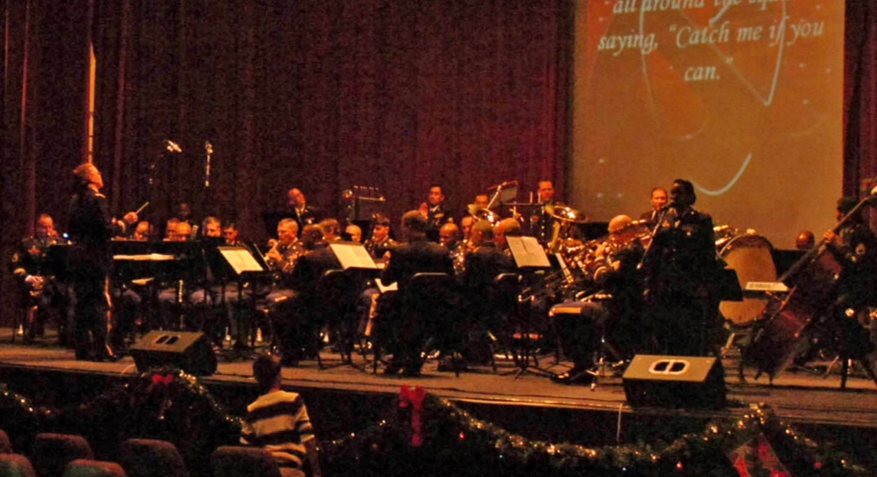
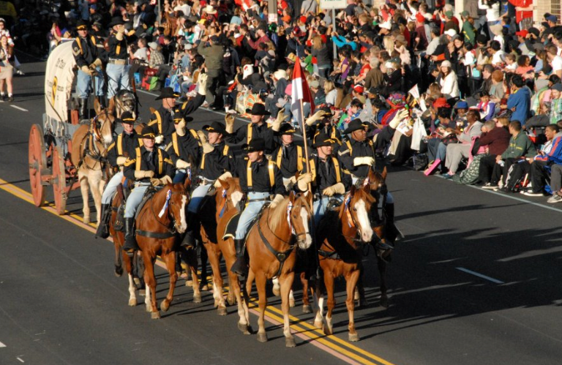
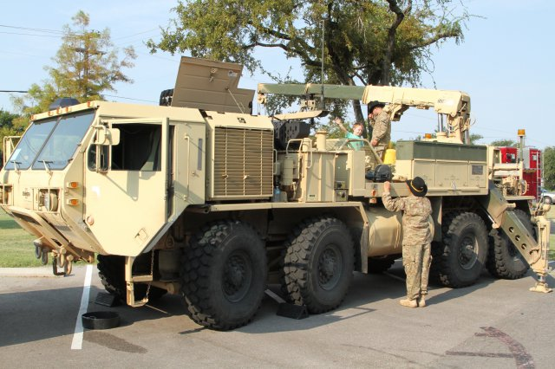
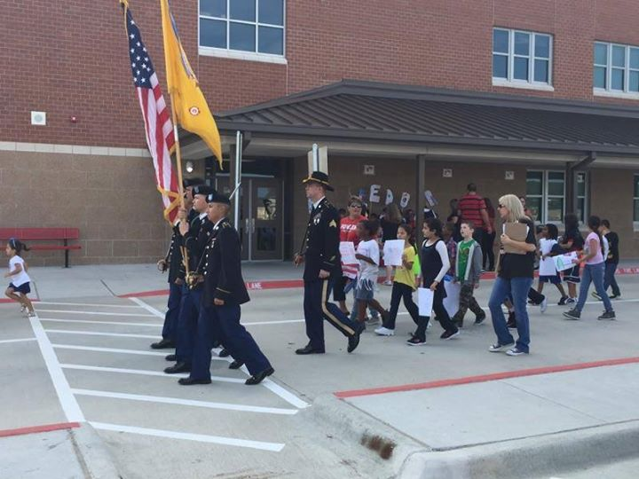
Troopers in the Community
UNCLASSIFIED
1CD Holiday Concert
Pasadena Tournament of Roses Parade
Temple Truck Days
9-11 Walk

Slide 10
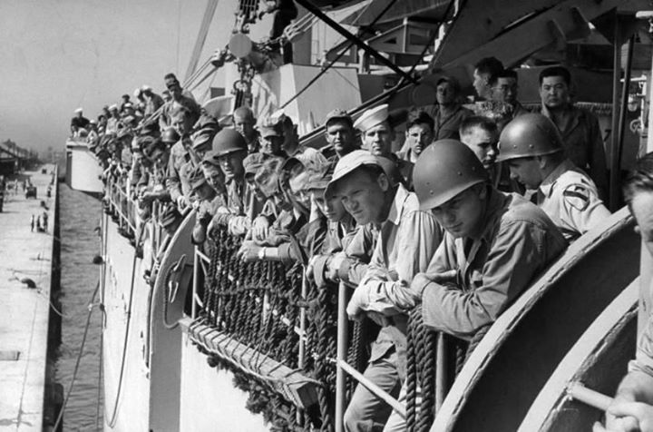
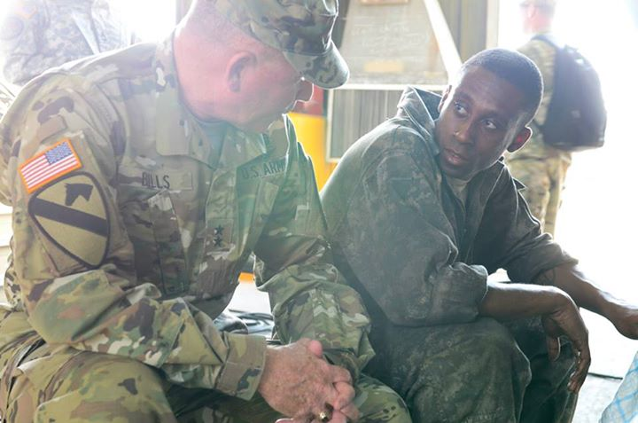
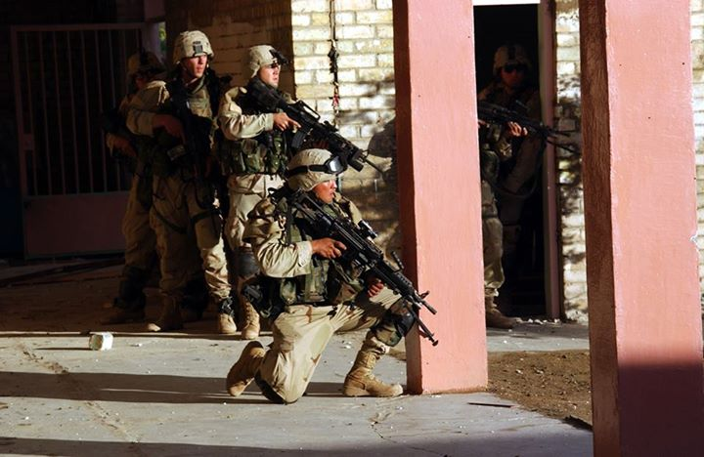
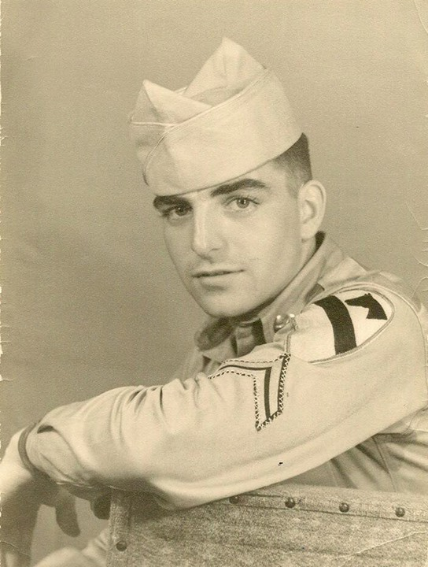
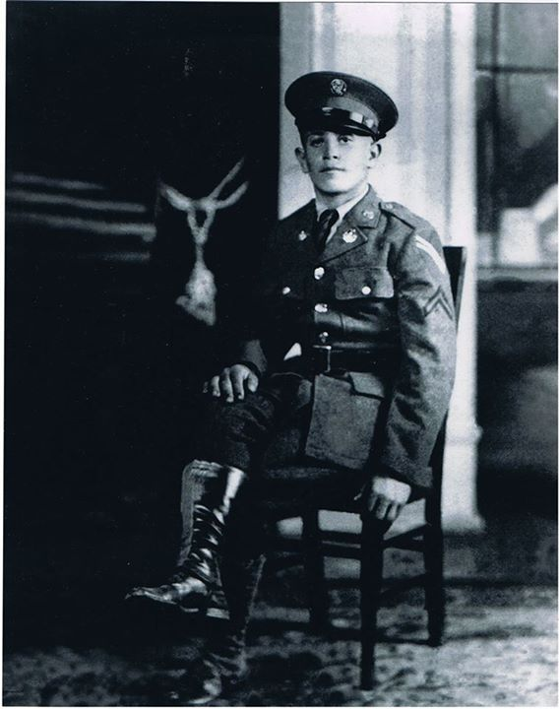
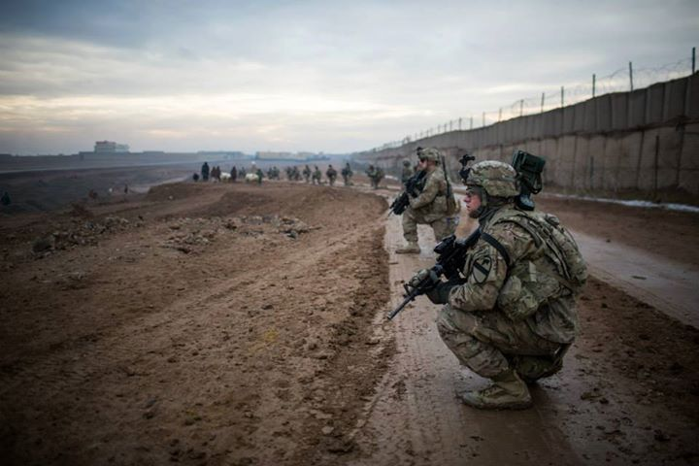
1st Cavalry Division: Live The Legend
UNCLASSIFIED

Slide 11
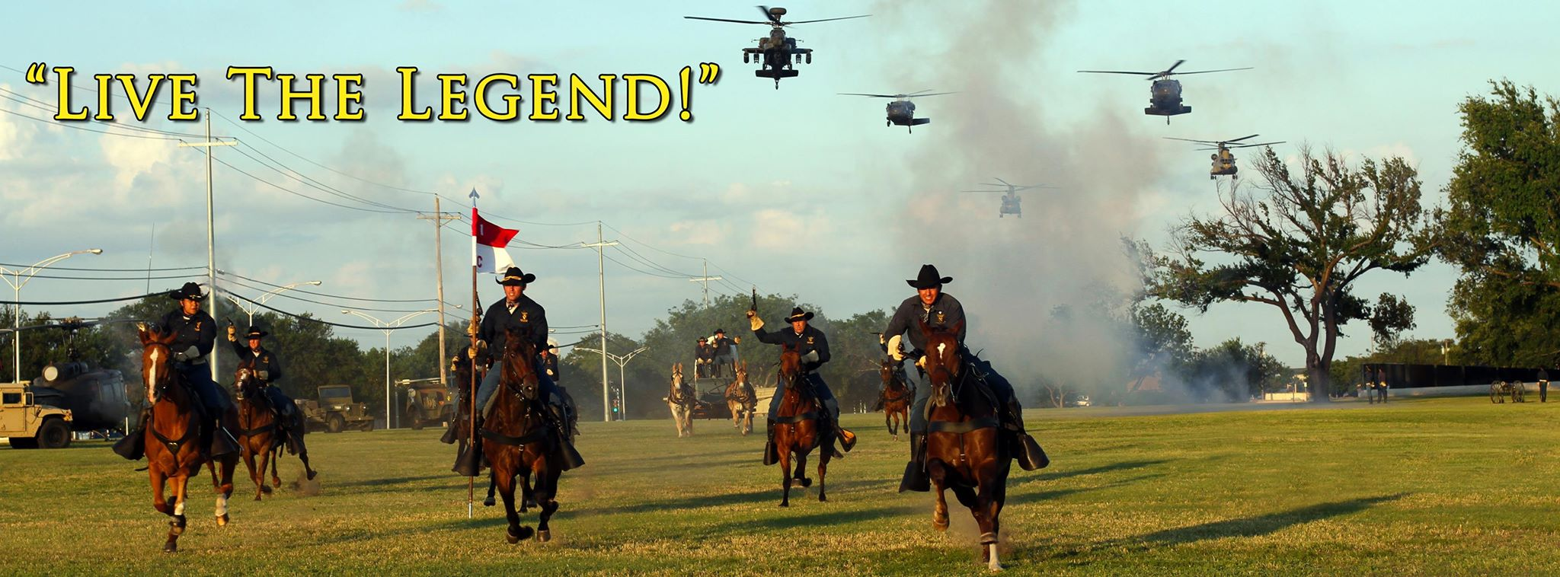
UNCLASSIFIED
Discussion/Questions

