Slide 1
2nd Armored Brigade Combat Team (2 ABCT), 1st Cavalry Division “Black Jack”
5 November 2015
Capabilities/Partnership Brief
Notes:
We would like to welcome you to United States Army Garrison- Casey

Slide 2
AGENDA
2ABCT Mission & Task Organization
2 ABCT Equipment
2 ABCT Road to Partnership
2 ABCT Partnership: Multiple Forms, Multiple Levels
Notes:
This is today’s agenda

Slide 3
2ABCT Mission
Team Black Jack
Trains & prepares to conduct decisive action with alliance partners
Builds & maintains combat readiness
Fosters a climate of professionalism, trust, & mutual respect
Promotes maintains resiliency
In order to
Deter DPRK aggression against the Republic of Korea
Support the Armistice
Enhance 2ID's ability to Fight Tonight
Ensure long-term health of the BCT and the Army

Slide 4
2ABCT Task Organization
X
2 1 CD
4-9 CAV
1-9 CAV
1-5 CAV
1-8 CAV
3-82 FA
8 EN
SUST
15 BSB
HHT/4-9
HHC/1-9
HHC/1-5
HHC/1-8
HHB/3-82
HHC/8
SUST
HHC/15
A/4-9
A/1-9
A/1-5
A/1-8
A/3-82
HHC/2/1
SUST
A/15
B/4-9
B/1-9
B/1-5
B/1-8
B/3-82
A/8
SUST
B/15
C/4-9
C/1-9
C/1-5
C/1-8
C/3-82
B/8
C/15
SUST
D/4-9
D/1-9
D/1-5
D/1-8
SUST
F/3-82
C/8
SUST
J/1-9
SUST
G/1-5
SUST
H/1-8
MI
D/8
SUST
E/8
CM/HHC/8

Slide 5
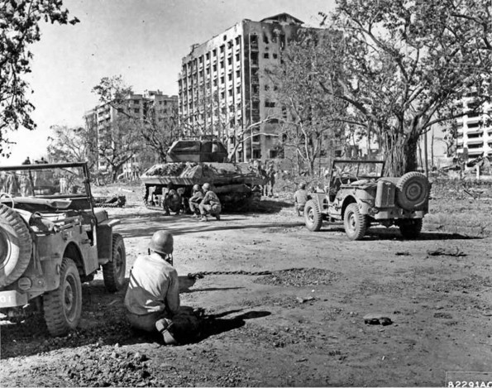
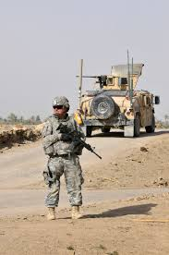
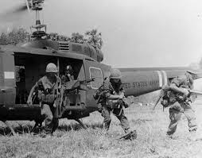
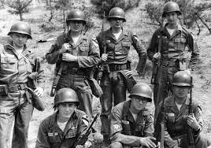
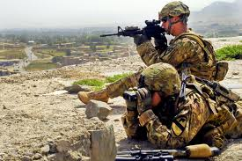
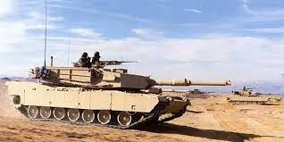
“Black Jack” History
Black Jack races to Manilla
Black Jack in Iraq
Black Jack AASLT Vietnam
Black Jack crosses
the berm in 1991
Black Jack in Korea
Black Jack in Afghanistan

Slide 6
Black Jack “Road to Korea”
Advantages of Rotational Brigade Combat Teams
Brigade trains as a unit for a deployment. Proficiency increases over time through the training progression and rotation in Korea.
Brigade is validated at the National Training Center prior to deployment.
Training in CONUS focuses on Korea missions (weapons of mass destruction-elimination and decisive action).
Reinforces deployment mindset in Brigades while reducing OCONUS footprint (permanently stationed forces and families). Brigades continue to maintain deployment “muscle memory.”
Deployment Lessons
Not an Iraq or Afghanistan deployment. Some requirements (manning, medical screening, military schools, pay, entitlements) are different and require a different deployment process (understood at CSA-level and changes in-progress).
Understanding the operating environment. Home-station training on the Korea Operational Plan, Korean culture, language, history, social environment, political environment, etc. is critical. Based on our feedback, training will improve for future rotations.
Building BCT Proficiency

Slide 7
Partnership – Multiple Levels, Multiple Forms
Levels of Partnership
Forms of Partnership
Command: Interface with RoKA Peers and Senior Leaders
Brigade
Staff: Joint Exercises, Professional Interface
Mil/Civil: Senior Community Ldrs

Slide 8
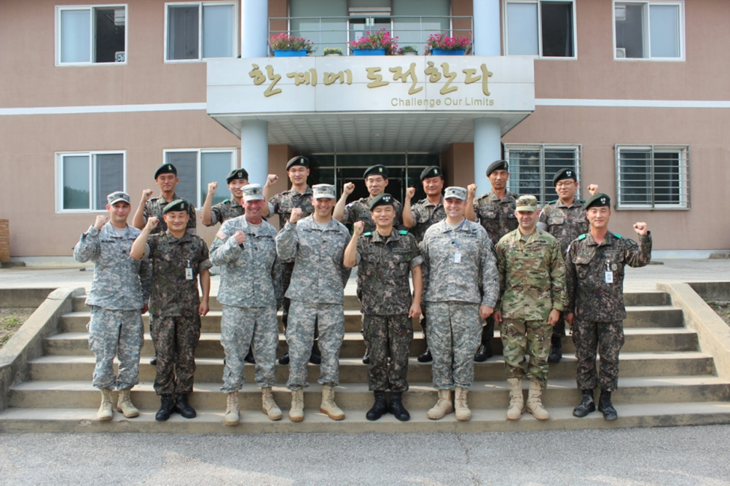
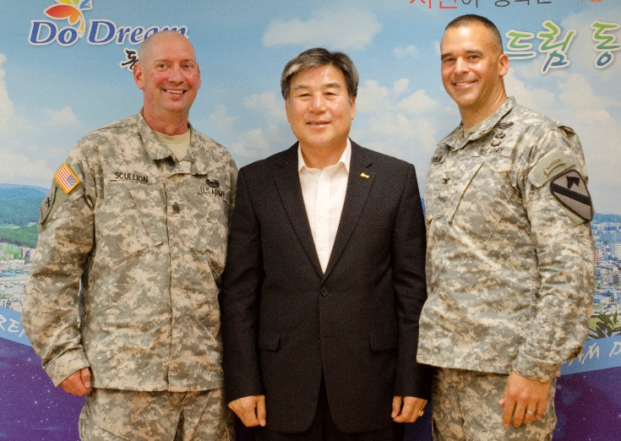
Partnership – BDE to BDE Engagement
2ABCT BCT and BN Command Teams visit and conduct a joint briefing, equipment display, and meal with 16th Mech Brigade. Key talking points were training plan over coming months, and a reception focused on identifying future team building opportunities.
2ABCT Command Team meets with the Mayor of Dongdocheon to discuss community partnership between the unit and local business and civic leaders. The Mayor also highlighted Korean-American Friendship Week, Korean Culture Experiences, and upcoming community mountain bike events and a marathon

Slide 9
Partnership – Multiple Levels, Multiple Forms
Levels of Partnership
Forms of Partnership
Command: Interface with RoKA Peers and Senior Leaders
Brigade
Staff: Joint Exercises, Professional Interface
Mil/Civil: Senior Community Ldrs
Command: Interface with RoKA Peers
BN
Units : Joint Exercises involving BN Lvl, Professional Interface
Mil/Civil: Local Organization and School Partnerships

Slide 10
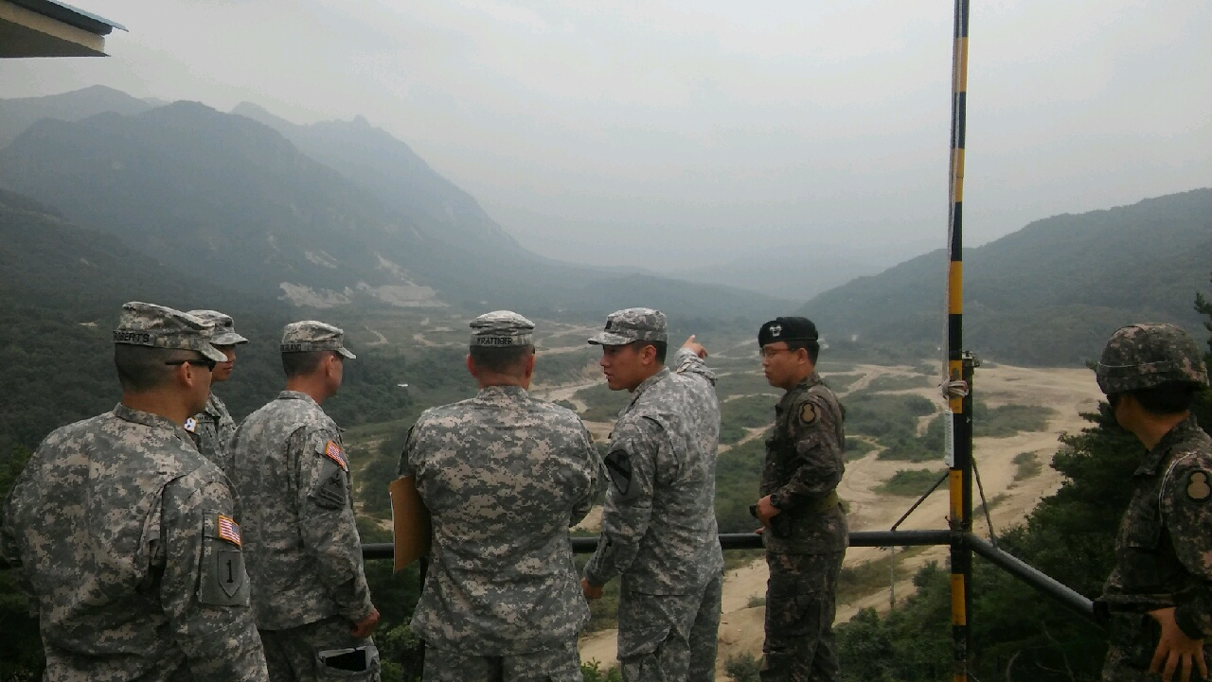
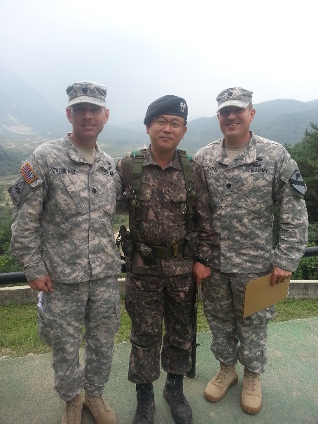
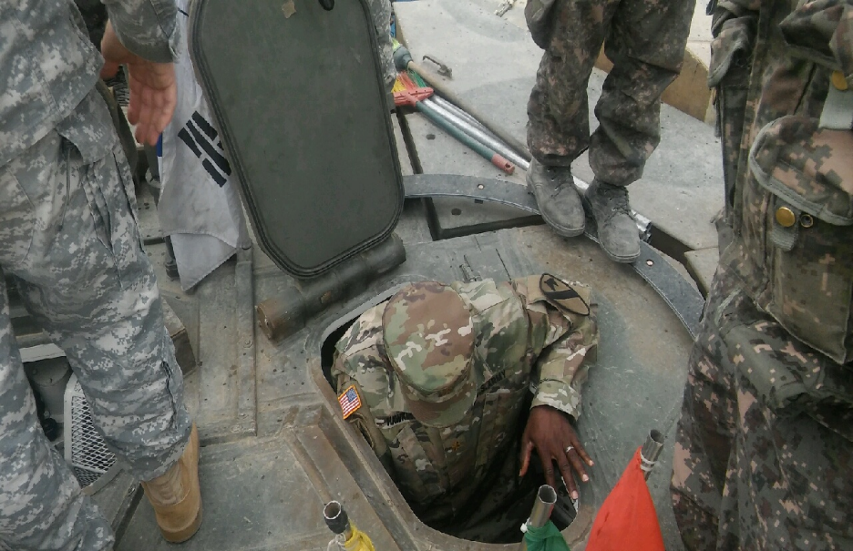
Partnership – BN Level Community Partnership
Event On 11 September 2015, 1-5 CAV’s leaders visited a training exercise at Chipori Range to meet the ROK-A 19th Armor Battalion leadership. The 19th Armor Battalion is the Black Knights Korean partnered unit and this was their first meeting. They discussed future training events, opportunities, combined training objectives, and 1-5 CAV’s upcoming gunnery in November was established. The Battalions agreed upon conducting combined maintenance during the 1-5 CAV’s November gunnery. Combining maintenance efforts will maintain high operational readiness and increase a sense of partnership strength between US and ROK-A Soldiers.
Highlights: The Battalions agreed to conduct combined maintenance during the Black Knights upcoming gunnery in November.
“Fight Tonight, Fight Together!”
Leaders from 1-5 CAV, 4-9 CAV and 19th Armor BN (ROK-A) discuss upcoming training events
1-5 CAV, 4-9 CAV and 19th Armor Battalion (ROK-A) Commanders
1-5 CAV Operations Officer settles into a 19th Armor BN (ROK-A) Tank Vehicle drivers seat
Notes:
On 31 July 2015 the Soldiers, NCOs, and Officers of Arch Angel Company 1-5 CAV, 2nd Armored Brigade Combat Team, 1st Cavalry Division competed in the Angel ROK PT Competition. This event took place in Dragon Valley and on the Arch Angel PT Pad. It was designed to increase the morale of the Company while emphasizing the importance of physical fitness in relation to combat readiness. The Soldiers, NCOs, and Officers walked away from this competition with a greater sense of unit cohesion, pride, and a physically fit Fight Tonight mentality.

Slide 11
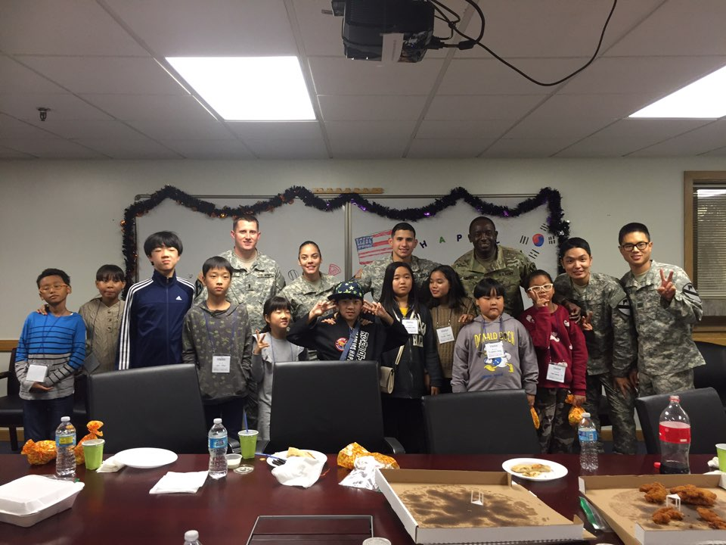
Partnership – BN Level Community Partnership
Who: 1-5 CAV, 2ABCT
# of Participants: US 12 / KATUSA 2 / CIV 12
When: 14 OCT2015
Where: Camp Casey (1-5 CAV AO and Carey Gym)
What: Soldiers and Leaders from 1-5 CAV hosted an activity day for children from the Dongducheon Dream Center.

Slide 12
Partnership – Multiple Levels, Multiple Forms
Levels of Partnership
Forms of Partnership
Command: Interface with RoKA Peers and Senior Leaders
Brigade
Staff: Joint Exercises, Professional Interface
Mil/Civil: Senior Community Ldrs
Command: Interface with RoKA Peers
BN
Units: Joint Exercises involving BN Lvl, Professional Interface
Mil/Civil: Local Organization and School Partnerships
- Units/Soldiers: KATUSA Program
CO/PLT/Soldier
- Soldiers: Tourism, Cultural Oppor.

Slide 13
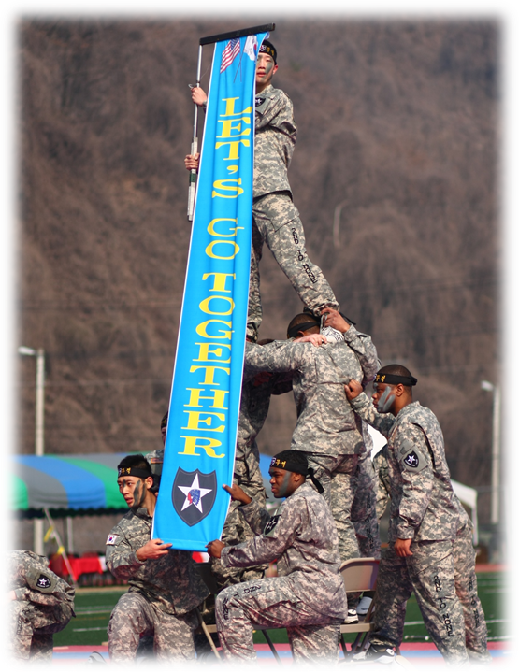
What is it:
The KATUSA Program has been an enduring feature of the RoK/USA Alliance from its inception. Consisting of an established system for embedding RoKA leaders and soldiers in USA units it is a dynamic force multiplier. Its current form provides an opportunity for not only valuable service exchange, but cultural exchange which improves the readiness and understanding of soldiers in both Armies.
Senior Manning
BDE (1) | ROKA Staff officer (1 MAJ)
CO~BN (8) | ROKA Staff officer (2)/ SGM (6)
CO (45) | Senior KATUSA
KATUSA Manning
Unit | Assigned | Current KATUSA Strength(%)
Total | 532 | 104
2/1CD HQ | 31 | 119
8 BEB | 91 | 97
1-9 CAV | 89 | 99
1-5 CAV | 86 | 96
4-9 CAV | 65 | 108
15 BSB | 54 | 95
3-16 FA | 77 | 126
1-8 CAV | 39 | 108

Slide 14
Questions

