Slide 1
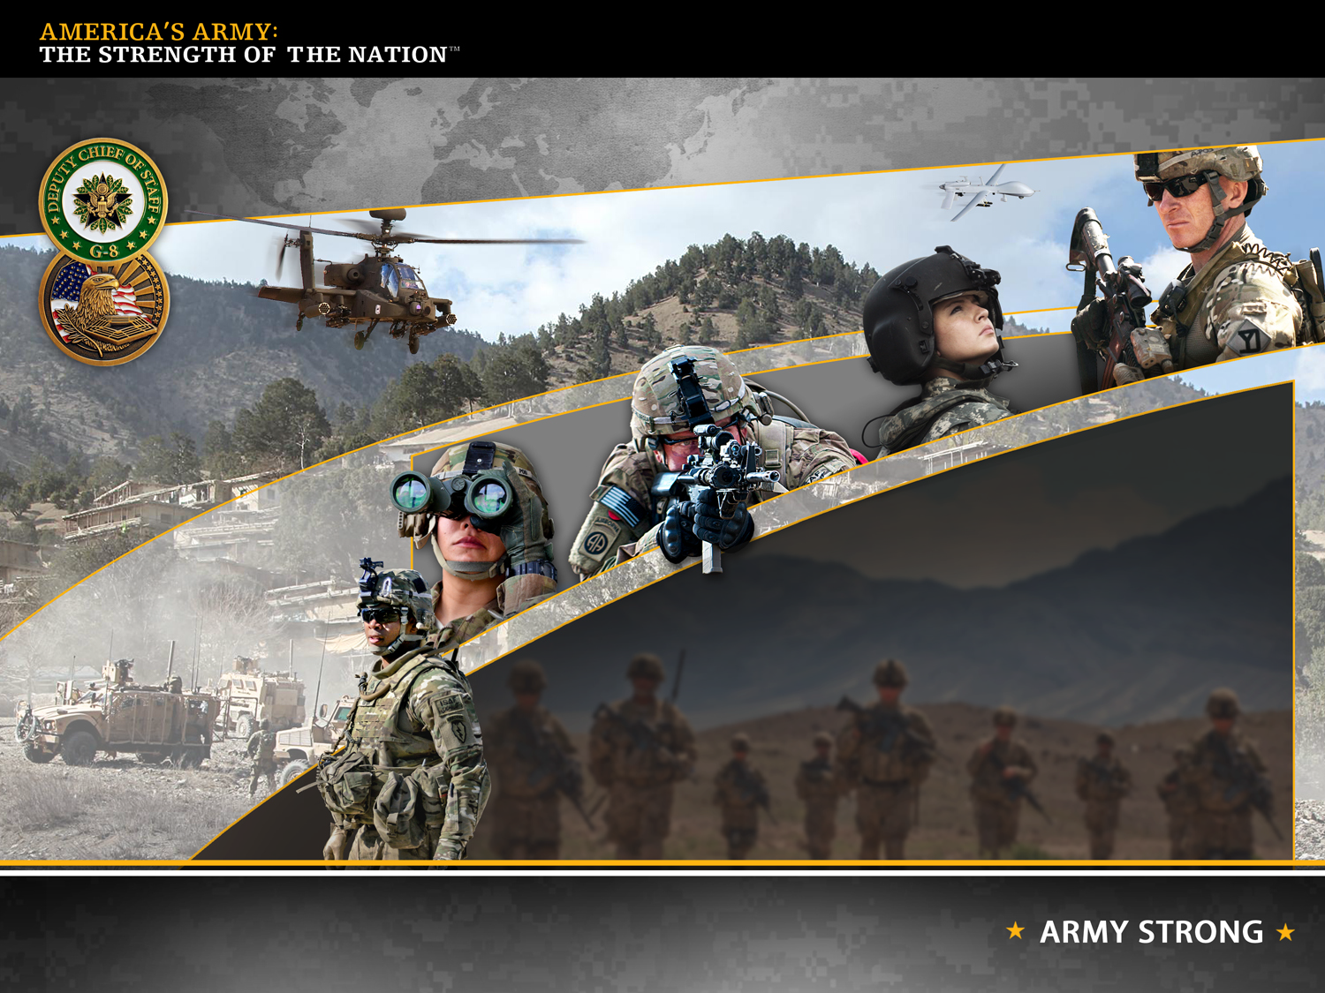
AMERICA’S ARMY:
GLOBALLY RESPONSIVE
REGIONALLY ENGAGED
UNCLASSIFIED
GORT Planning/Guidance
Session with LTG Barclay
1000-1030
Army Equipment Modernization Strategy
Mr. Brian Dando
As of 14 0900 AUG 13

Slide 2


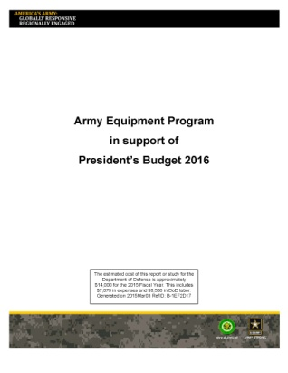




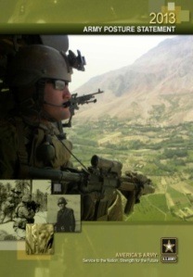

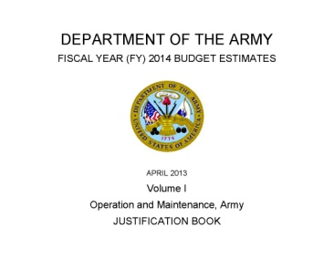

Drivers and Purpose of Army Equipment Modernization and Equipping Guidance Documents
National
Strategy & Guidance
Army Senior Leader Guidance
The Army Plan (TAP)
Revision
Primarily for Congress and OSD engagements Requirements, Acquisition and Resourcing Communities
It establishes a framework for how the Army will modernize our equipment over time
Revised to delete outdated annexes and address AOC and F2025B.
Primarily for Congress and OSD engagements
More system specific
Formerly titled the Army Equipment Modernization Plan
Annual update
Section I
Vision
Army Vision (AV)
SA/CSA
Section II
Strategy
Army Strategic Plan (ASP)
DCS G-3/5/7
ARMY
POSTURE STATEMENT
Section III
Planning
Army Planning Guidance (APG)
DCS G-3/5/7
Section IV
Programming
Army Programming Guidance Memo (APGM)
DCS G8 PAE
ARMY BUDGET ESTIMATE
Army Decisions on Readiness and Force Generation
Section V
Decisions
Army Campaign Plan(ACP)
DCS G-3/5/7
Primarily for Army Components, Commands and Units
Synchronizes Army resources and commander expectations
Revisions based on significant force generation changes
Links:
Army Equipment Modernization Strategy: http://www.g8.army.mil/pdf/AEMS_31MAR15.pdf
2016 Army Equipment Program
http://www.g8.army.mil/pdf/Army_Equipment_Program2016.pdf
Army Equipping Guidance 2013-2016
http://www.g8.army.mil/pdf/AEG_20June2013_lq.pdf

Slide 3
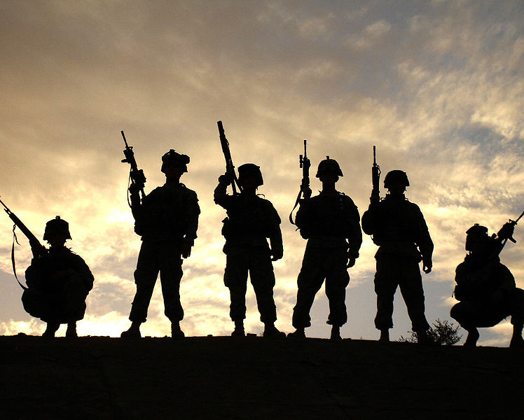
Army Equipment Modernization Strategy
Readiness is the number one priority.
Army Equipment Modernization Strategy (AEMS) - Ends
  Enhance the Soldier for Broad Joint Mission Support
  Enable Mission Command
  Remain Prepared for Joint Combined Arms Maneuver
Key Initiatives
  Protect Science and Technology Investment
  Leverage Current Fleets
  Optimize Procurement Capacity
Enhance the Soldier for Broad Joint Mission Support
Mission tailored, Lethal, Protected, Situationally Aware
Enable Mission Command
Remain Prepared for Joint Combined Arms Maneuver
The Soldier
Robust, Scalable, Expeditionary Network
Information to the Tactical Edge
Deployable, Expeditionary, Mobile, Protected Firepower
Scalable, Tailorable Combat Enablers
Reduced Logistics
Resilient Soldiers
Adaptive Leaders
Cohesive Teams
Enabling our Soldiers to Win in a Complex World
3

Slide 4
Army Equipment Modernization Strategy provides the framework….
Enhanced Joint Coalition Interoperability
  Integration leverages unique strength of joint service and coalition partners
Versatility
  Equip for operations across various missions, terrain and conditions
  Account for water and energy constrained environments
Scalable and Tailorable Capability to Multiple Formations/Missions
  From Soldier to Corps
  From Humanitarian Assistance/Disaster response teams to Brigade Combat Teams
Support to Equipping Demands across all Army Warfighting Functions
  Keeping combat enablers equipped at high operational readiness rate
  Keeping technology updated
Reduced Training, Maintenance and Energy Burdens
    Intuitive in use
    Easily repaired
    Energy efficient
Innovation
    The cornerstone of the Army of the future
    Prototyping to reduce program risk
Opportunities with Industry
  Create conditions for focused industrial base performance and support
  Maintain key capabilities in the industrial base and advanced skills
4

Slide 5
Army Equipment Modernization Strategy will….
Provide Mobile Protected Firepower
  Balance mobility, protection and survivability
  Deployable / Tailorable
Create Lethality and Effects
  Provide Commanders with Overmatch
  Tailorable / Scalable
Enable Logistics Optimization
  Sustain operations at the end of extended supply lines
Enhance Aviation Capability; Offset Loss of Capacity
  All environments, terrain, conditions
  Increased range, firepower, movement, payload
  Interoperable
Enhance Information to Decision Flow
  Enable situational understanding from Strategic to Tactical
  Information to the point of need
Improve Medical Science Applications
  Advance Soldier resiliency
Optimize Human Performance
  Increase Soldier cognitive and physical performance
Apply Autonomy-enabled Systems
  Improve the effectiveness of Soldiers and units
Protect S&T
Investment
Delay Next Generation, Invest in Current Fleet
Technology
Optimize Procurement Capacity
Minimize Development Costs
Risk Mitigators
Output:
Modernized Forces within tolerable risk measures (force and mission)
5

Slide 6
AEMS Summary
Readiness is the number one priority
Investments guided by the Army Operating Concept: - Adapting, Evolving and Innovating
Equipment Modernization Supports: Adaptable and tailorable Army forces prepared to accomplish missions while operating as part of joint, interorganizational, and multinational teams.
The Army must be equipped to win in a complex world: across multiple mission sets, under widely varied conditions, in unforgiving geographies and against evolving threats.
Equipment Modernization Ends:
      Enhance the Soldier for Broad Joint Mission Support;
      Enable Mission Command;
      Remain Prepared for Joint Combined Arms Maneuver; while
Equipment Modernization Ways:
  Protect S&T Investments in key technologies
  Selective Investment in new capabilities for priority areas
  Incremental Upgrades to existing platforms
  Reset equipment returning from contingency operations
  Divestment to reduce O&S costs

Slide 7
AMERICA’S ARMY:
GLOBALLY RESPONSIVE
REGIONALLY ENGAGED
UNCLASSIFIED
Questions
GORT Planning/Guidance
Session with LTG Barclay
1000-1030
As of 14 0900 AUG 13

