Slide 1
Performance-Based Compensation
Program Overview
Army DCIPS
Notes:
Please refrain from editing the content of the slides as the Intelligence Personnel Management Office team would like to maintain consistency in messaging and language regarding DCIPS.
However, you may wish to create an additional command level slides that help explain specific issues related to your Performance-Based Compensation (Pay Pool) Program.

Slide 2
Purpose
The purpose of this brief is to provide Pay Pool Managers with a detailed understanding of the Process and the Tools associated with the Army DCIPS Performance-Based Compensation Program (convening of pay
pools within Army for the purpose of determining performance-based bonuses and base-pay increase monetary awards).

Slide 3
Performance-Based Compensation Timeline
July/August 2019 | September | October | November | December | January 2020
Key Milestone
Key Milestone
9/30
USD(I) & Army G-2 Set Range of Budget Percentages for DCIPS Pay Pools
USD(I) Required Due Date
USD(I) Required Due Date
G-2 Guidance Release
G-2 Guidance Release
Commander Selects Percentage from Army approved range for calculation of DCIPS Pay Pool budgets
Final Due Date
9/30
Final Due Date
Training Date
Pay Pool Data Admin verifies Pay Pool membership in CWB
11/11
Effective 1st Day of 1st Pay Period of New Year
Pay Pools Managers begin review of CWB algorithm recommendations
11/15
1/5
11/30
Command Pay Pool PRA Approves Pay Pool Decisions
Rating Officials Discuss Payouts With Employees
Army G-2 PRA Receives Certification Letters from Command Pay Pool PRA
12/13
1/3
Pay Pool Decisions Finalized/Uploaded into DCPDS
12\13
Begin Performance-Based Compensation/Pay Pool communications products release
Pay Pool Data Administrator Training on CWB/DPAT

Slide 4
Systems and Tools Used in Performance-Based Compensation/Pay Pool Process
Performance Appraisal Application (PAA)
  The PAA is a Department of Defense (DoD) wide tool used to manage performance under DCIPS
Defense Civilian Personnel Data System (DCPDS)
  The DCPDS is a human resources information support system for civilian personnel operations in the DoD
Compensation Work Bench (CWB)
  CWB is a tool used by DCIPS organizations to facilitate the performance-based bonus and base-pay increase monetary award process. It is a spreadsheet that contains all the functionality needed to conduct an effective performance-based compensation program
DCIPS Payout Analysis Tool (DPAT)
  The DPAT is a tool that combines multiple CWB spreadsheets, CWB export, and/or CWB import files and provides analysis of the Pay Pool results including ratings, bonuses, and funding
Notes:
These tools are used by the Pay Pool Data Administrator to support the Performance-Based Compensation program
PAA contains employees approved ratings and will be used to load the CWB
DCPDS contains employees personnel data such as salary, date of last promotions, etc. It will be used by Data administrators, HR personnel to administer the Pay Pool process.
CWB contains employees ratings, up-to-date salary information, and the bonus algorithm that calculates bonus recommendations
DPAT assists commands in combining information from CWBs from multiple pay pools and allows the Pay Pool Performance Review Authority (PP PRA) to review all pay pool data simultaneously

Slide 5
DCIPS Performance-Based Compensation Program
DCIPS Performance-Based Compensation (aka DCIPS Pay Pools) is an annual performance-based rewards program linking employee performance to rewards and bonuses—with the greatest rewards going to those who make the greatest contributions.
The Army will conduct the Pay Pool deliberations in November covering the performance period from
October – September
Ratings are based on:
  Impact to Organizational mission
  Individual accomplishments via performance objectives
Performance-based payouts:
Acknowledge significant
contributions to mission
  Distribute larger payouts to higher performers
Notes:
Speaker’s notes:
The guiding principles of the Pay Pool process are to:
Provide credible, transparent, and consistent processes to determine DCIPS performance-based bonuses and base-pay increase monetary awards
Develop and implement an effective bonus program that will appropriate reward top performing employees during the performance period
Continue to educate and increase awareness around DCIPS, performance management, and performance-based recognition.
Since ratings drive bonuses under DCIPS, an employee’s performance rating (numerical value of 1-5) determines whether they are eligible for a DCIPS performance-based bonus or base-pay increase monetary award. It is critical that employees understand that DCIPS is system that is intended to reward high performers and not all will a bonus or award.
Reminder: DCIPS includes a performance management performance review authority (PM PRA) that provides oversight across the organization to ensure rating consistency. The role of the PM PRA is to conduct a statistical review of the employee evaluations of record and Closeout Performance Evaluations and return the ratings if too high or too low or if more information is needed to justify a rating.

Slide 6
Types of Performance-
Based Awards
Bonus:
  A performance-based monetary award generally distributed annually at the beginning of the New Year based upon performance from the previous performance cycle which ended on 30 September. The purpose of a bonus is to provide meaningful reward for highest levels of performance and/or work accomplishments within the context of the employee’s work level.
DCIPS Quality Increase (DQI):
  A DQI is considered a performance-based award and provides a salary increase equal to the value of one GG step increase at the employee’s grade level. DQIs may be awarded to an employee whose performance evaluation of record identify them as top performers for the current rating period by being in a percentage of top ratings for the Command. ACOMs, DRUs, ASCCs, and the AASA have the option to select a percentage from 1% - 10%.
DCIPS Sustained Quality Increase (DCIPS SQI):
  A DCIPS SQI provides the highest base-pay increase monetary award available to employees of under the DCIPS graded structure. The DCIPS SQI is a sustained performance award reserved to recognize truly exemplary sustained performance. The award consists of a base-pay increase monetary award in the form of an increase in an employee’s pay of two steps at their current grade. Commander’s of the ACOMs, DRUs, ASCCs, and the AASA may choose from employees whose performance evaluations of record identify them as top performers by being in a percentage of top scores for the Command, which shall not exceed 10 percent for a base-pay increase monetary award for 3 consecutive years, the current and two preceding performance evaluation cycles. Employees to be awarded an SQI must have been under the DCIPS Performance Management system and in the same DCIPS grade for the last 3 years. An employee may not receive more than one SQI during any 3-year period.
Notes:
References:
VOL 2012 – Defense Civilian Intelligence Personnel System Performance-Based Bonus Program
There are three types of rewards available to employees through the Army Performance-Based Compensation Program (via Pay Pools): a performance-based bonus, a DQI, and a DCIPS SQI. Employees who receive a DQI or DCIPS SQI will not be eligible for a performance-based bonus.

Slide 7

Eligibility for Performance-Based Awards
Employees eligible for bonuses must meet or exceed a “successful” rating of at least 2.6
Per USD(I) requirement, bonus distribution is not to exceed 50% of the eligible population per Component
Those eligible for DQIs/SQIs must be in a percentage of top scores within their Pay Pools NTE 10%
  DQIs/SQIs do not count towards the NTE 50% limit of bonuses
Employees rated as unacceptable or minimally successful are not eligible for a performance-based bonus
Note: Performance-Based Compensation can be either a bonus payout , OR a DQI/SQI but not both (a bonus and a DQI or SQI)
Notes:
Reference: Army Policy Volume 2012 and DoD 1400.25, Volume 2012 - Defense Civilian Intelligence Personnel System Performance-Based Compensation Program.
Up to 50% of a Pay Pool is eligible for a bonus under DCIPS, according to USD(I) policy. To be eligible for a DCIPS performance-based bonuses, employees must have a rating of at least 2.6 and above. Those with higher ratings are more apt to receive a bonus.
An employee may not receive more than one DQI in any 52-week period. An employee may not receive a DQI if the employee has received an award based in whole or in part on the performance being recommended for recognition.
The DQI will not change the effective date of the employee’s normal periodic increase except when receipt of a DQI places an employee in the fourth or seventh step of the General Grade (GG), the waiting period for a regular periodic increase is extended by 52 weeks under the graduated waiting-period schedule prescribed by section 5335(a), title 5, United States Code (10 USC 5335(a)).
Commands may use the DCIPS SQI to reward employees who were deemed initially eligible for consideration for a base-pay increase monetary award for 3 consecutive years, the current and two preceding performance evaluation cycles. Refer to Army DCIPS Annual Bonus and Awards Guidance for eligibility criteria when determining sustained performance for current and 2 previous years.

Slide 8
Performance Based Compensation Program Command Preparation Steps
Assign Pay Pool Data Administrators
Create Pay Pools/Assign Pay Pool ID’s
Designate Pay Pool Managers/
Pay Pool Members
Establish Business Rules
Establish Pay Pool Budget
Notes:
To ensure successful implementation, Commands complete these preparatory actions prior to beginning the Pay Pool Process:
Data administrators assist Pay Pool Managers with the CWB. It is suggested that the data administrators have the following knowledge and skills:
Knowledge of DCPDS
PAA Tool
Microsoft Excel
Other Army personnel data processes
Data administrators should also complete required CWB/DPAT training and USD(I) Pay Pool web-based training
Pay Pools are employees who work in an Army organization and share funding for performance payouts . Note: Employees can only have one Pay Pool assignment
Pay Pool Managers administer the Pay Pool process and make Pay Pool recommendations to the PRA; may also choose to establish Pay Pool Panels to review Pay Pool recommendations; and are groups of managers who have chain of command responsibility for those in their Pay Pool.
Command business rules specify considerations to adjust recommendations generated by the CWB, i.e.:
Army G-2 guidance on priorities for the performance year
Receipt of other performance-based considerations (e.g., On-The-Spot Awards, Special Act Awards)
Budgets are established annually by multiplying the total base salaries of the employees in a Pay Pool by a percentage selected by the Commander from the Army approved range. Salaries of those ineligible for a performance-based bonus are included in the computation of the Pay Pool budgets.
All Performance-Based Compensation Program Process References:
Step-by-Step Guide in Appendix B
AP-V 2012
DoDI 1400.25, Volume 2012

Slide 9
Pay Pools
Pay Pool are an aggregation of employees who work in an Army organization and share pay pool funding for Performance-Based Bonuses
Pay Pools may be organized as follows:
  Division, directorate, organizational structure and geographic distribution
  Number of employees, occupations, work levels, and work categories
  Chain of Command
Note: DCIPS Employees can only be assigned to one DCIPS pay pool.
Notes:
Pay Pool. A logical aggregation of employees within Army for the purpose of making annual DCIPS performance-based bonuses and base-pay increase monetary awards decisions. The organizing construct for a Pay Pool may include consideration of organization or region of assignment, occupation, or other organizing criterion involving a common mission focus.

Slide 10
Pay Pool Managers
An individual typically in the chain of command for employees assigned to a pay pool, responsible for conducting the annual pay pool decision-making process
The Pay Pool Manager administers the pay pool process and makes performance-based bonus and base-pay increase monetary award recommendations to the Command Pay Pool PRA
Organizations may also choose to establish Pay Pool Panels to review performance-based bonus and base- pay increase monetary award recommendations but are still required to have a Pay Pool Manager
Notes:
Reference Step-by-Step Guide – Pay Pool Manager Responsibilities:
The Manager will provide oversight by ensuring that:
Supervisors and management officials tasked to participate in the pay pool panel have been adequately trained;
Rating officials comply with timely issuance of midpoint reviews, closeout assessments, early annual recommended ratings, and recommended ratings;
Pay Pool Panels (if applicable) are convened in a timely manner to meet payout timelines;
Procedures and policies are exercised in a consistent manner throughout the pay pool panel process and comply with merit system principles; and
Pay Pool funds are distributed in compliance with DoD, Army, and Performance Review Authority financial management policies and based on employee performance and contributions.
Additionally:
Manages the pay pool program process for employees assigned to a Pay Pool
Reviews bonus recommendations generated by the CWB for each Pay Pool and suggests changes
Provides recommendations to PRA for approval
Oversees Pay Pool deliberations for Pay Pool Panel

Slide 11
Other Pay Pool Key Players
Role | Responsibility
Pay Pool Panel Members | Group of managers who share chain-of-command responsibility for employees assigned to a Pay Pool Participates in the annual Pay Pool decision-making process for bonuses and base-pay increase monetary awards under the leadership of a Pay Pool Manager
Commander/ Pay Pool Performance Review Authority (PRA) | Designates Pay Pool Managers and/or Pay Pool Panel Members in writing Approves Pay Pool recommendations Establishes their respective Pay Pool PRA structure in writing
Notes:
The charts on the next two pages identifies the different responsibilities for the different assigned roles in the Pay Pool process.
Pay Pool Manager
An individual typically in the chain of command for employees assigned to a Pay Pool, responsible for conducting the annual pay pool decision-making process. If Pay Pool Panels are formed, a Pay Pool Manager is still responsible for administering the pay pool process. Organizations are required to use a Pay Pool Manager. Pay Pool Managers administer the pay pool process and make pay pool recommendations to the PRA.
Pay Pool Panel(s) (Optional)
Organizations may also choose to establish Pay Pool Panel to review pay pool recommendations. Pay Pool Panel members are senior leaders or managers who typically share chain-of-command responsibility for employees assigned to a pay pool responsible for conducting the annual pay pool decision-making process under the leadership of a Pay Pool Manager.
Organizations are not required to use a Pay Pool Panel for review of DCIPS performance-based bonus and base-pay increase monetary award recommendations.

Slide 12
Performance-Based Compensation Program Inputs
Budget for Performance-Based Compensation
Midpoint of Work Level
Business Rules
Performance-Based Compensation Algorithm
Employee
Performance
Evaluation of Record
Other Performance Factors
Pay Pool Manager / Pay Pool Panel Review
Organizational PRA
Performance-Based Compensation
Notes:
Each of the factors in the graphic represent all the inputs that influence the final bonus payouts to employees.
The performance evaluation of record or an employee’s rating drives bonus eligibility and amount of bonus.
The USD(I) bonus algorithm takes into the dollar amount of the midpoint of the employee’s work level for that performance year, NOT how the employee salary compares to the midpoint. This ensure fairness and consistency across the organization.
Each ACOM, DRU, ASCC, or the AASA will use its selected percentage from the approved Army G-2 range to calculate a bonus budget
Each ACOM, DRU, ASCC, or the AASA may develop business rules that can also impact the bonus amount that each employee will receive. For example, if an employee has been with the organization for ½ year, the command may choose to pro-rate that bonus amount. Or if an employee has received a On-The-Spot or Special Act Award outside of the bonus process, the Bonus Group Manager based on the command’s business rules may decide to adjust or eliminate a bonus for that employee.
Other performance factors that can affect a bonus amount are:
Recently awarded salary increase or award
Work accomplished within the context of the pay band
Extraordinary achievement of organizational goals
Grade/salary level of employee
Special duties
Recent promotion
The performance-based bonus algorithm uses a formula that reconciles the employee rating, the midpoint of the work level, the amount of the budget, and the number of people in the bonus group. To use this algorithm, each organization is provided a copy of the USDI() Compensation Workbench (CWB) tool . Each bonus group uses a CWB to allocate an initial bonus amount for each employee that is eligible for a bonus.
The CWB generates bonus recommendations and Pay Pool Manager/Pay Pool Panels will review/discuss these recommendations and may make adjustments based on business rules. Remember that no more than 50% of the bonus group (Commands/organizations may dictate a smaller percentage) may receive a bonus.
The Pay Pool Manager and/or Pay Pool Panel members review the final recommendations adjusted by business rules and other discussion and send to the Command PRA for final review and approval.
The Command/Organizational PRA reviews the DCIPS performance-based bonuses and base-pay increase monetary awards recommendations for each pay pool for consistency across the Command organization. The PRA may choose to send these recommendations back to the Pay Pool Manager/Panel for further adjustments if needed.

Slide 13
Determining the Pay Pool Budget
USD(I)
Recommend Percentage Range for Pay Pool budgets across the DoD IC
Army G-2
Sets Percentage Range for Army Pay Pool budget
Commander
Selects a percentage of budget based on Army G-2s recommended range for the Pay Pool
Pay Pool
Multiplies the selected percentage by the sum of employee base salaries in the pay pool
  Example:
  50 employee base salaries in one Pay Pool total $3.5 million
  Command selects Pay Pool budget percentage of 1.8
  1.8% x $3.5million= $63,000
  Pay Pool Budget for bonuses = $63,000 for that pay pool
Notes:
USD(I) recommends (or dictates) a bonus percentage range for budgets across the DoD IC. In return, the Army G-2 sets a bonus percentage range within the Army Budget (where flexibility allows).
As a result, each Army Command is able to select from this Army approved range, one bonus percentage to calculate the bonus budget across the Command to be used for all respective bonus group budgets:
The Bonus Group multiplies the Command selected percentage of the budget by the sum of the base salaries of the employees in that Bonus Group.
The resulting amount is used to payout bonuses and DQIs/SQIs.
Army Policy mandates that bonuses are not given to no more than 50% of each Bonus Group population. The 50 percent limit is to distinguish value among ratings and reward the higher performing employees in the Army. Commands (ACOMs, DRUs, ASCCs, and the AASA) and organizations can dictate a percentage lower than 50% but not more than.

Slide 14
Pay Pool Process
Employee receives
final rating of record
Ratings from PAA input to the CWB tool that generates bonus recommendations
15 November
Commanders provide certification letter to Army-wide PRA
Employees
performance-based bonus and base-pay increase monetary award effective date
Pay Pool /Board reviews
performance-based bonus recommendations and determines base-pay increase monetary recommendations
Pay Pool Manager submits performance-based bonus and base-pay increase monetary award recommendations to PRA
PRA reviews and approves performance-based bonus and base-pay increase monetary award recommendations
Pay Pool Manager certifies CWB for performance-based bonuses and base-pay increase monetary awards Payout
1st Day of 1st Pay Period of New Year
Notes:
How does the Army Performance-Based Compensation Program work?
Army’s Performance-Based Compensation is distributed using a Pay Pools review process, led by a Pay Pool Manager and/or Pay Pool Panel through a review of the performance ratings, specific pay pool budget, and an application of the USD(I) bonus algorithm. Pay Pool Managers use the Compensation Workbench, a USD(I) tool, that administers the bonus algorithm.
This diagram provides an overview of the performance-based bonuses and base-pay increase monetary awards decision making process. Note the short time frame available to finalize employee ratings prior to 15 November AND that the pay pool process does not include a review of ratings. Ratings are already final when they reach the pay pool review process.
The ratings are then downloaded by the data administrator from DCPDS (the system that supports the PAA Tool) by the data administrator into Compensation Work Bench, a USDI tool that provides a compensation algorithm that calculates a recommended bonus.
The Pay Pool Manager administers the pay pool process and makes DCIPS performance-based bonus and base-pay increase monetary award recommendations to the PRA.
However, each command may develop business rules that could lead to a change to the bonus recommendation. For example, if an employee has only been on –board for six months, the Pay Pool Manager may recommend that the CWB recommended bonus amount is reduced accordingly.
The CWB calculates a preliminary bonus recommendation for each eligible employee in the Pay Pool based on the USD(I) bonus algorithm
The USD(I) bonus algorithm is based on:
Formulas that automatically reconcile performance ratings
The midpoint of each pay band for the relevant employee (not the salary in relation to the work level)
Available budget within each Command
Business rules will be developed at each Command and help provide guidance for pay pool managers and/or pay pool panels consistently throughout the Command.

Slide 15
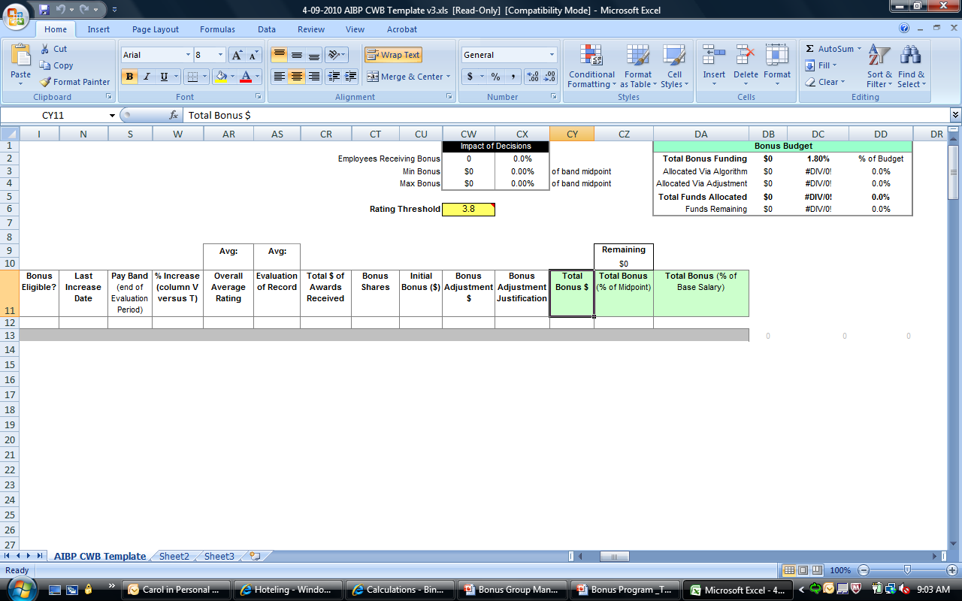
Pay Pool Manager reviews the bonus recommendations
Pay Pool Managers receive a CWB populated with employee final ratings:
The CWB calculates a preliminary bonus recommendation for each eligible employee. The information for this recommendation is based on:
  Employee performance ratings
  Midpoint of each work level
  Number of employees in Pay Pool
  Available budget within each Command
In most cases, Pay Pool Managers will accept the bonus recommendation as is
However, adjustments to the bonus recommendations may be made according to Army-wide core Pay Pool Business Rules and Command specific business rules
Notes:
The Pay Pool Manager and/or Pay Pool Panel begins review of the bonus recommendations generated by the Compensation Workbench following the close of the rating period and approval of final ratings.
The Pay Pool Manager makes a decision on whether they will reward a DQI, SQI, or bonus.
Employees will be eligible for a DQI if they are top performer by being in a percentage of top scores within their pay pools, which shall not exceed 10 percent; however, not all employees will be able to receive a DQI due to budgetary concerns or if they are at a virtual Step 12 or on retained pay. The Pay Pool Manager/Pay Pool Panel will decide of those eligible who should receive the DQI, keeping in mind budgetary considerations and business rules the Command may have developed.
Employees will be eligible for a DCIPS SQI to reward those deemed initially eligible for consideration for a base-pay increase monetary award for 3 consecutive years, the current and two preceding performance evaluation cycles. Refer to Army DCIPS Annual Bonus and Awards Guidance for eligibility criteria when determining sustained performance for current and 2 previous years.
Any adjustments to a bonus recommendation must be justified with Army G-2 and Command business rules and documented in the CWB

Slide 16
Pay Pool Business Rules
Business rules:
  Provide standard guidance for the review and recommendation of performance-based bonuses and base-pay increase monetary awards a by Pay Pool Managers across the Army
  Identify considerations that may require adjustments to the preliminary award recommendations
  Allow Commands to develop specific rules for conducting the pay pool
  Guidance on how to conduct pay pool meetings
  Receipt of other performance-based considerations
  (e.g., On-The-Spot Awards, Special Act Awards)
  Recent hire or promotion
Business Rules Considerations
Notes:
The Army G-2 will issue core business rules across all Army organizations and each organization may wish to develop its own set of business rules as long as they do not conflict with Army G-2.
Sample Rules for Pay Pool Deliberations:
Bonuses generated by the algorithm will be accepted “as is” unless there is compelling reason to propose an adjustment.
All pay pool decisions will be performance-based and equitable for all employees.
Pay Pool Panel members must comply with policies and procedures.
The size of the pay pool budgets will be predetermined by the USD(I) guidance and command discretion. The budgets will be determined by a fixed percentage of the total base pay of the employees in the pay pool and will be provided to each Pay Pool Manager/Panel via the CWB prior to convening. Changes in the distribution of payouts to one employee in the pool will affect every other employee in the pool.
All deviations from the recommendations initially presented by the CWB must be individually documented. The specific business rule used as the basis for the deviation must be recorded within the CWB.
No deliberations are permitted unless all members–voting and non-voting are present. Members will not be in the room when their payout is being discussed. Pay Pool Panel deliberations and discussions are to be conducted in confidence. No deliberations should occur outside the approved meeting room. Non-disclosure agreements must be signed.
For more samples of business rules refer to the Step-by-Step Guide.

Slide 17
DQI Decisions
Pay Pool Managers also review employees for DQI eligibility (top performer by being in a percentage of top scores within their bonus groups, which shall not exceed 10 percent)
    If an employee receives DQI, he or she will not receive a bonus
    Not all eligible employees receive DQIs: Budgetary Limits or Retained Pay status will affect the assignment of DQIs
  If a Pay Pool Manager/Pay Pool Panel chooses to award a DQI, the Data Administrator will make adjustments to the CWB. The processing is done within the CWB and manual RPAs are not required.
Notes:
It is important to note that DQI decisions are made within the pay pool process. DQIs are performance-based pay increases and therefore require the same type of review and input from a Pay Pool Manager/Pay Pool Panel.
The DQI is subtracted from the budget but does NOT count against the 50% limit for awarding bonuses for each bonus group. The bonus manager must indicate in the adjustment column of the CWB that a DQI was awarded.
Even if eligible, every employee will not receive a DQI because some employees are not eligible if they are on retained pay (are at the virtual step 12 of the pay scale), or if the Command budget does not support full award distribution of DQIs.

Slide 18
DCIPS SQI Decisions
  Pay Pool Managers also review employees for a DCIPS SQI eligibility (eligible for consideration for a base-pay increase monetary award for 3 consecutive years, the current and two preceding performance evaluation cycles. Refer to Army DCIPS Annual Bonus and Awards Guidance for eligibility criteria when determining sustained performance for current and 2 previous years.
    If an employee receives SQI, he or she will not receive a bonus
    Not all eligible employees receive SQIs: Budgetary Limits or Retained Pay status will affect the assignment of DQIs
  If a Pay Pool Manager/Pay Pool Panel chooses to award a SQI, the Data Administrator will make adjustments to the CWB. The processing is done within the CWB and manual RPAs are not required.
Notes:
It is important to note that DCIPS SQI decisions are made within the Army pay pool process. SQIs are performance-based awards and therefore require the same type of review and input from a Pay Pool Manager/Pay Pool Panel.
The SQI is subtracted from the budget but does NOT count against the 50% limit for awarding bonuses for each pay pool. The Pay Pool Manager must indicate in the adjustment column of the CWB that a SQI was awarded.
Even if eligible, every employee will not receive a SQI because some employees are not eligible if they are on retained pay (are at the virtual step 12 of the pay scale), received a SQI during the previous 3-year period, or if the Command budget does not support full award distribution of SQIs.

Slide 19
Pay Pool Manager submits payout recommendations
Pay Pool Managers will submit the CWB for approval:
  Once all DCIPS performance-based bonus and base-pay increase monetary award recommendations have been made, the Pay Pool Manager submits to their Command Pay Pool PRA
  In cases where the Pay Pool Manager also serves as the Approving Official (Command Pay Pool PRA) he or she will approve the CWB
Approval of Pay Pool payout decisions should occur in late November to allow for DCPDS processing and effective the 1st day of the 1st pay period of the New Year
Notes:
Pay Pool Manager will submit the CWB/bonus recommendations to the PRA for approval
Late November/early December
In cases where the Bonus Group Manager also serves as the Approving Official, he or she will approve the CWB

Slide 20

PRA reviews and approves payout recommendations
The Command/Organizational Pay Pool PRA reviews and approves pay pool payout recommendations
  If inconsistencies are found, the PRA returns the pay pool payout recommendations to the Pay Pool Manager for adjustments
Notes:
The Pay Pool Manager will submit the CWB to the Approving Official/PRA for approval.
After the Pay Pool Manager/Panel review process, probably in Late November or early December, the Command/Organizational PRA reviews and approves pay pool recommendations.
The Command PRA submits a certification letter to the Army G-2 that all pay pool processes have been conducted in accordance with Army policy.

Slide 21

Certification of CWB for
Payout
Command Pay Pool PRAs provide a certification letter to the Army Pay Pool PRA
Pay Pool Managers are notified that results are PRA approved
Pay Pool Managers certify bonus results in the CWB
Data administrators submit approved Pay Pool decisions
  Supervisors may now communicate results of payout decision
DCIPS performance-based bonuses and base-pay increase monetary awards decisions are effective the first day or the first pay period of the New Year
Notes:
Once the Command PRA approves the pay pool decisions, the Pay Pool Manager certifies the CWB by clicking the check box in the CWB.
Data administrators submit final pay pool decisions to begin payment processing in DCPDS.
Employee notices are generated by the Data Administrator and distributed to the supervisors for issuance once CWB is certified.
Rating or reviewing officials can provide the pay pool decision to the employee without the use of the employee notice.
After the Organization Pay Pool PRA authorizes the results of the pay pool decisions they are processed with an effective date of the 1st day of the 1st pay period of the New Year.
Certifications notices to the HQDA, G-2 and pay pool results will be available and approved such that payments are made to employees to coincide with the annual General Pay Increase (under most circumstances, paid to most Federal government employees in January).

Slide 22
Pay Pool Overview
Assign Pay Pool Data Administrators
Establish Business Rules
Establish Pay Pool Budget
Pay Pool Managers review initial Pay Pool Payout recommendations
Pay Pool Manager submit Pay Pool payout recommendations
PRA reviews and approves Pay Pool payout recommendations
Commanders provide certification letter to Army PRA
Pay Pool Manager certifies CWB for Payout
Pay Pool Payout Decision Communicated to Employee
Create Pay Pool structure
Designate Pay Pool Managers
Employee Receives Pay Pool Payout
  For more information on DCIPS, see the Army DCIPS website:
  http://g2-public-website.azurewebsites.us/site/dcips/index.aspx
Notes:
The highlighted boxes indicate the involvement of the Pay Pool Manager in the overall pay pool process.

Slide 23
Questions?

Slide 24
Contact Us
DCIPS E-Mail Inbox
NIPRnet: usarmy.pentagon.hqda-dcs-g-2.mbx.dcips@mail.mil
Notes:
Speaker notes:
Please add your command information to this slide.
Please add your Transition Manager Information to this slide

Slide 25
End of Course Review
What is the DCIPS Performance-Based Compensation Program?
  An annual rewards program—with the greatest rewards going to experience and longevity.
  An annual performance-based rewards program linking employee performance to individual accomplishments—with the greatest rewards going to those who make the greatest contributions.
  A semi-annual program relating employee performance to individual accomplishments.
  A program that will give all employees rewards annually regardless of accomplishments.
T or F Performance-based payouts are the basis for Ratings
  False. Ratings are the basis for performance-based payouts because they acknowledge significant mission and Agency contributions and give larger payouts to higher performers

Slide 26
End of Course Review
Which statements are true about DCIPS employee eligibility for Performance-based awards:
  Employees eligible for bonuses must meet or exceed a “successful” rating of at least 2.6.
  Those eligible for DQIs must have a rating of “in the percentage of top scores within their pay pools, which shall not exceed 10%.”
  Employees rated as unacceptable or minimally successful are not eligible for Performance-Based Compensation.
  All of the above.
What steps are followed in convening Pay Pools to determine performance-based bonuses and base-pay increase monetary awards?
  Pay Pool Managers review and submit Pay Pool payout recommendations, The PRA reviews and approves recommendations, Commanders provide certification letter to Army PRA.
  Assign Data Administrators, Create Pay Pool structure, Designate Pay Pool Managers, Establish Business Rules and Pay Pool Budget.
  Both A and B

Slide 27
End of Course Review
What are the responsibilities of a Pay Pool Manager?
  An individual typically in the chain of command for employees assigned to a Pay Pool, responsible for conducting the annual bonus decision-making process
  Administer the pay pool process and make performance-based bonus and base-pay increase monetary award recommendations to the PRA
  Both A and B.
T or F Pay Pools are DCIPS employees who work in an Army organization and share funding for performance payouts
  True
T or F The CWB tool generates employee ratings
  False. Ratings from PAA feed the CWB tool that generates performance-based bonus and base-pay increase monetary award bonus recommendations

Slide 28
End of Course Review
Choose the correct answer to complete the following statement: Business Rules _____.
  Are a spreadsheet that contains all the functionality needed to conduct an effective Performance-Based Compensation Program
  Provide an annual performance-based rewards program linking employee performance to individual accomplishments
  Provide standard guidance for the review and adjustment of performance-based bonuses and base-pay increase monetary awards by Pay Pool Managers
  None of the above
What are the final steps in the Pay Pool process in determining performance-based bonuses and base-pay increase monetary awards?
  Commanders provide certification letter to Army-wide PRA
  Pay Pool Manager certifies CWB for payout
  Both A and B
  Neither A nor B

Slide 29
End of Course Review
T or F The Command/Organizational PRA reviews and approves pay pool recommendations and if inconsistencies are found, the PRA returns the performance-based bonus and base-pay increase monetary award recommendations to the Pay Pool Manager.
  True

Slide 30
Back-up Slides

Slide 31
Ways to Reward Employees
Performance-Based Program (Bonus or DQIs/SQIs)
Special Act or Service Awards
Time-Off Awards
Ways to Reward Employees
On-the-Spot Cash Awards
Honorary Awards
Notes:
Employees are eligible for various rewards, including bonuses, DQIs, SQIs, On-the-Spot, and Special Act awards.
The next two slides will describe each of the ways listed above to reward employees.

Slide 32
Monetary Awards
Special Act Awards:
Meritorious accomplishments achieved outside of normal job responsibilities up to $2,000.
    On-the-Spot Cash Award (OTS) – A smaller Special Act Award given by a supervisor for day-to-day employee accomplishments. Amounts for this award range from $50 to $500.
Time Off Award (TOA):
Up to 40 hours granted to an employee’s single contribution with a maximum of 80 hours for the leave year awarded. A TOA may be used alone or in combination with monetary or honorary awards, but not in connection with or a substitute of a performance-based award.
Notes:
DCIPS Awards and Recognition program, approving officials are encouraged to use the full range of non-monetary and monetary awards available to recognize DCIPS employees for their accomplishments:
A Special Act or Service Award is a cash award given to recognize a meritorious personal effort, act, service or other achievement accomplished within or outside assigned job responsibilities. The maximum award amount is $2,000 (DoDI 1400.25, Volume 2008).
On-the-Spot cash award is a small Special Act or Service Award that may be given by a supervisor for day-to-day accomplishments of subordinate employees. Amounts for this award range from $50 to $500. Based on volume 2008.
A Time-Off Award (TOA) may be granted to an employee for up to 40 hours for a single contribution. A maximum of 80 hours time off may be granted to an employee during a leave year without charge to leave or loss of pay as an award for achievements or performance contributing to the Army mission. A TOA may be used alone or in combination with monetary or honorary awards, but not in conjunction with or a substitute for a performance-based award.

Slide 33
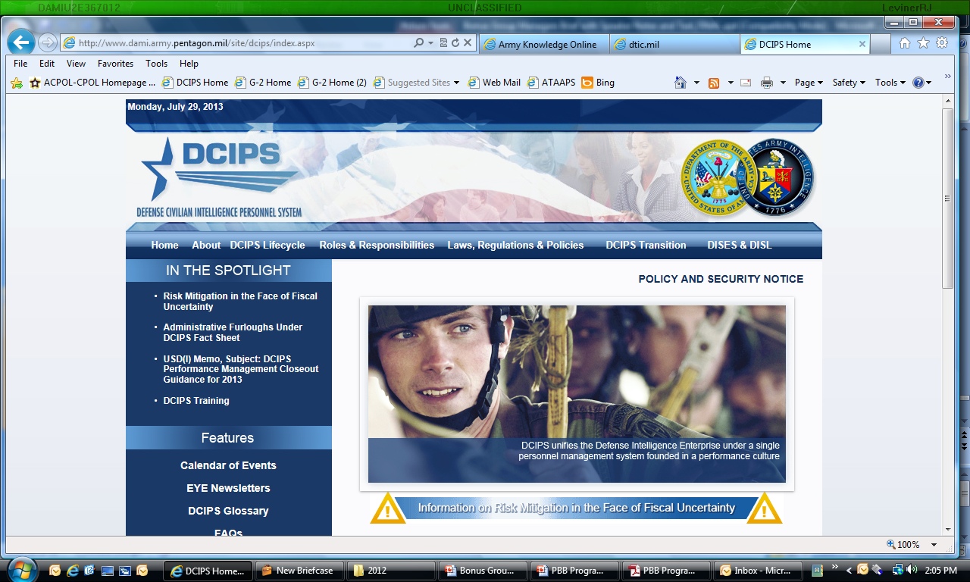
Army DCIPS
Website
33
NIPRnet: http://g2-public-website.azurewebsites.us/site/dcips/
SIPRnet: https://intelshare.intelink.sgov/sites/g2kcps/dcips/sitepages/
lc-er%202011.aspx
JWICS: https://army.daiis.army.ic.gov/org/hqdag2/g2kcps/DCIPS/default.aspx
Notes:
The Army DCIPS website is located on all 3 networks
The Army DCIPS website is a comprehensive repository of all DCIPS materials since inception.
Policy
Communications
Trainings
Guides

